Slide 1
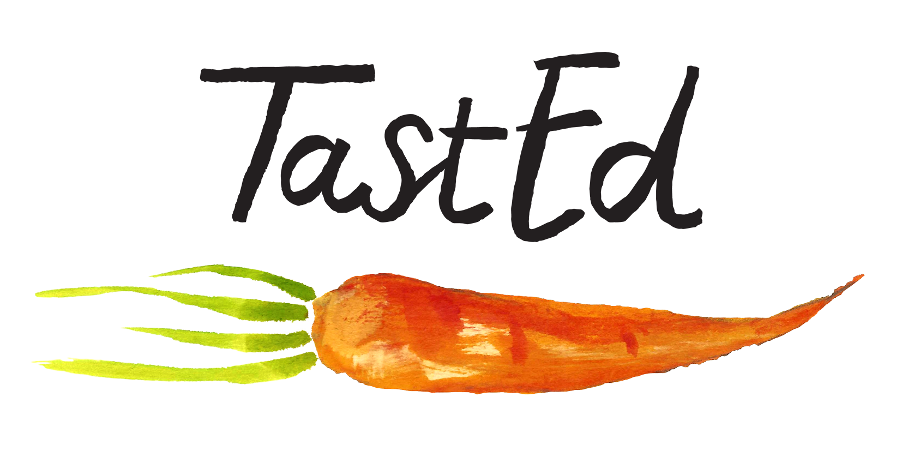
Upper KS2 - Years 5 and 6
Beans, Pulses and Peas Curriculum
Taste and Sight: Beans and Biodiversity

Slide 2
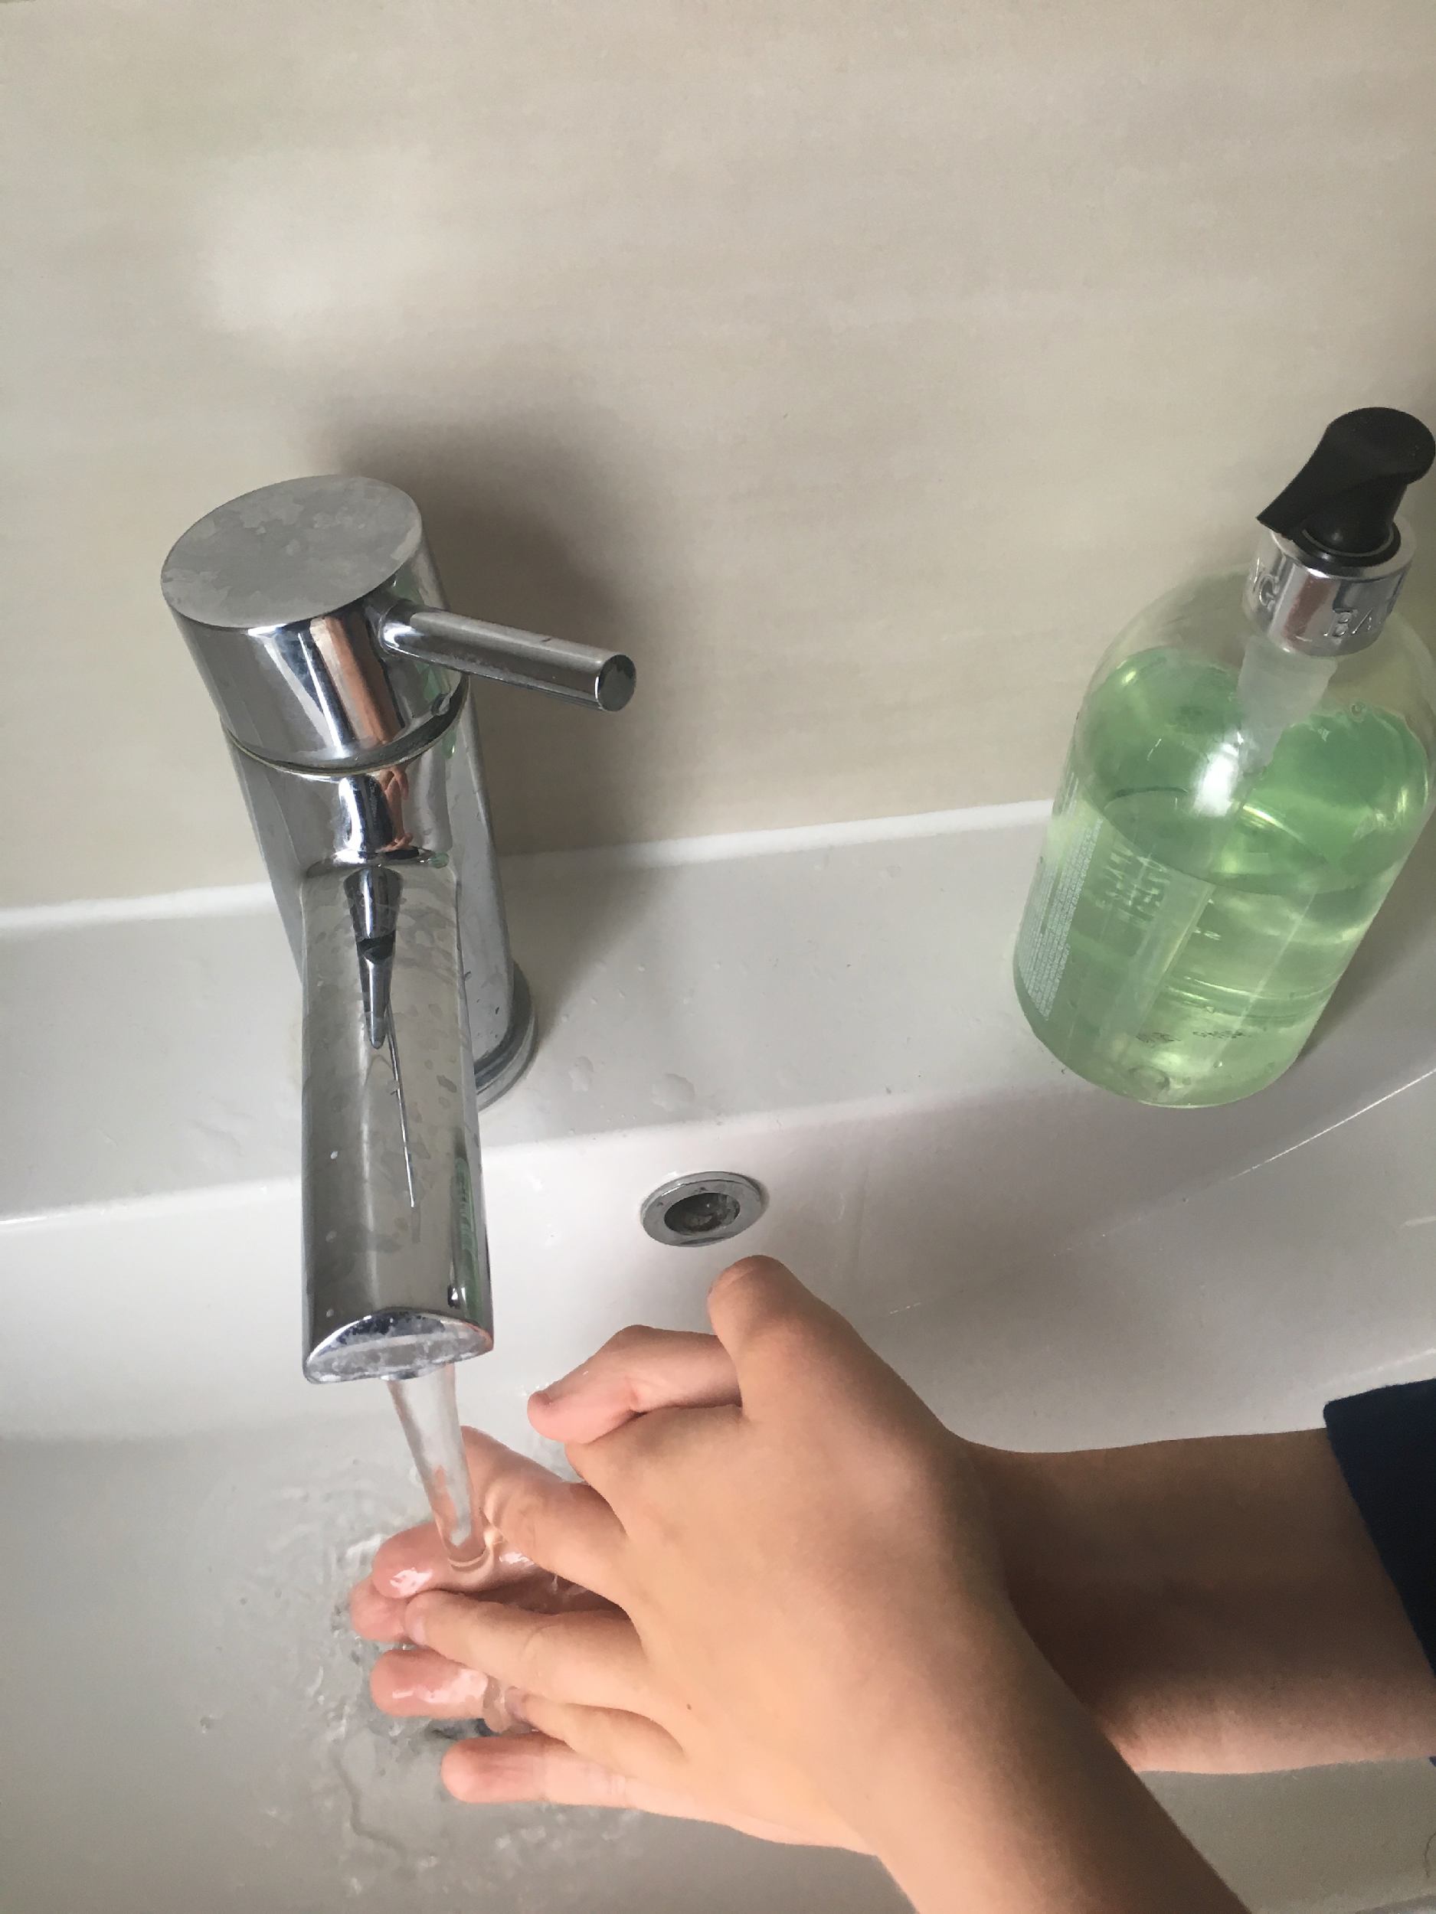
Before we start, has everyone washed their hands?

Slide 3
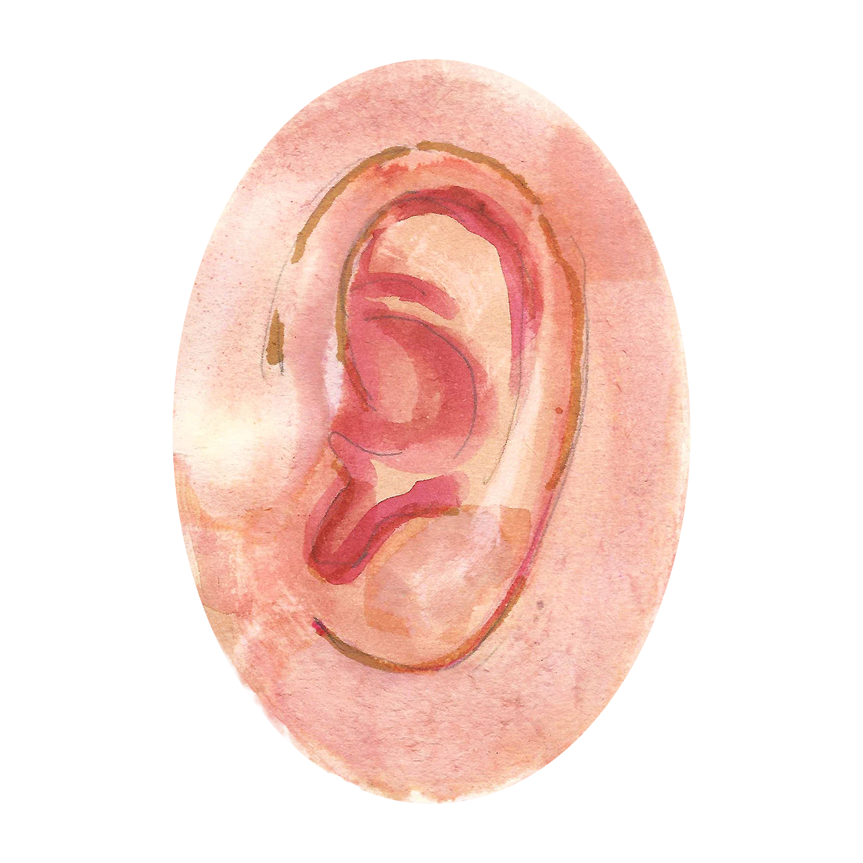
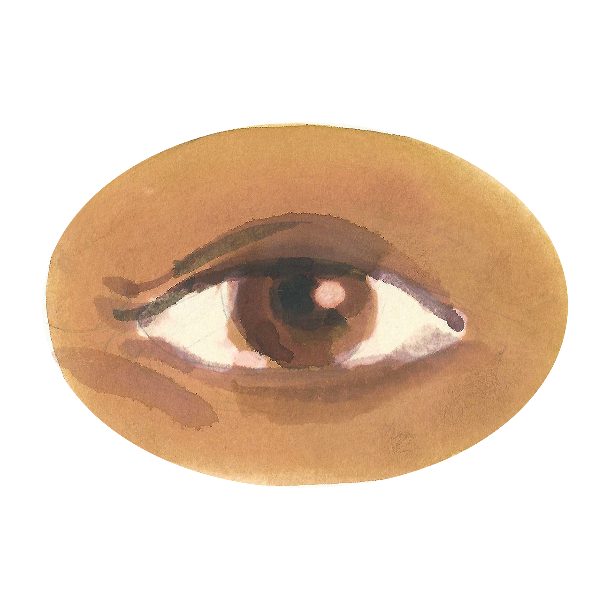
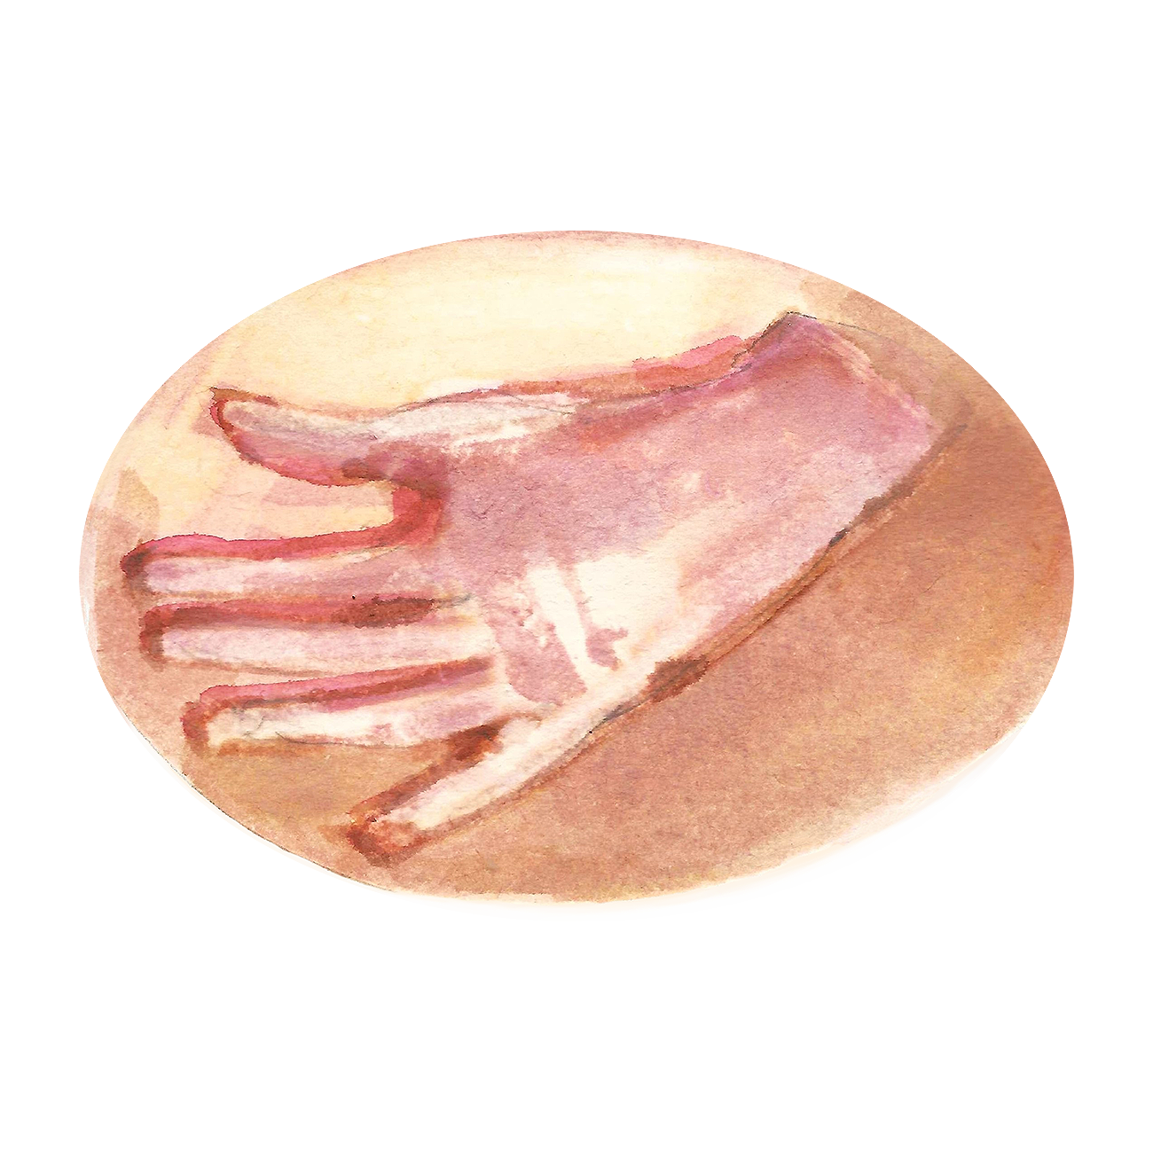
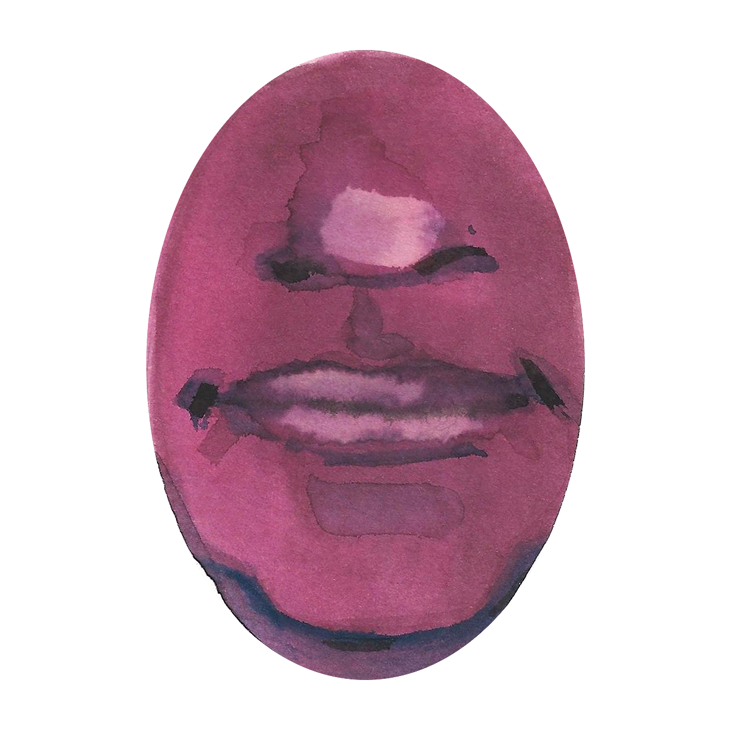
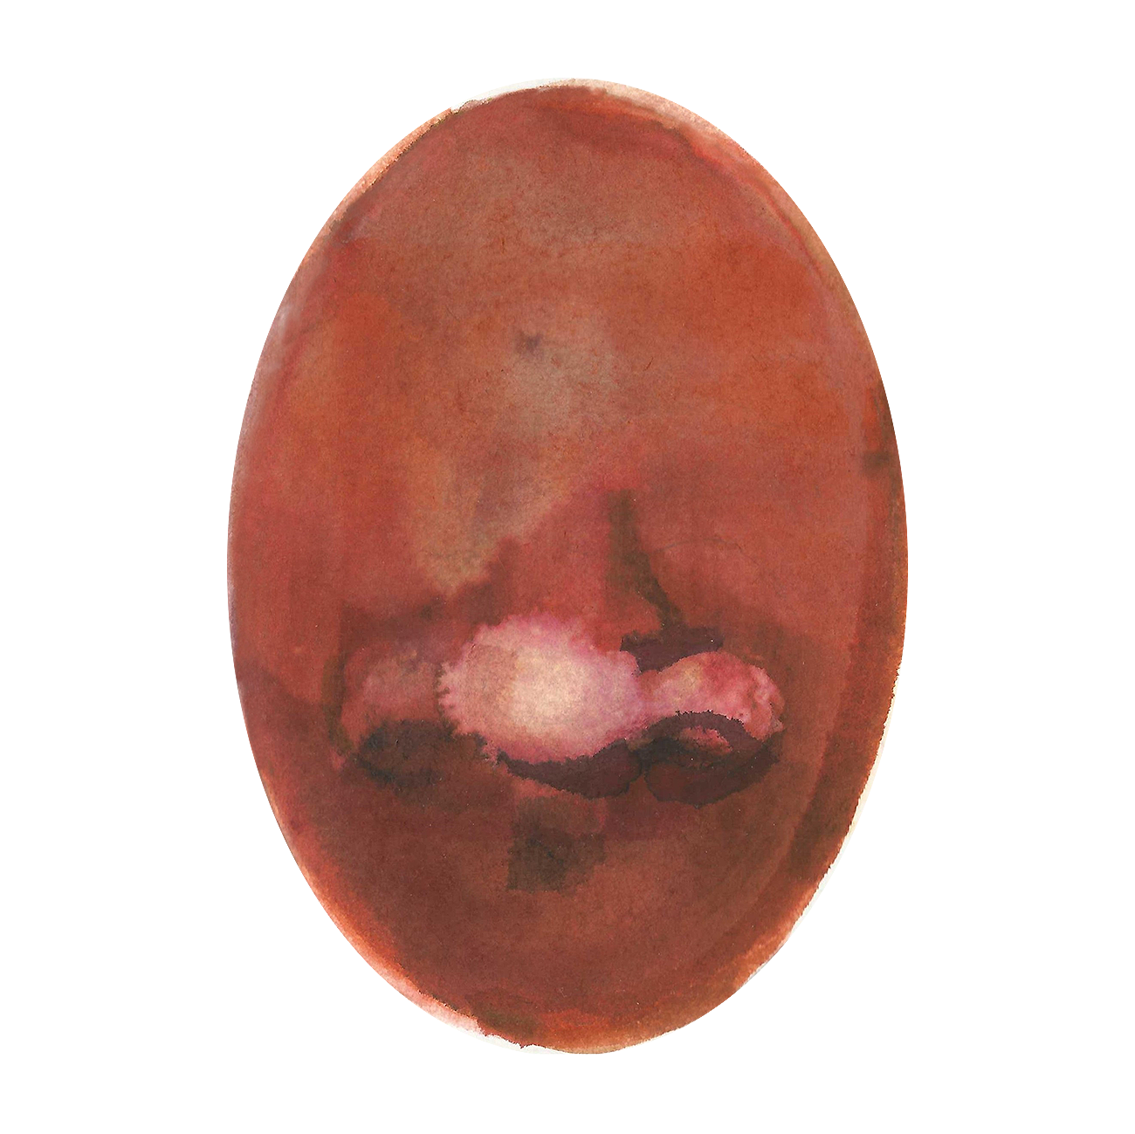
Can anyone tell me what the five senses are?
And which part of our body do we use?

Slide 4
The two golden rules of
No one has to try
No one has to like

Slide 5
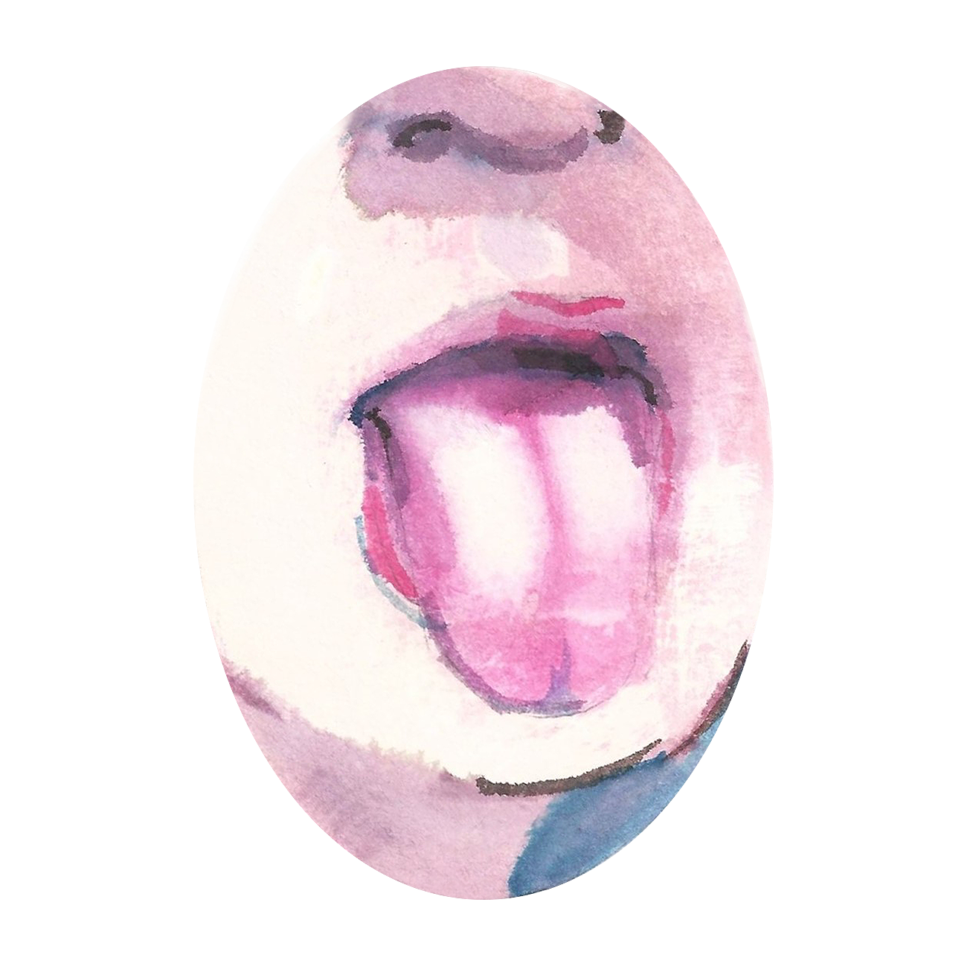
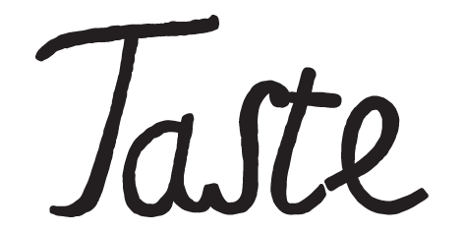
Today we are exploring taste and some of the many varieties of beans and peas.

Slide 6
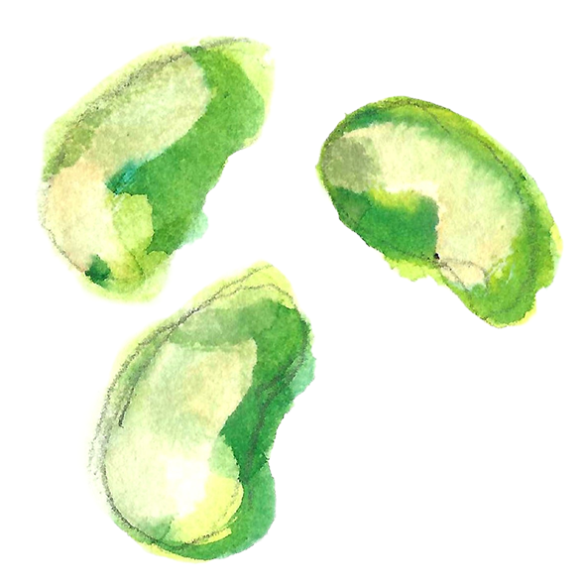
How many different beans can you name?
What beans have you tried?

Slide 7
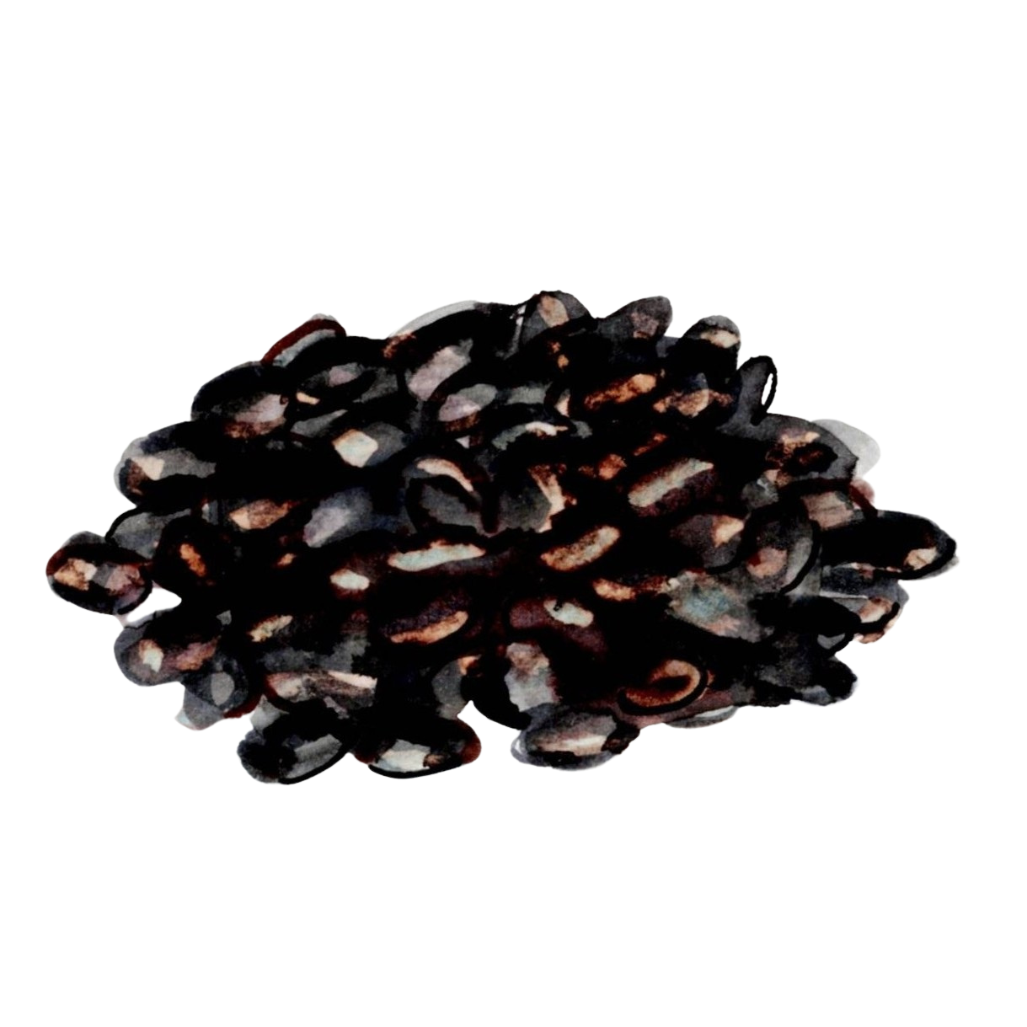
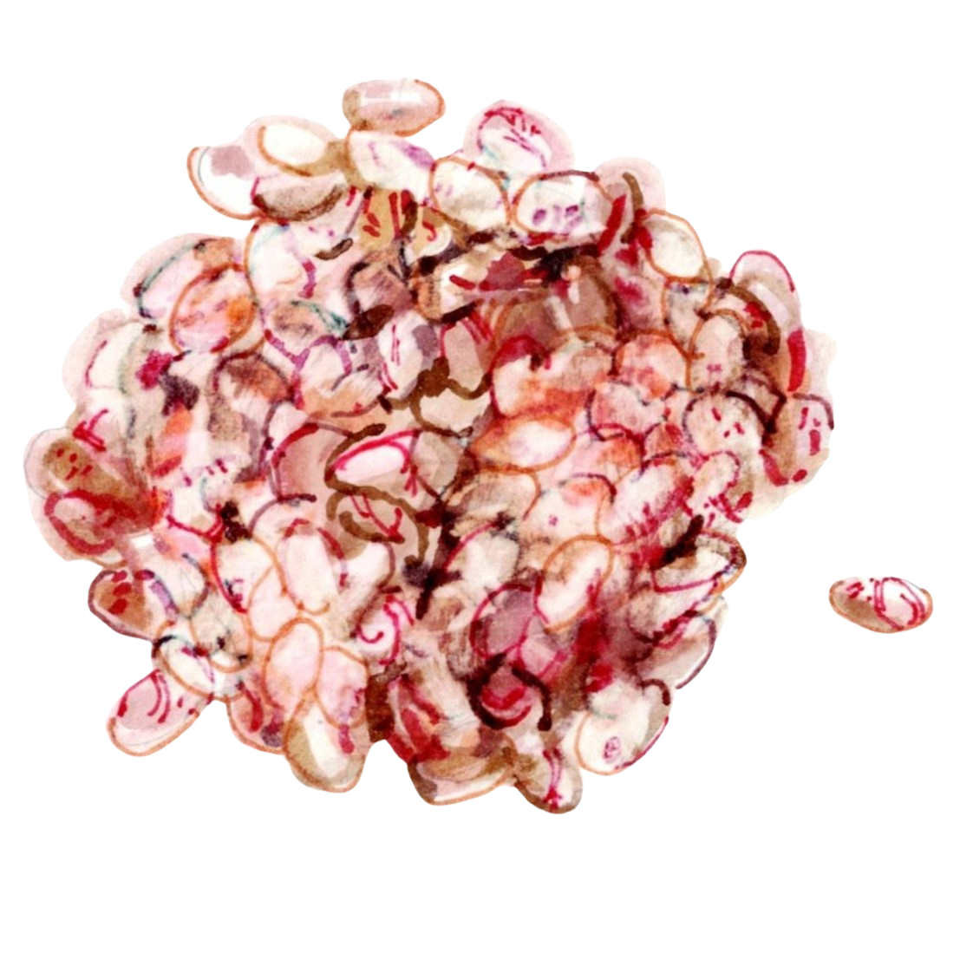
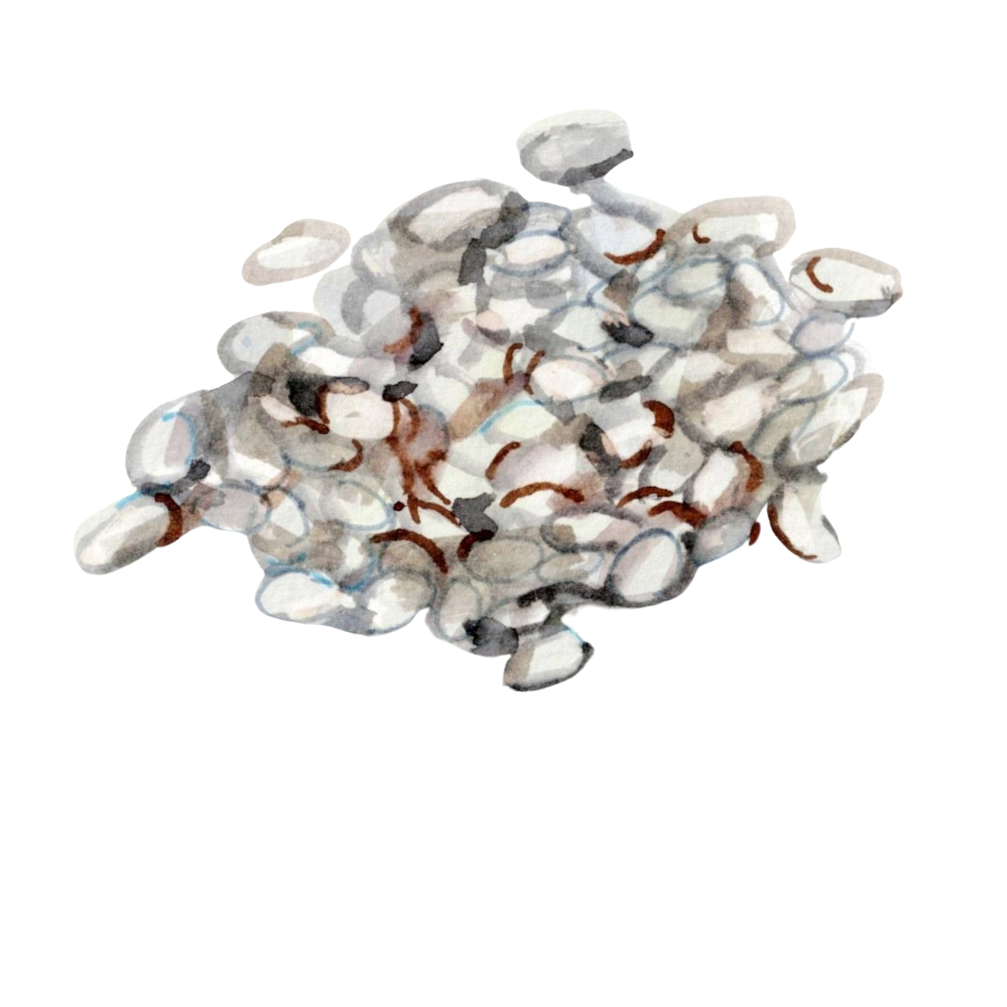
There are around 400 types of edible dry beans grown around the world (including chickpeas, which some people call garbanzo).
Black beans
Borlotti beans
Cannellini beans

Slide 8
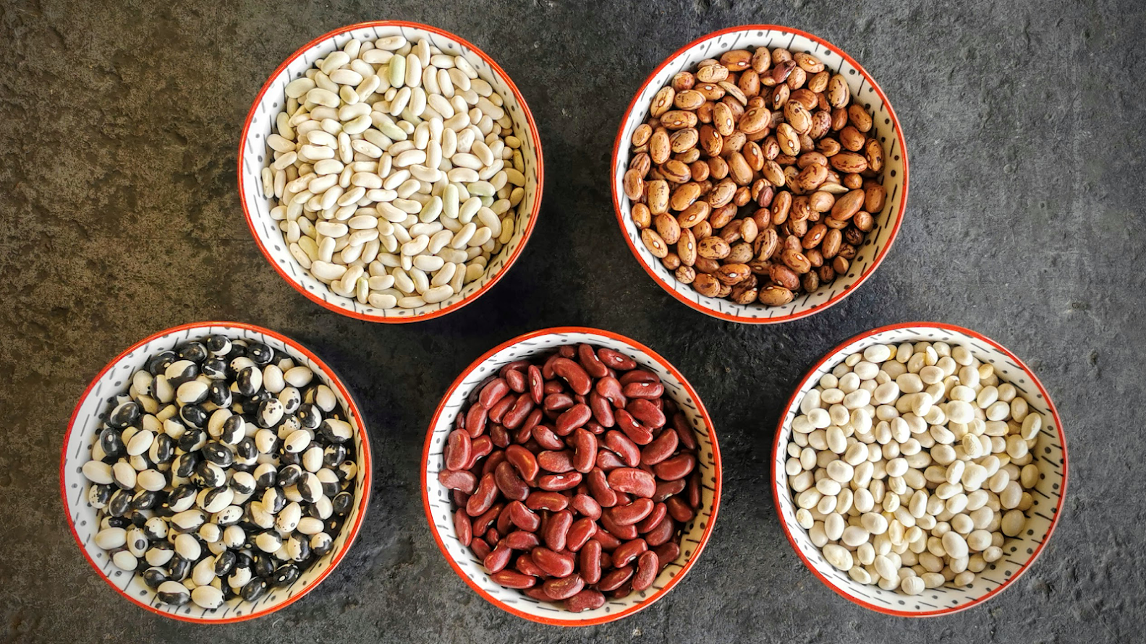
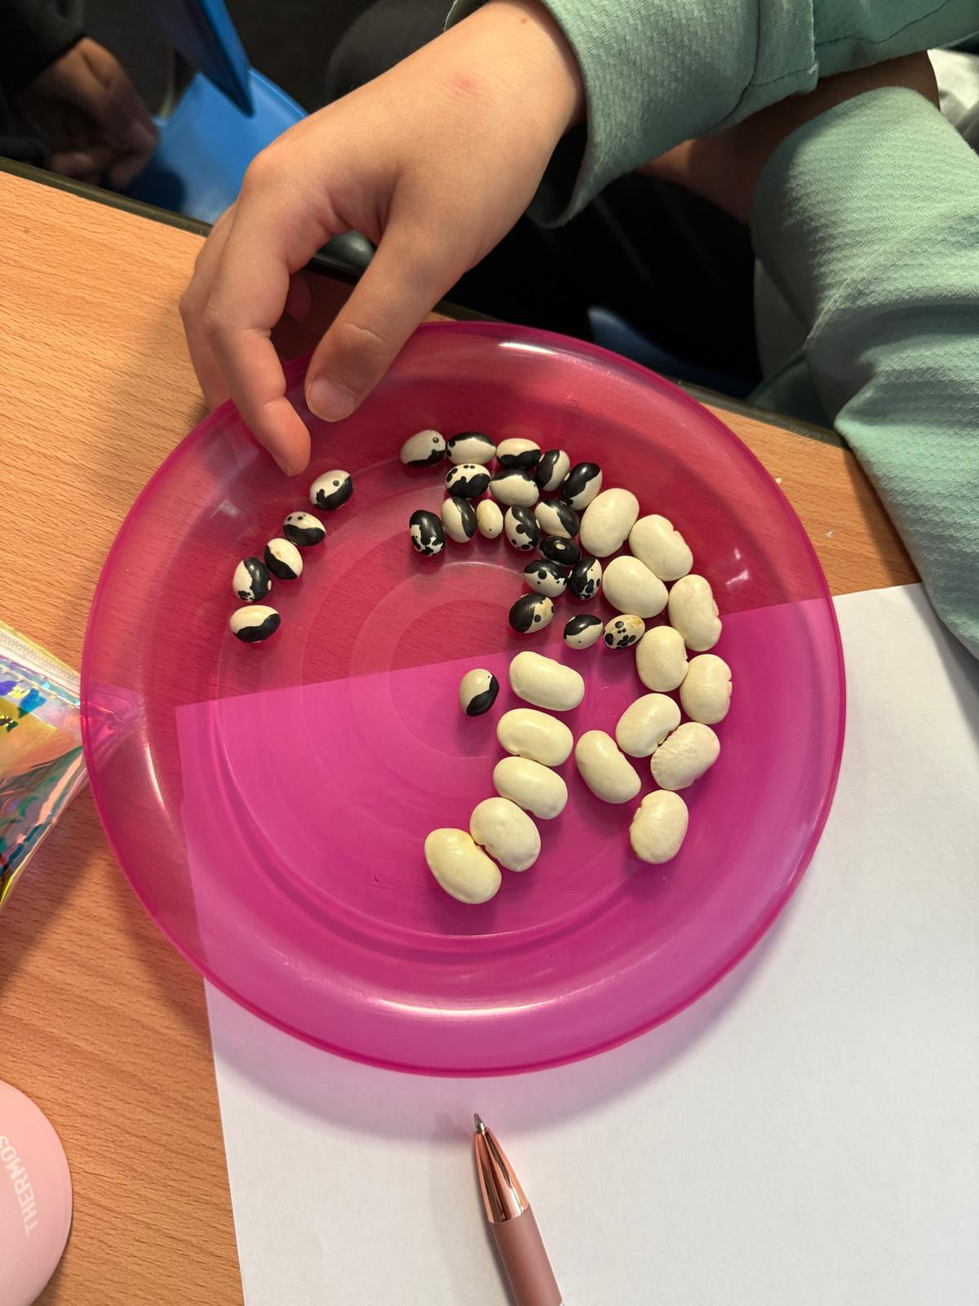
Here are some dried beans to look at.
What do you see?

Slide 9
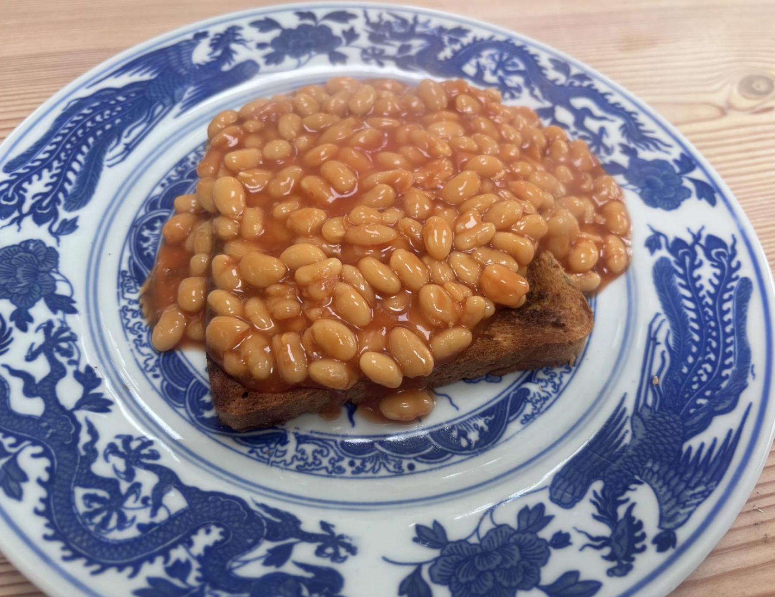
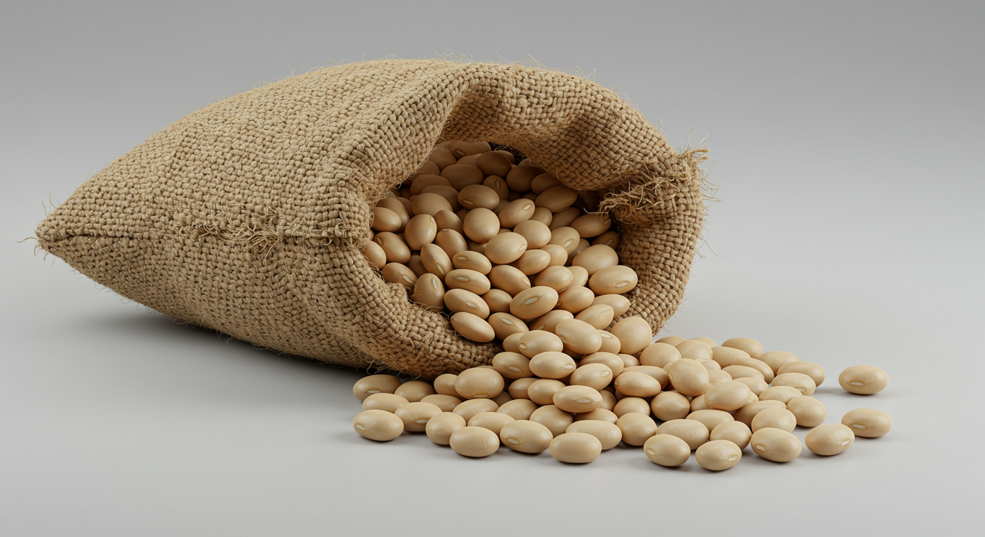
Most people in the U.K. eat just one kind of beans: baked beans. More than 2 million cans are sold every day!
The beans used in canned baked beans are haricot beans.

Slide 10
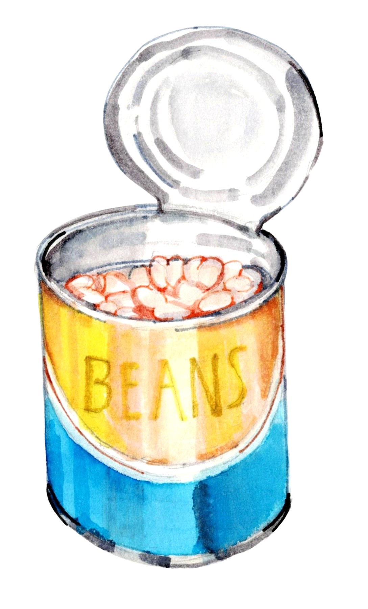
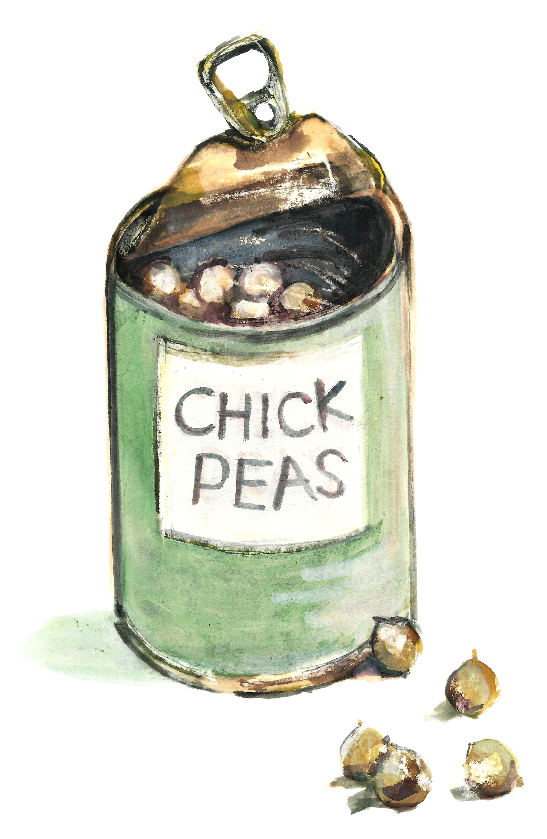
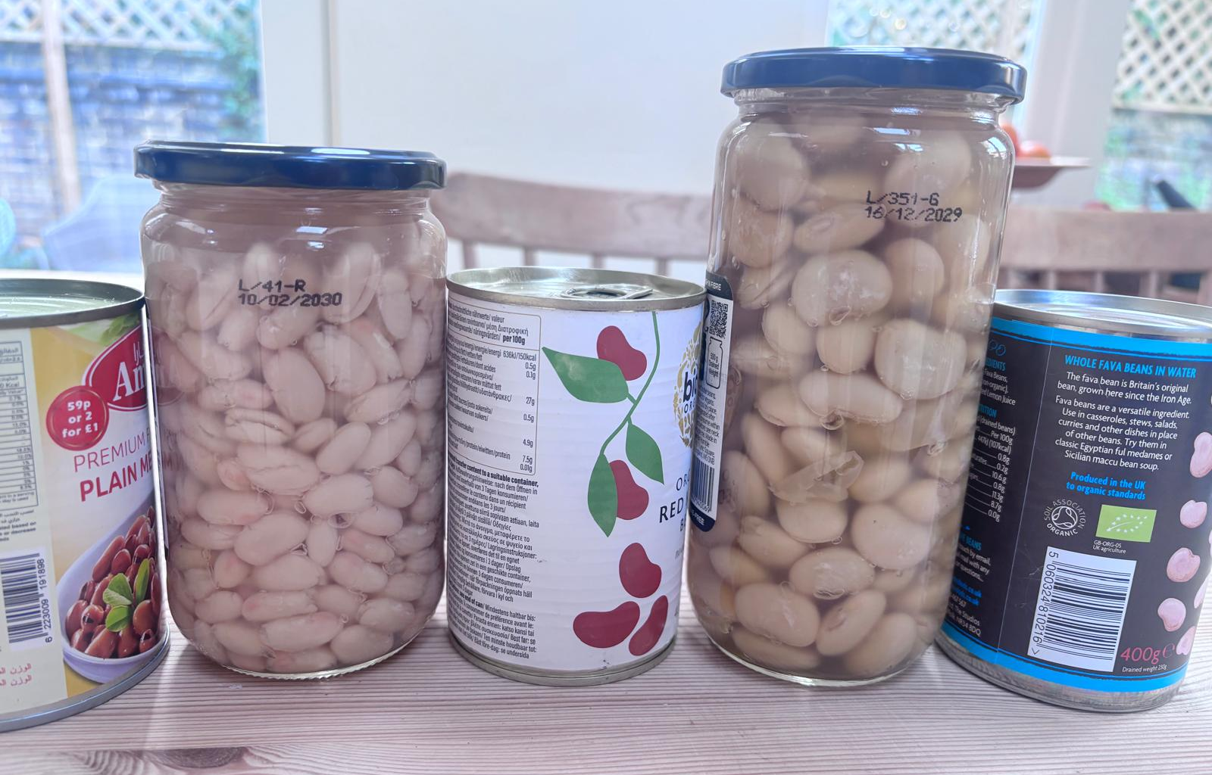
You can cook beans and chickpeas from dry or you can buy them in a can or a jar ready to eat.

Slide 11
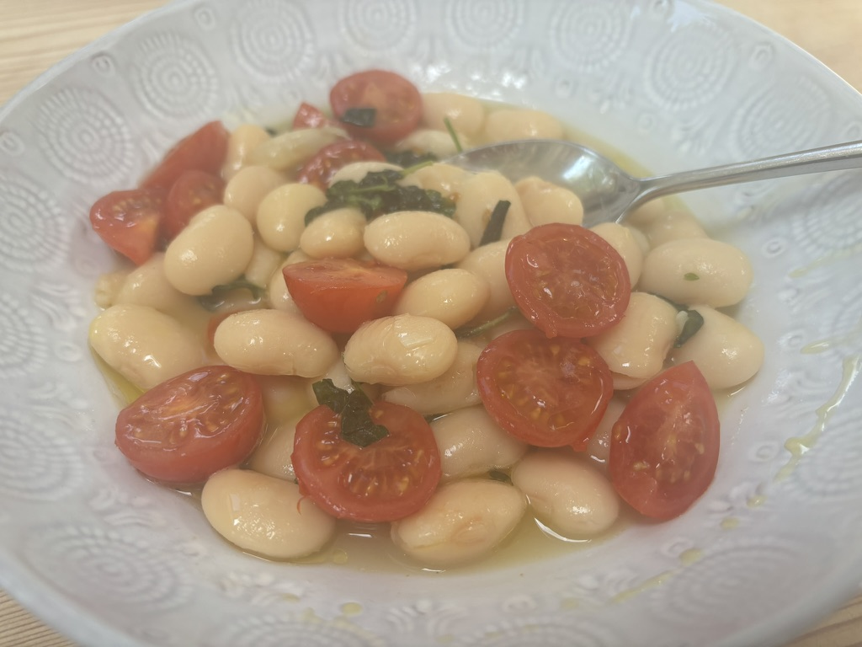
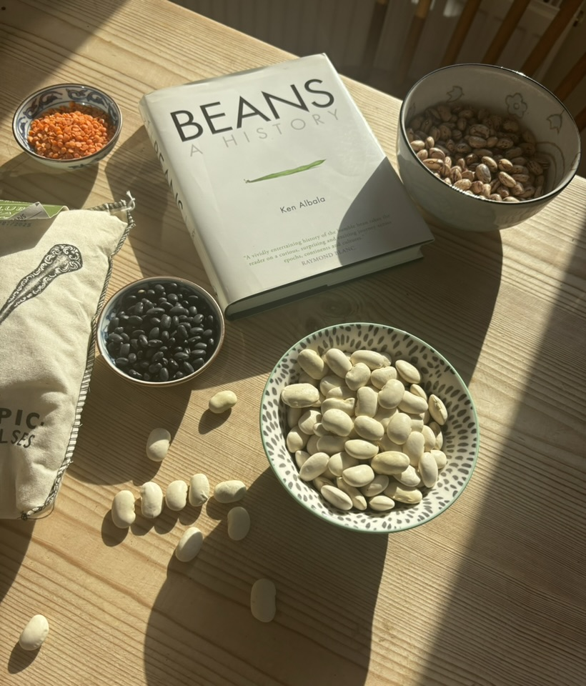
Who likes beans? Can you say why? Do you eat them at home?
Notes:
Image on the left to be replaced.

Slide 12
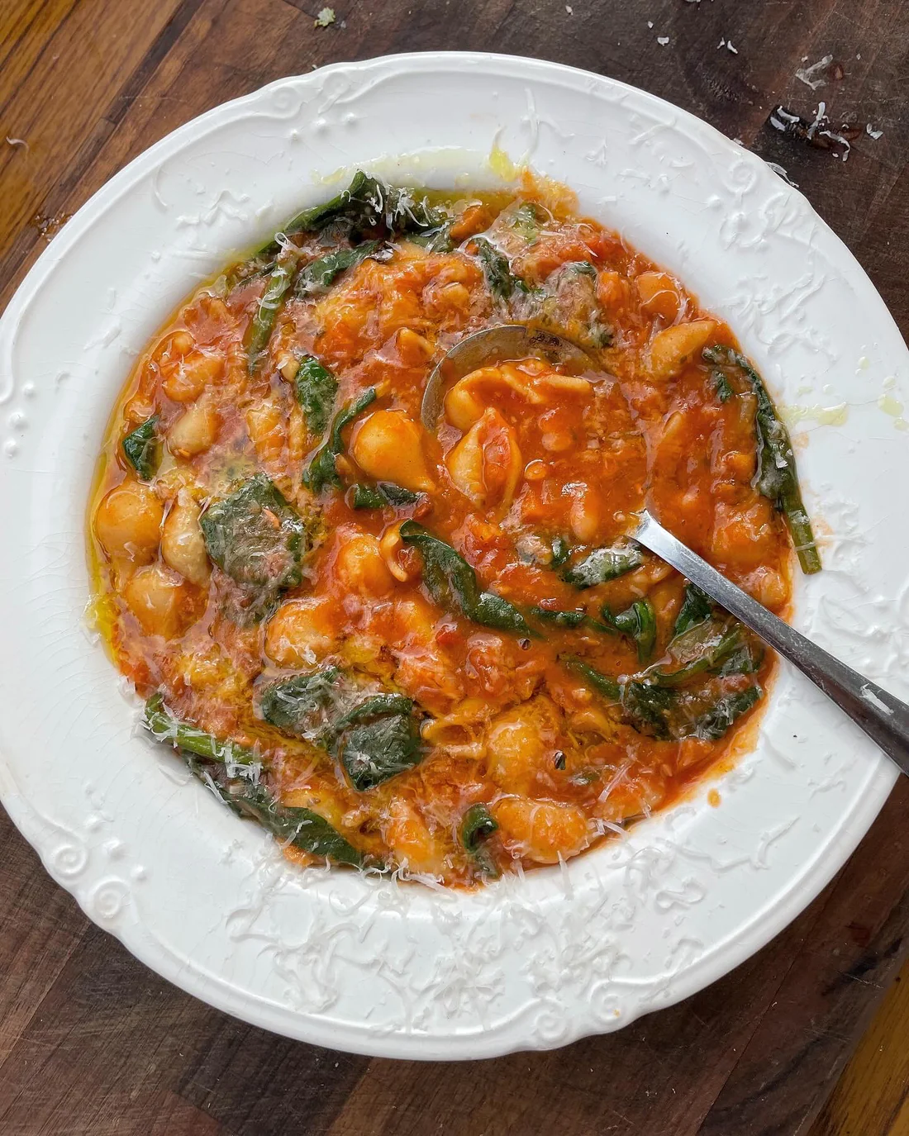
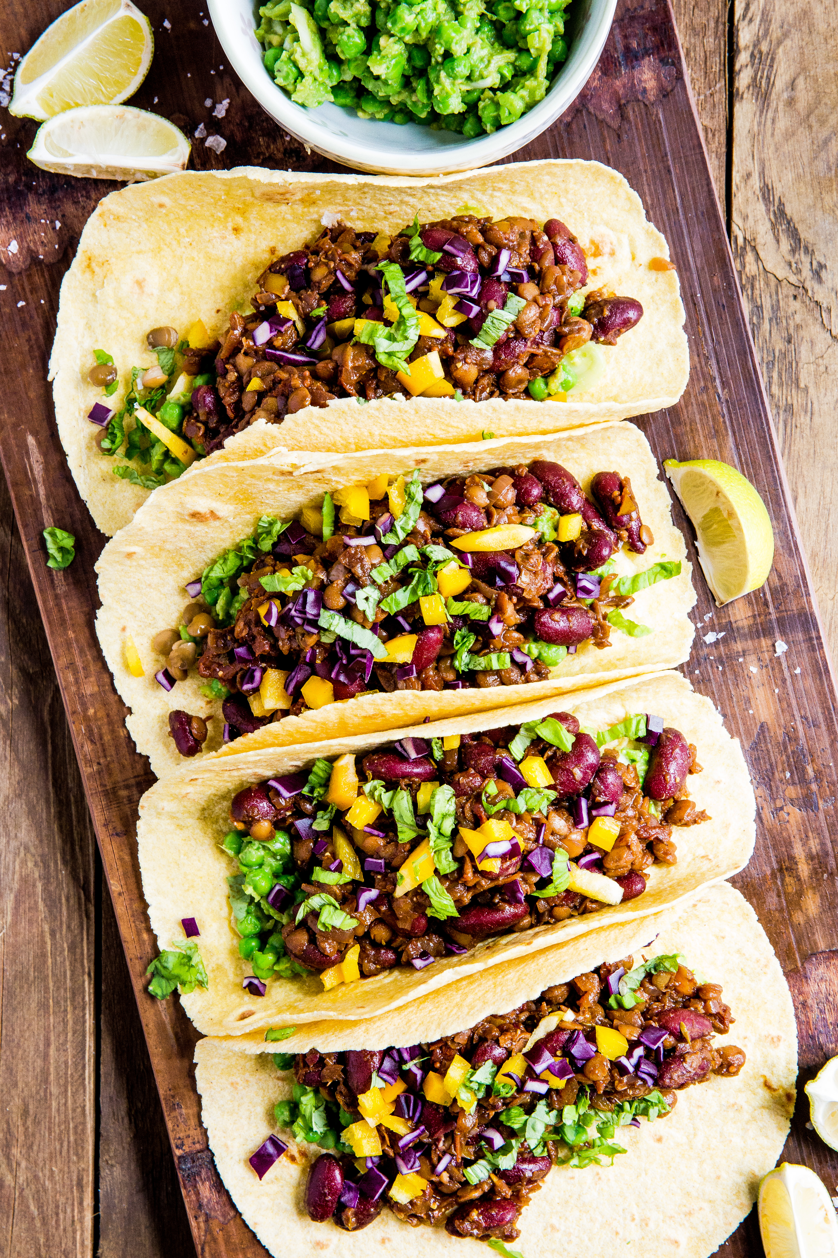
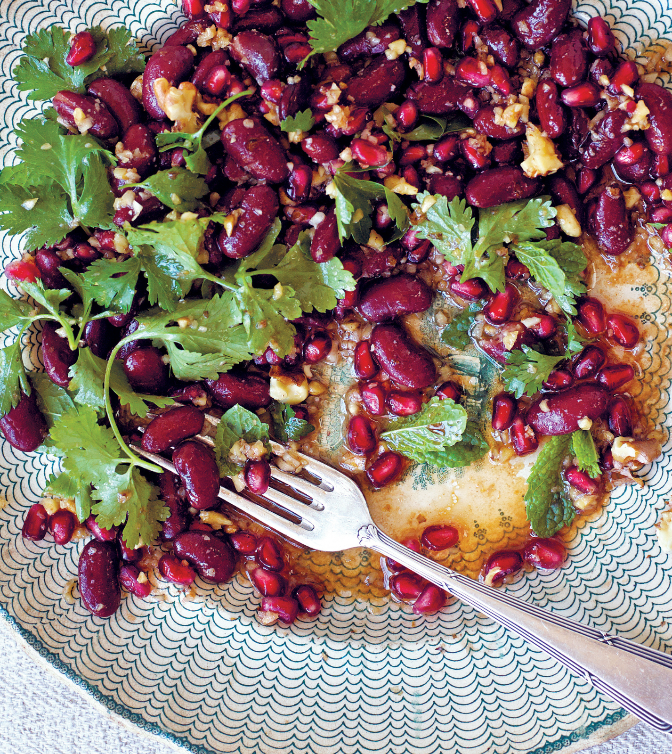
If you’ve never had any beans except for beans on toast, here are some other ways to try them.
In a soup
In tacos
In a salad with herbs

Slide 13
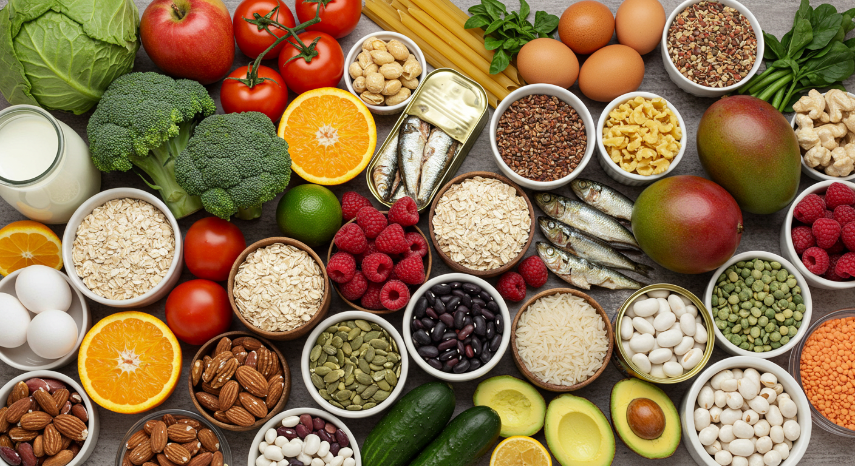
It is important for our bodies to eat lots of different foods. But why?
diversity = variety

Slide 14
We need a diversity of foods to give our bodies different nutrients. Eating more types of beans gives us a range of nutrients (as well as different flavours and textures).
White beans such as haricot and cannellini are very high in IRON (you need this to keep your blood healthy)
Black beans are especially high in FIBRE (great for digestion) and MAGNESIUM (good for bone health)
All beans are high in PROTEIN (your body needs this to grow) and borlotti beans are especially protein-rich and have B vitamins for energy.

Slide 15
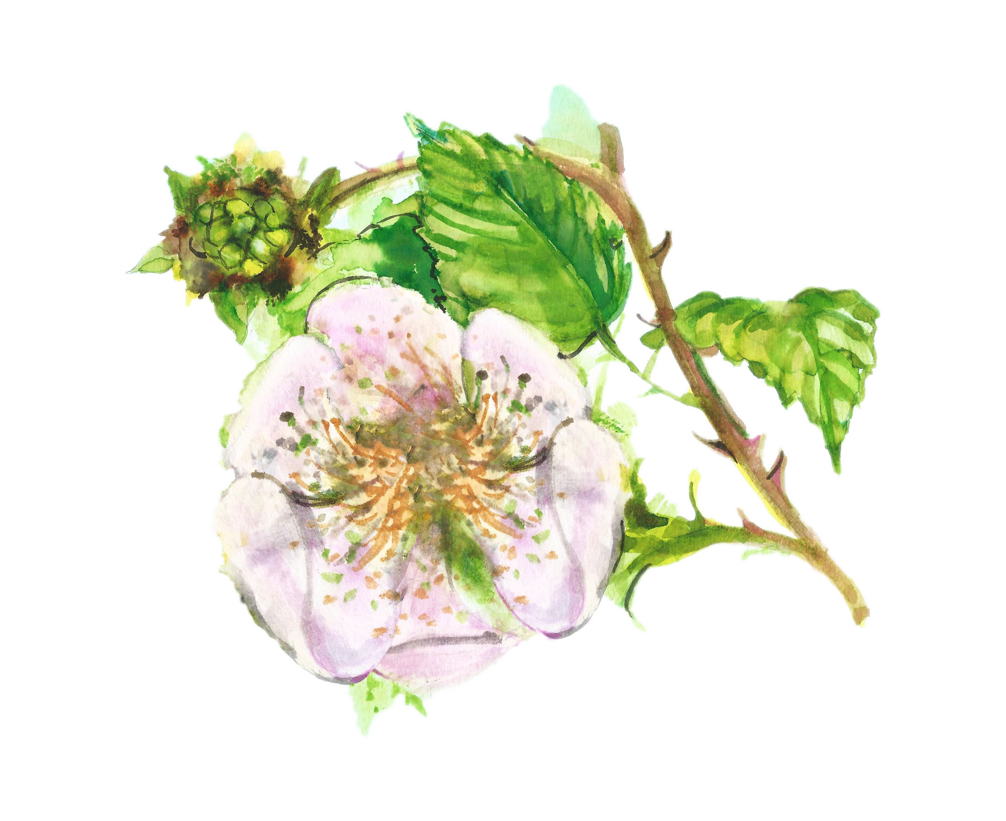
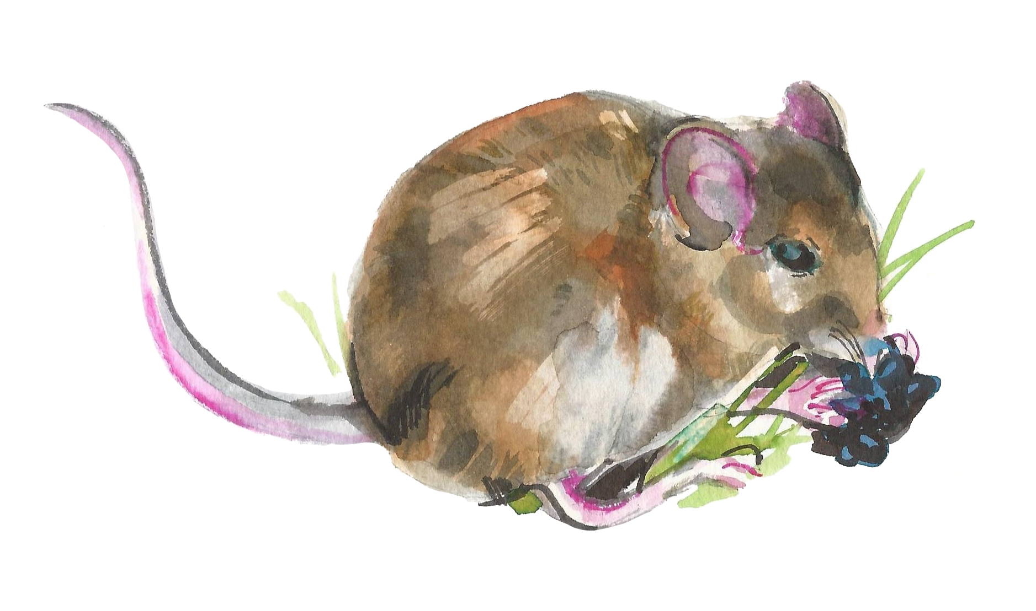
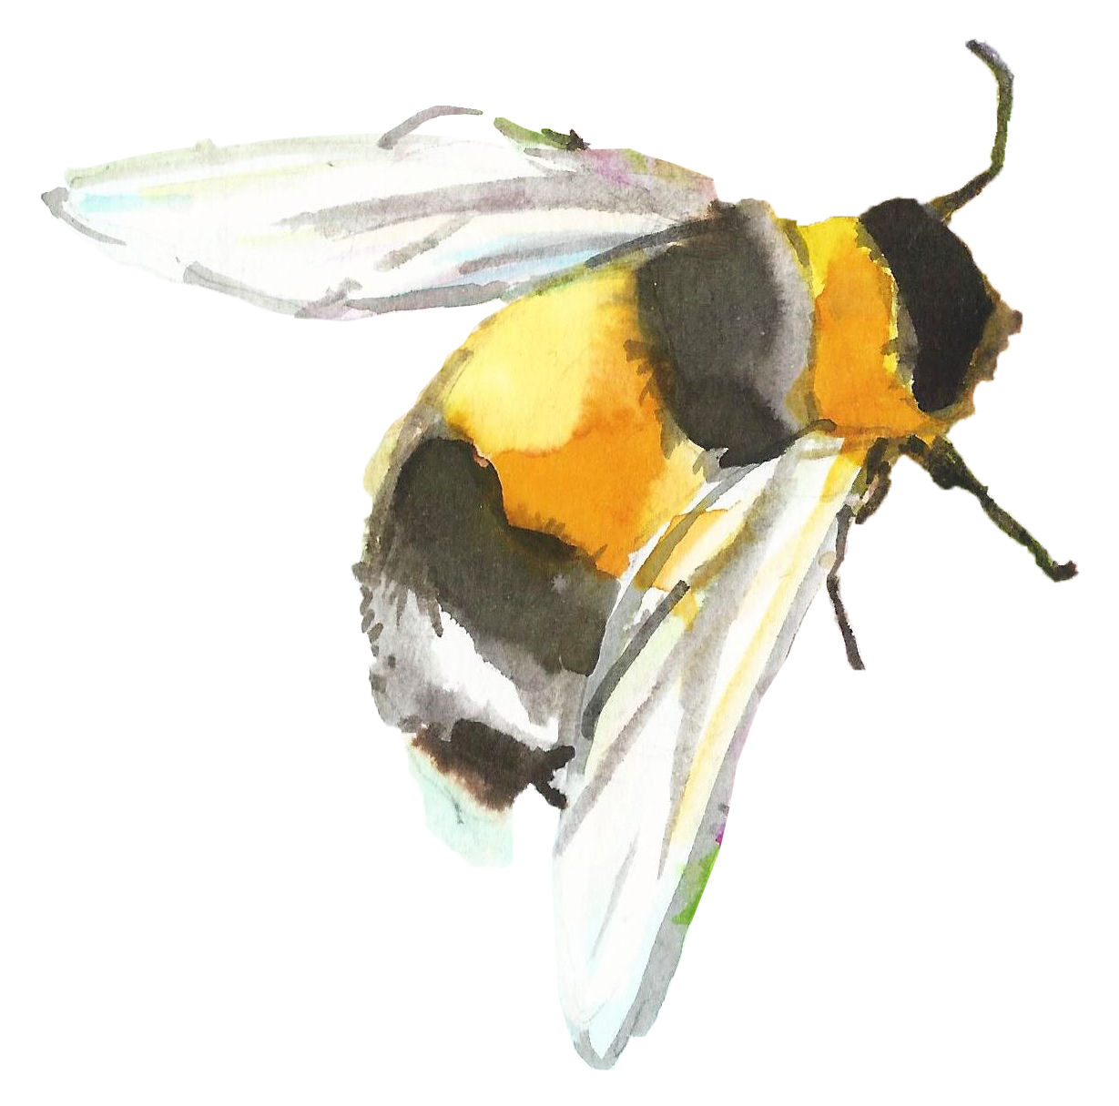
Another reason to eat lots of different beans is for BIODIVERSITY which means the variety of life on the planet. (Bio=life). Plants and animals need each other to survive.

Slide 16
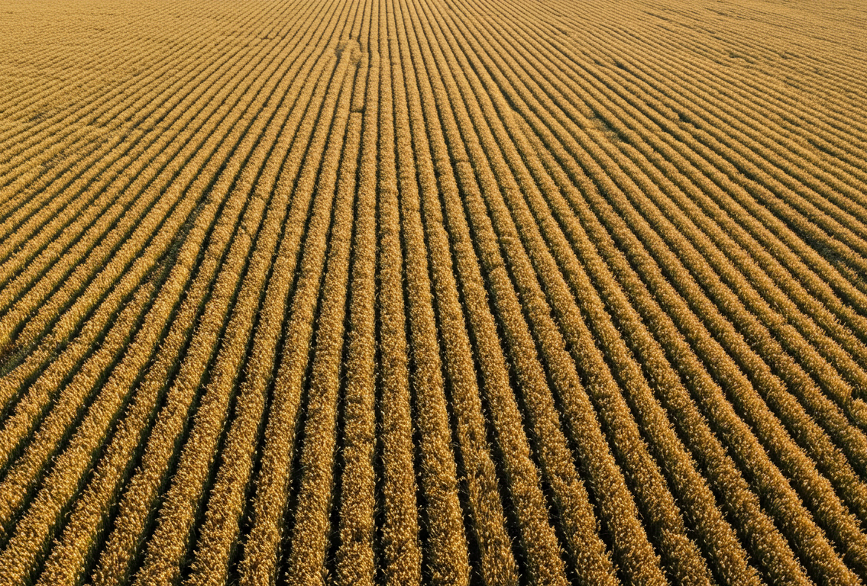
Biodiversity is getting lost. Around a quarter of all plant and animal species are threatened with extinction.
The homes (habitats) of many plants and animals have been destroyed:
By climate change
By intensive farming
Q: Why is this wheat field bad for biodiversity?

Slide 17
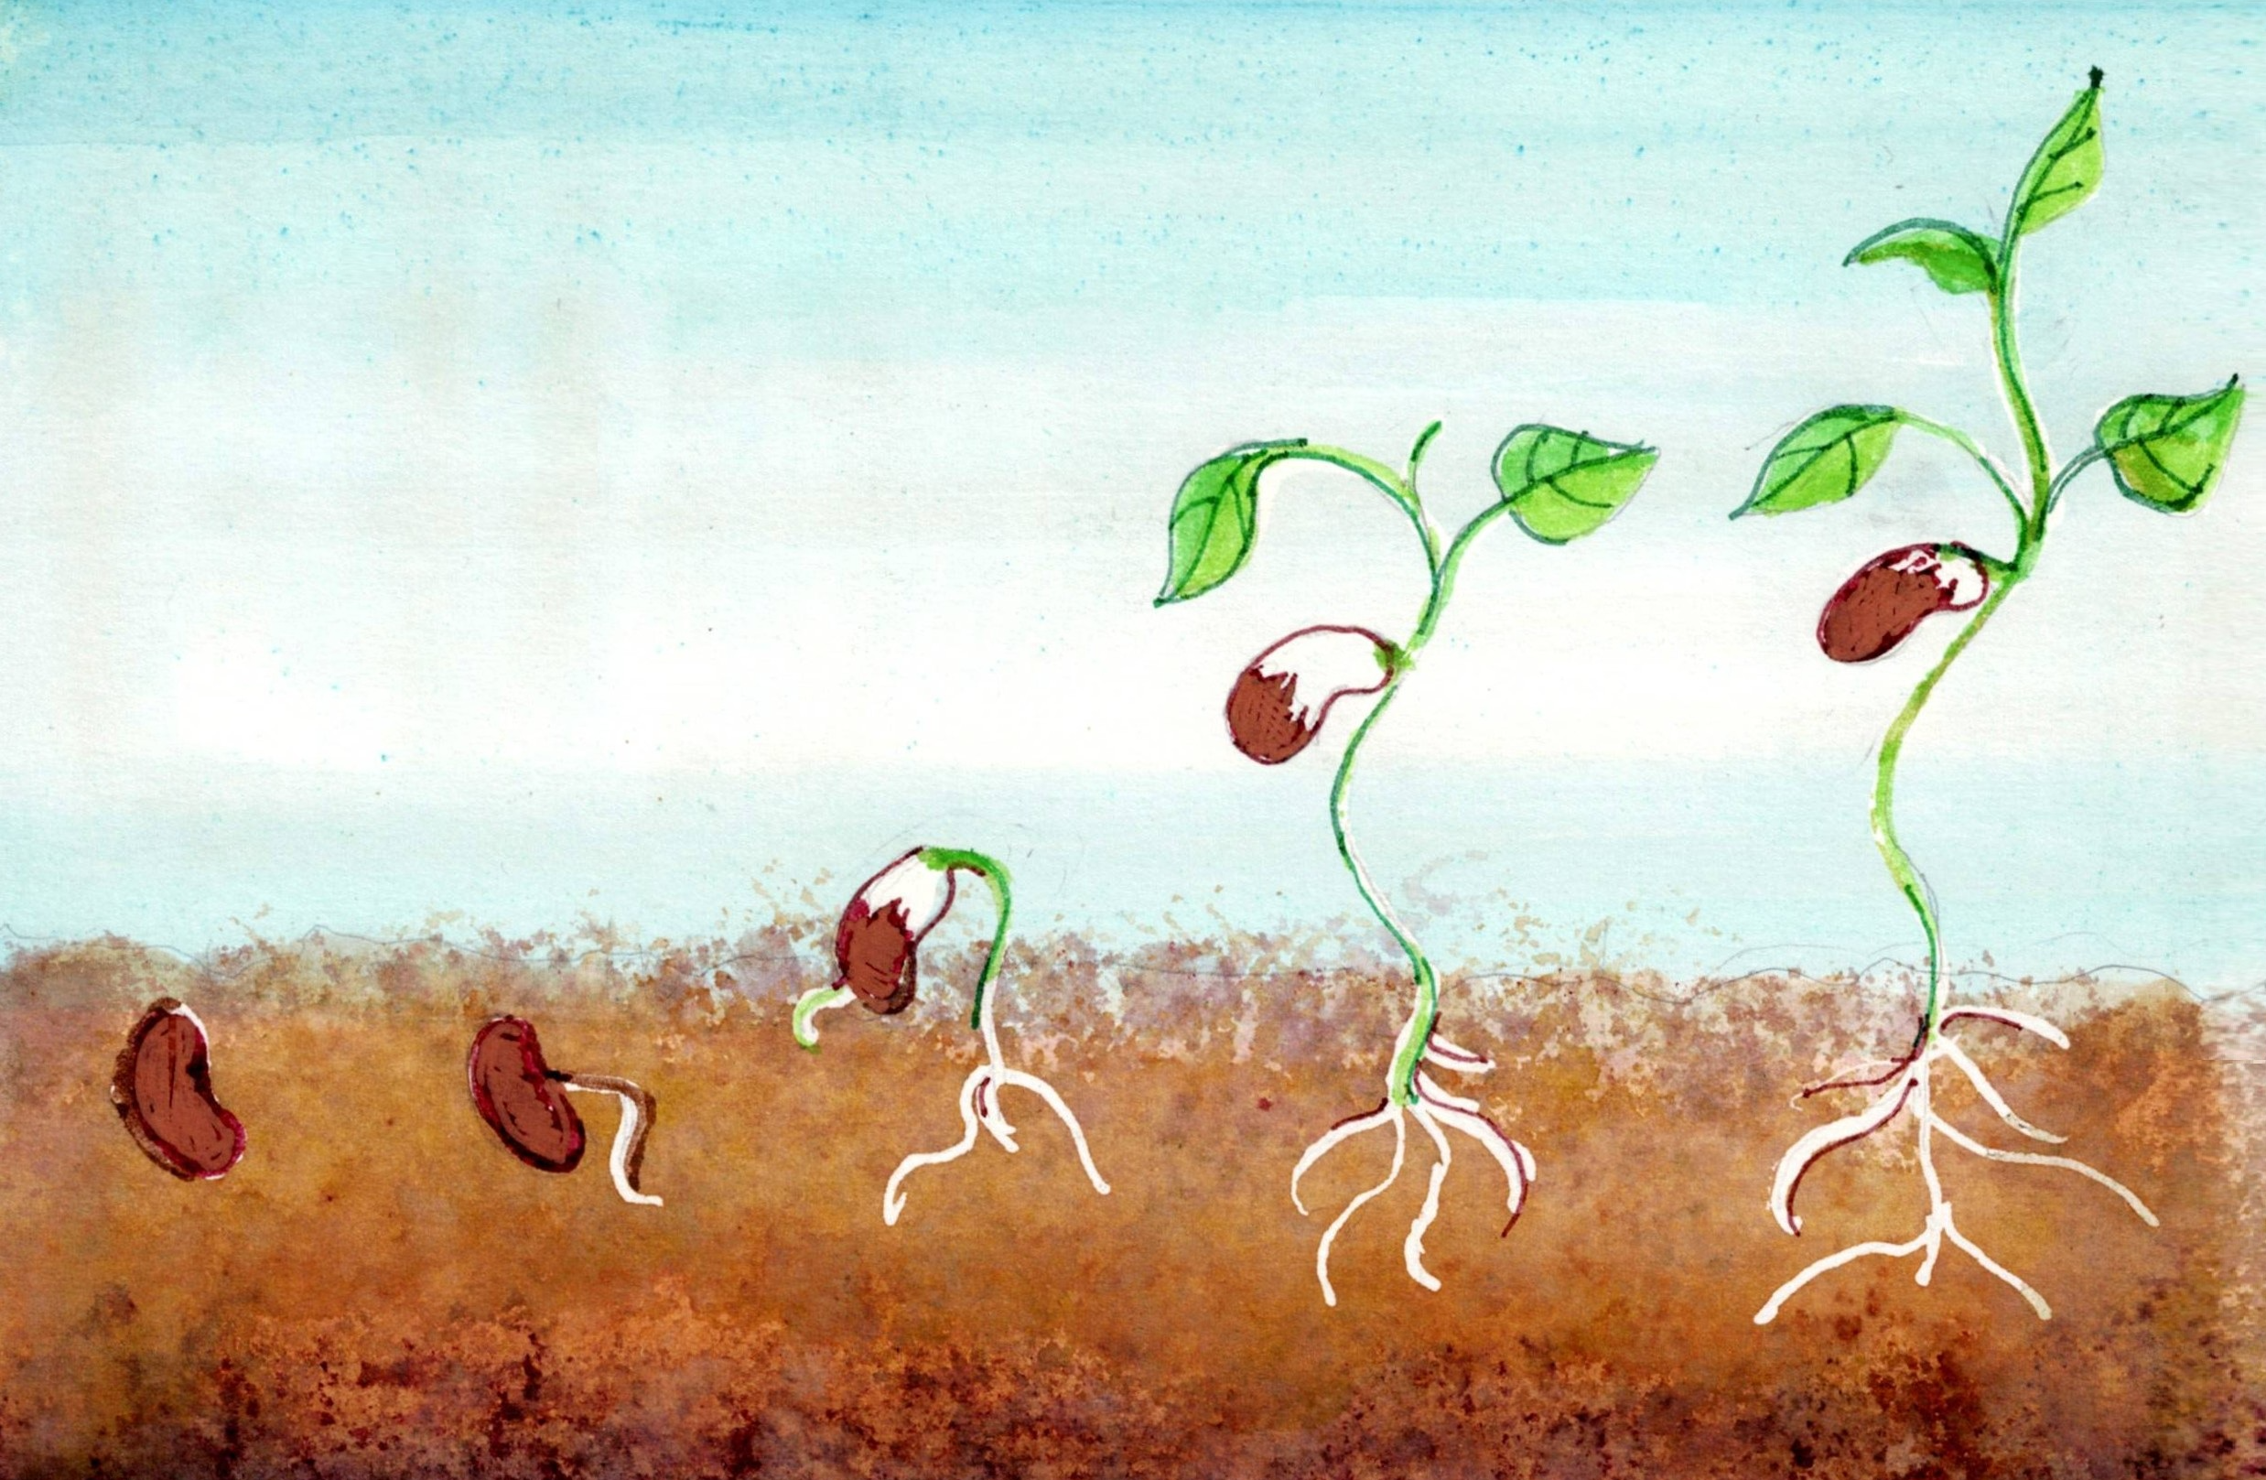
Growing beans means growing biodiversity!

Slide 18
Beans are great for biodiversity because…
Beans attract pollinators (bees love them)
Beans make soils healthy by fixing nitrogen. They don’t need much fertilizer which helps to protect soil diversity and habitats for plants and animals.
Eating more beans instead of meat means less land is needed for farming (leaving more land for wildlife).

Slide 19
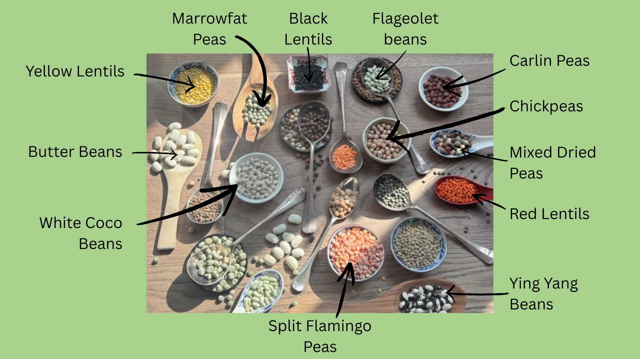
Now let's make a mixed bean salad.
Let's name the beans we will use.

Slide 20
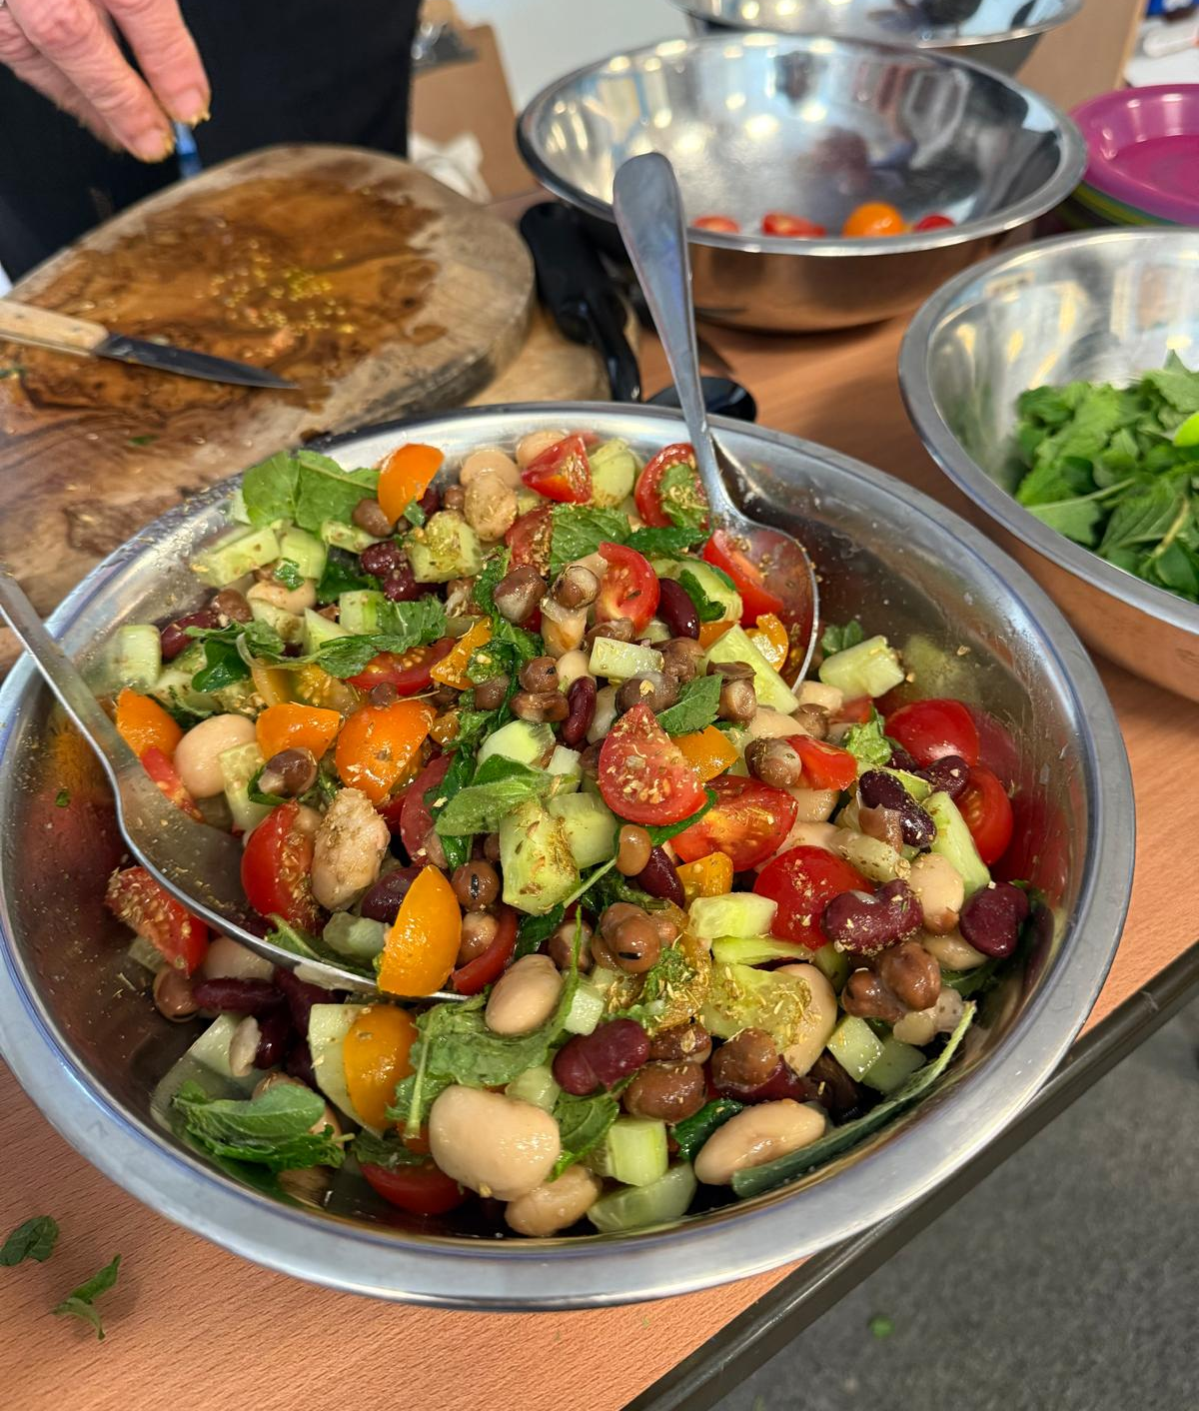
To make a mixed bean salad we will mix different beans with olive oil, vinegar, herbs, sweet tomatoes and crunchy cucumber.

Slide 21
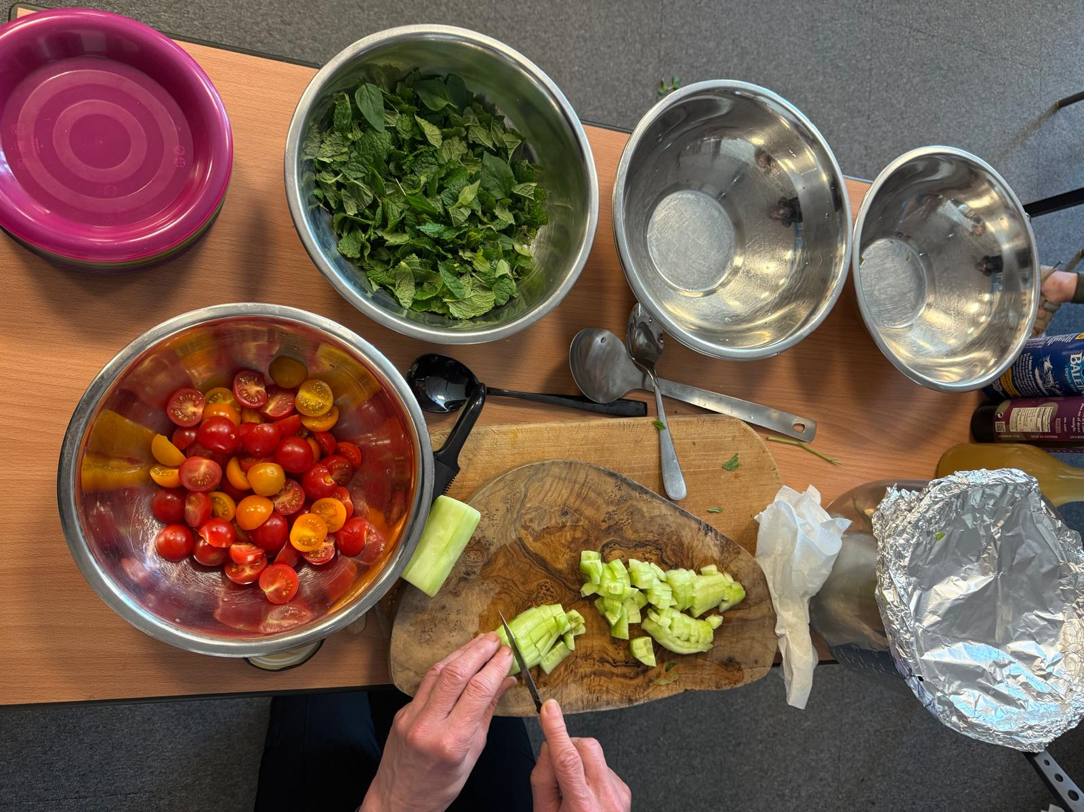
We will make our bean salad. While some people are helping to make it, can you write how you are expecting it to taste?

Slide 22
Shall we try the bean salad that we have made?

Slide 23
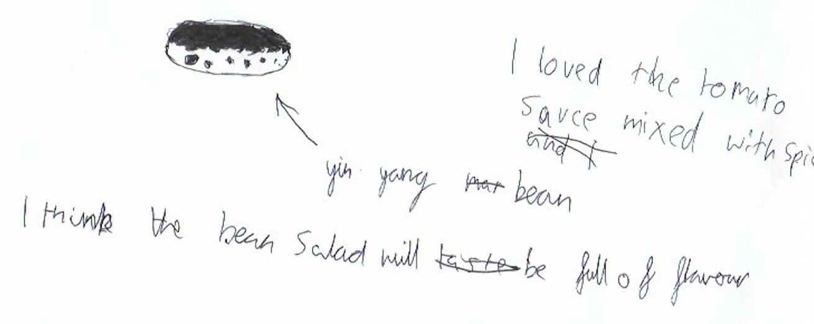
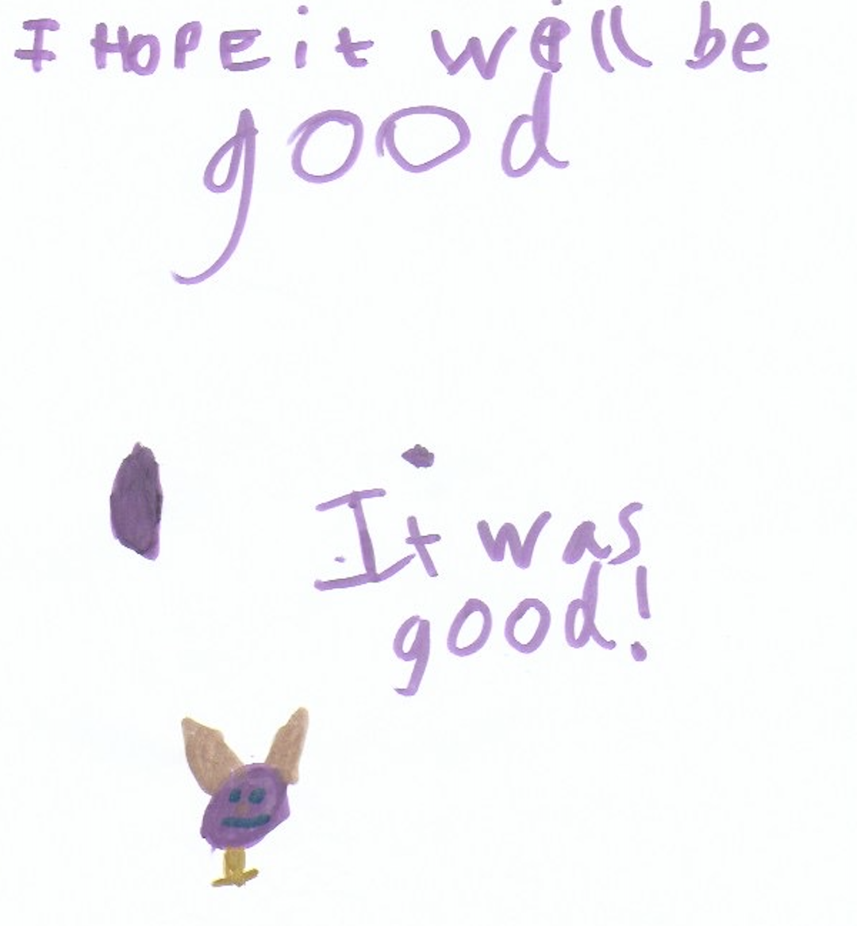
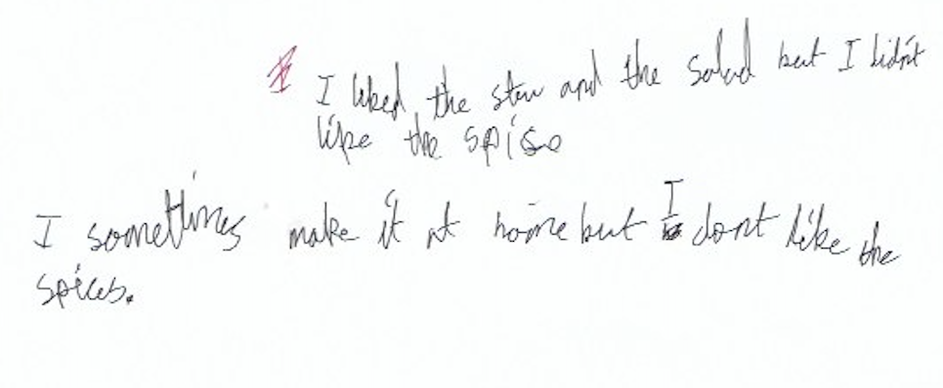
How did the different beans or peas taste to you? Here is what some other children wrote.

Slide 24
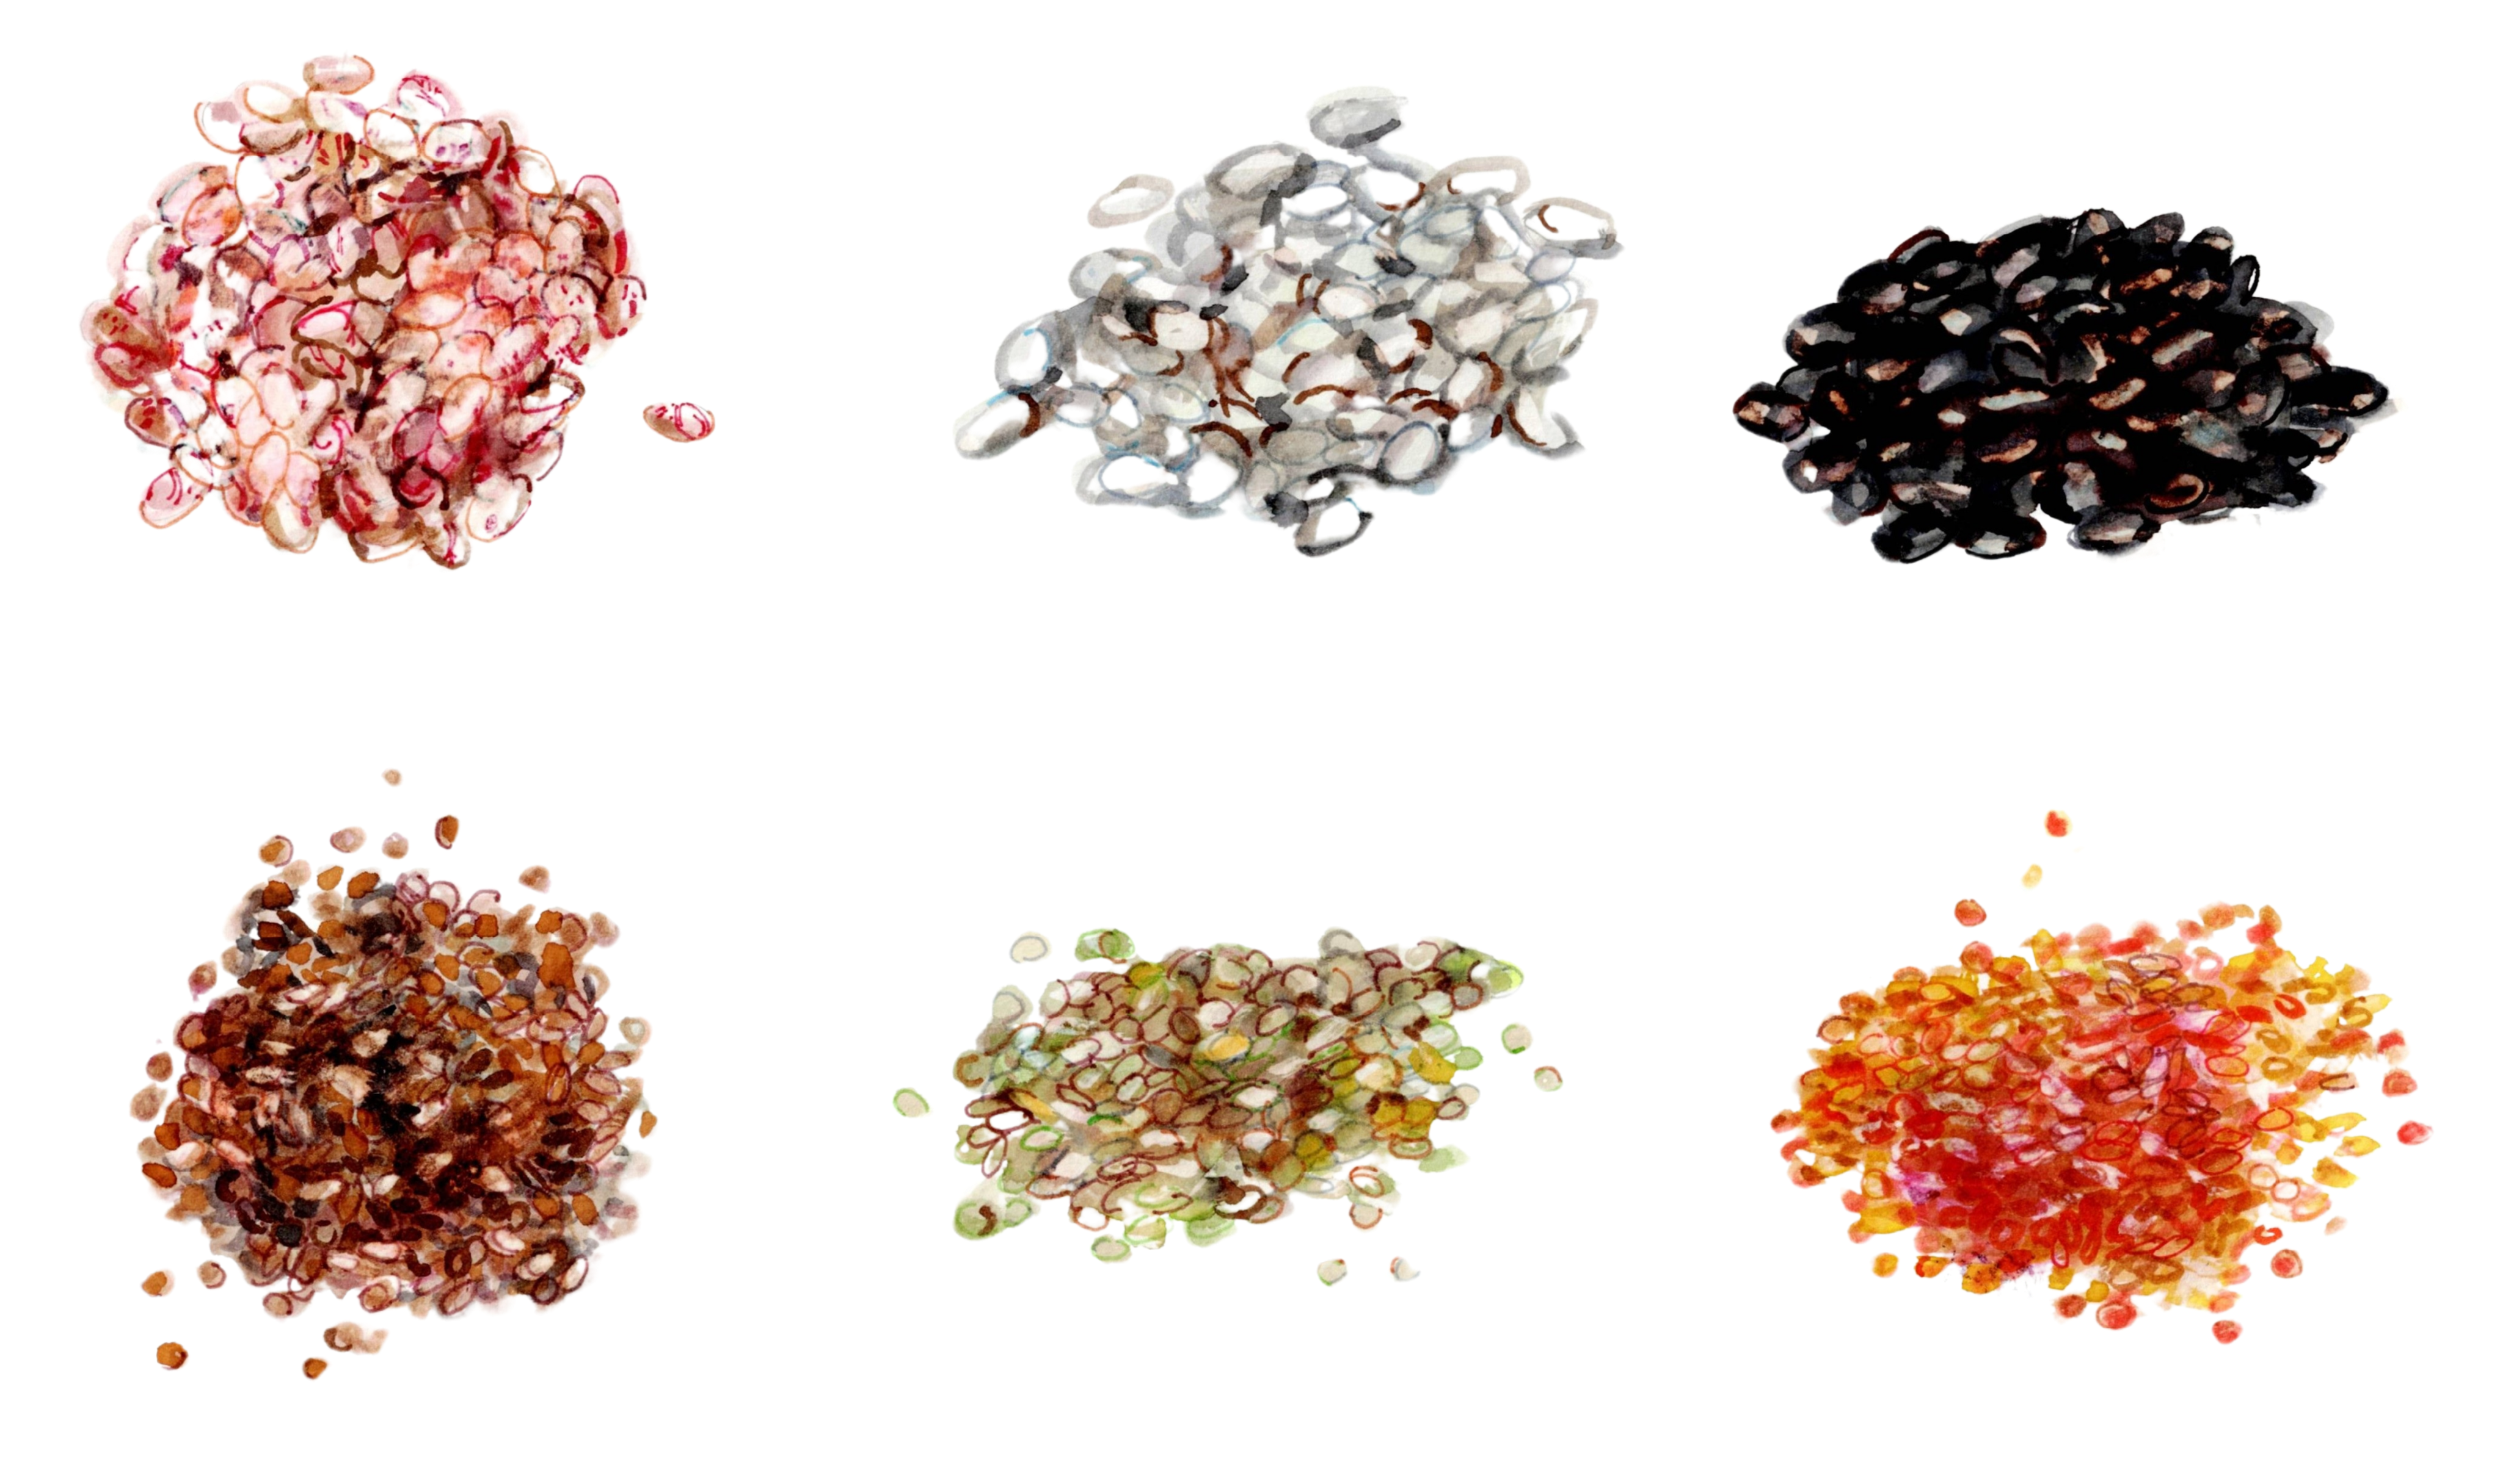
Did anyone try anything new today?

Slide 25
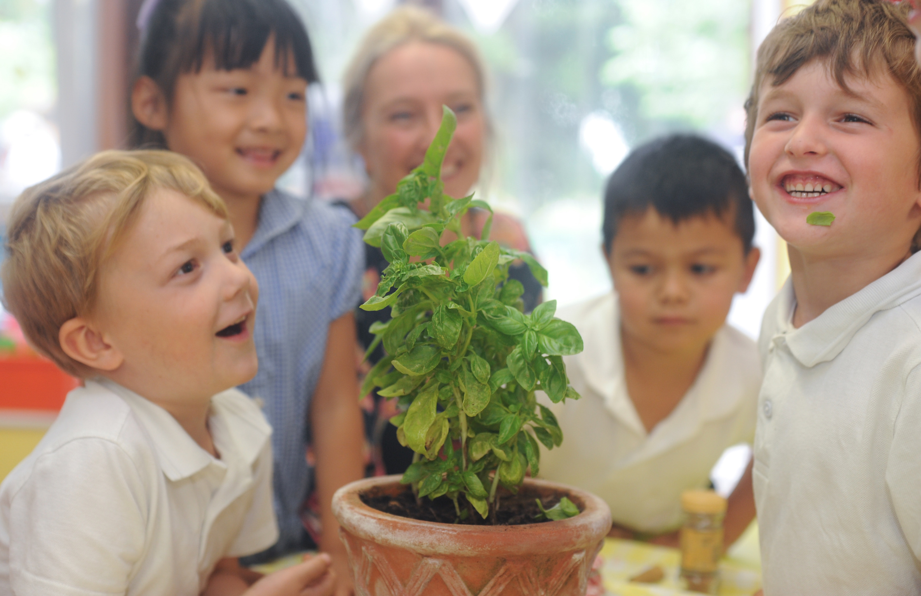
Teachers:
Please click HERE to tell us what new foods the children tried!
Please let us know how many children tried something new today – and what they tried. This information will help us measure the impact of our work. Our main objective is to understand how many children tried a new vegetable or fruit

Slide 26
Thank you for listening! Next time, we will explore another sense and try some different foods.
© 2025

