Slide 1
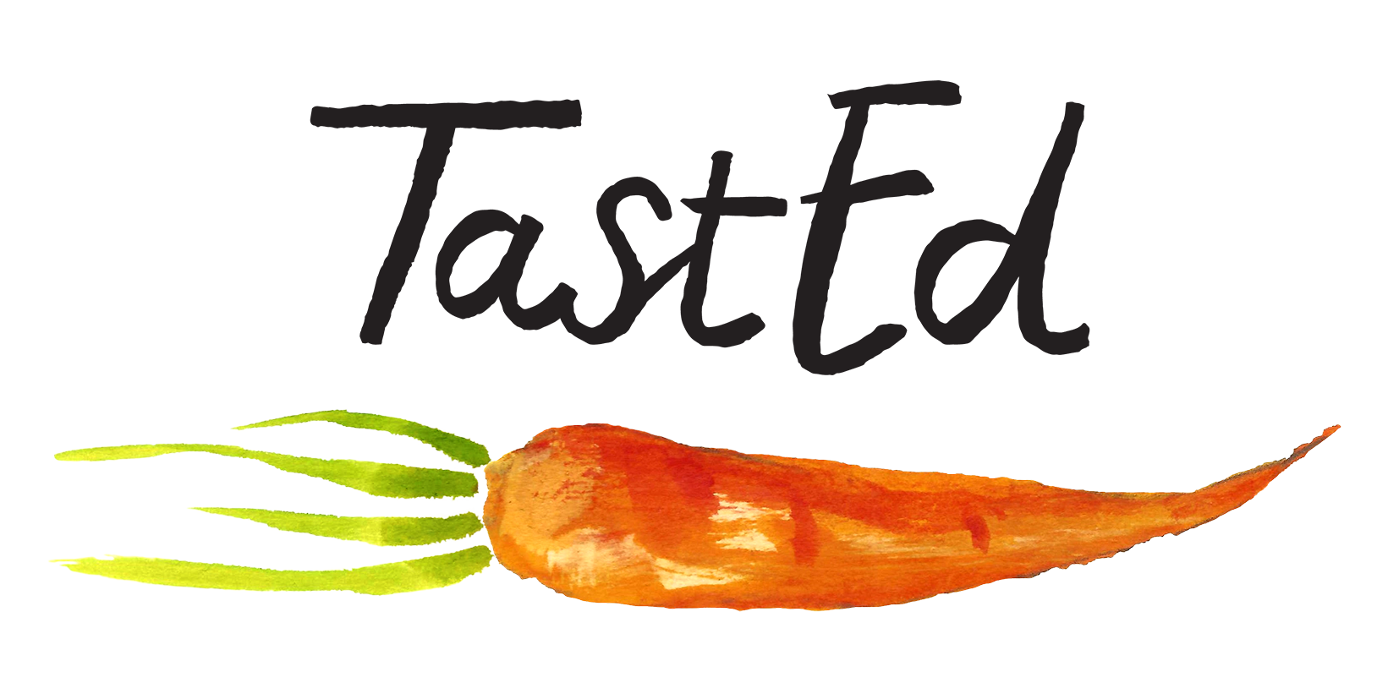
Upper KS2 - Years 5 and 6
Beans, Pulses and Peas Curriculum
Touch: Chickpeas – Green, Raw and Cooked

Slide 2
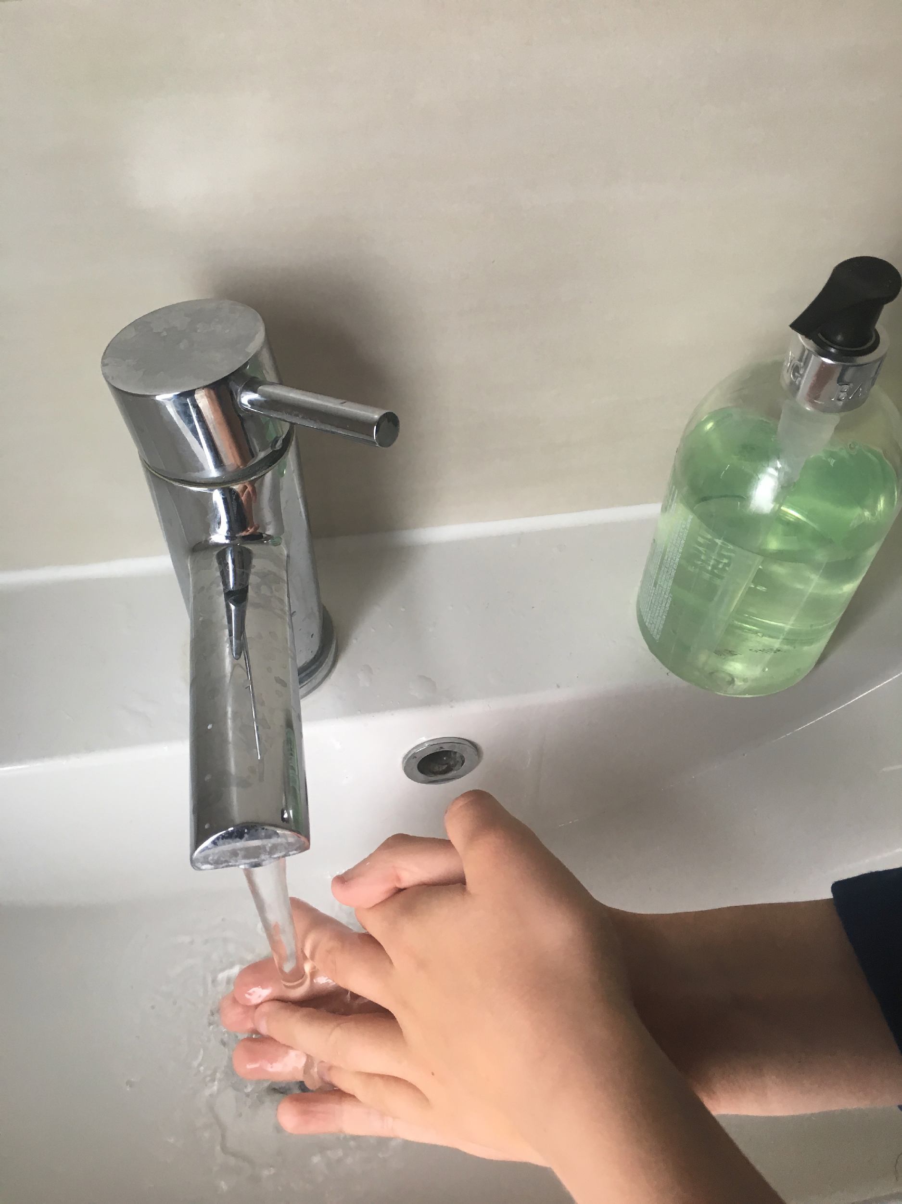
Before we start, has everyone washed their hands?

Slide 3
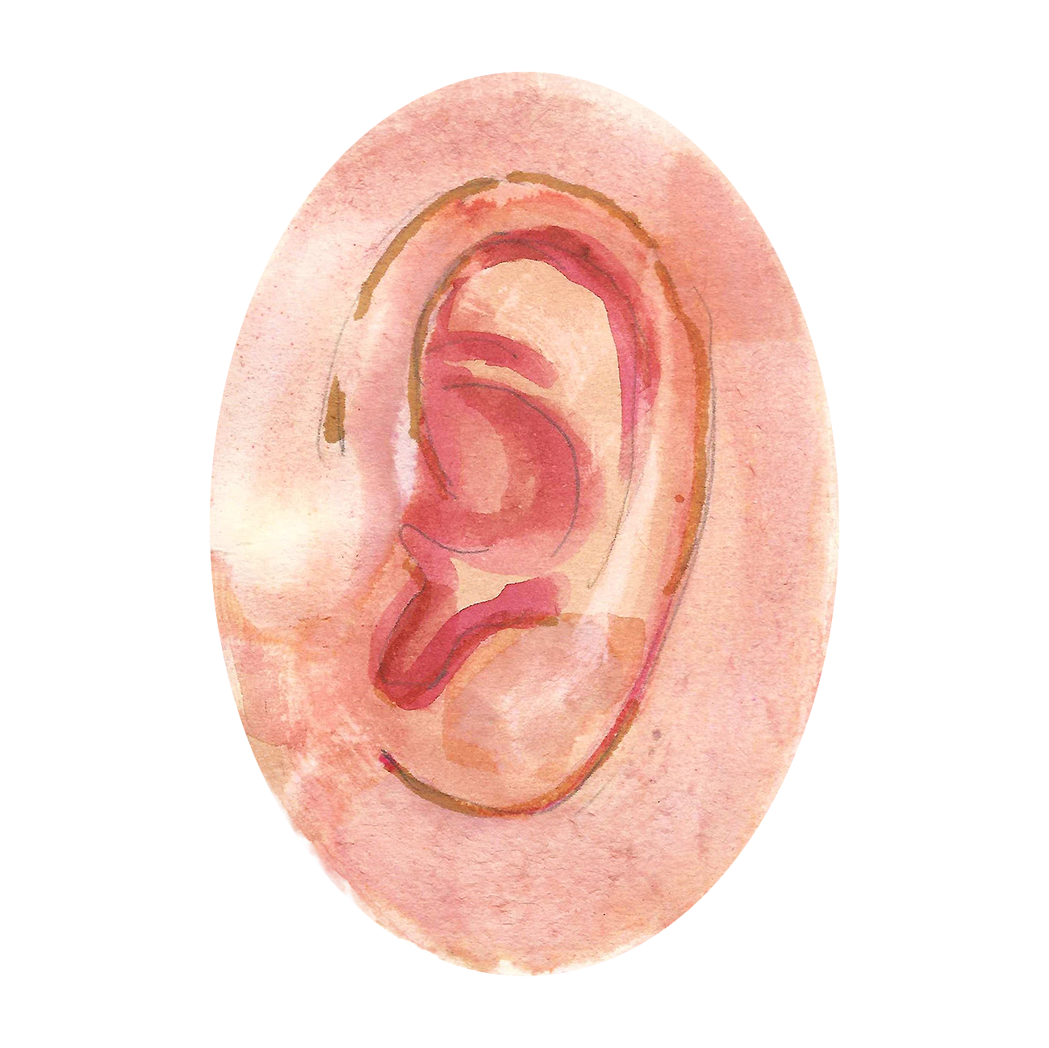
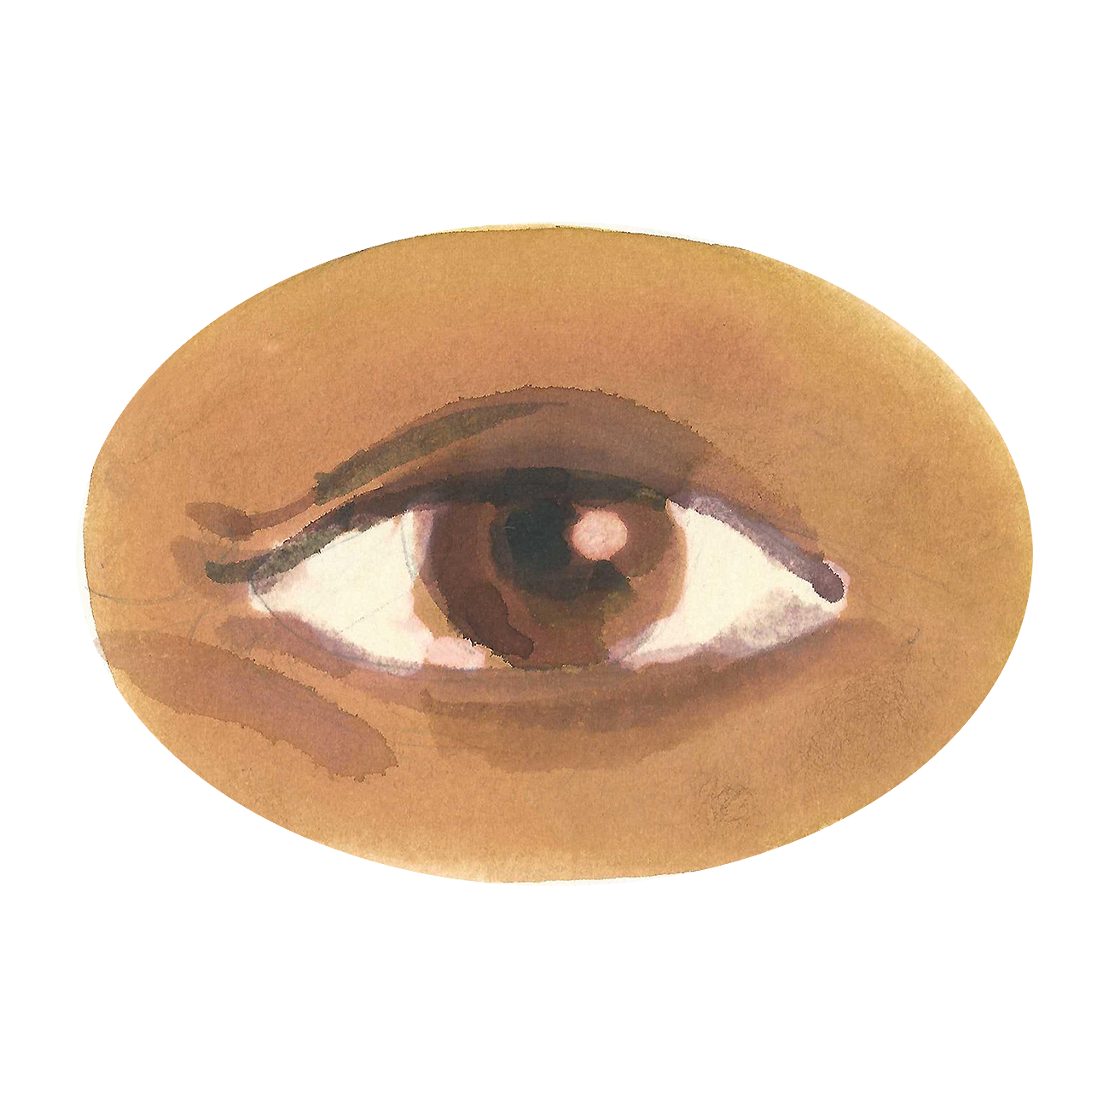
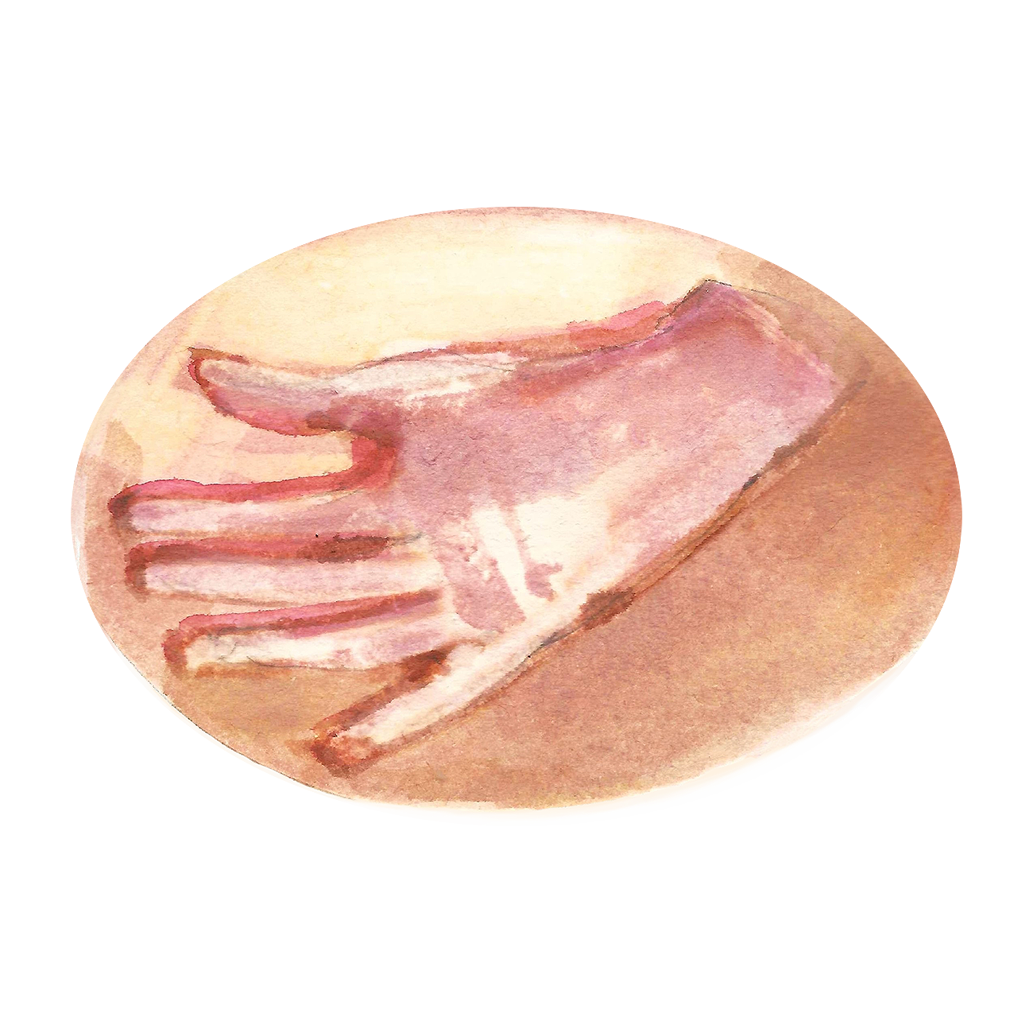
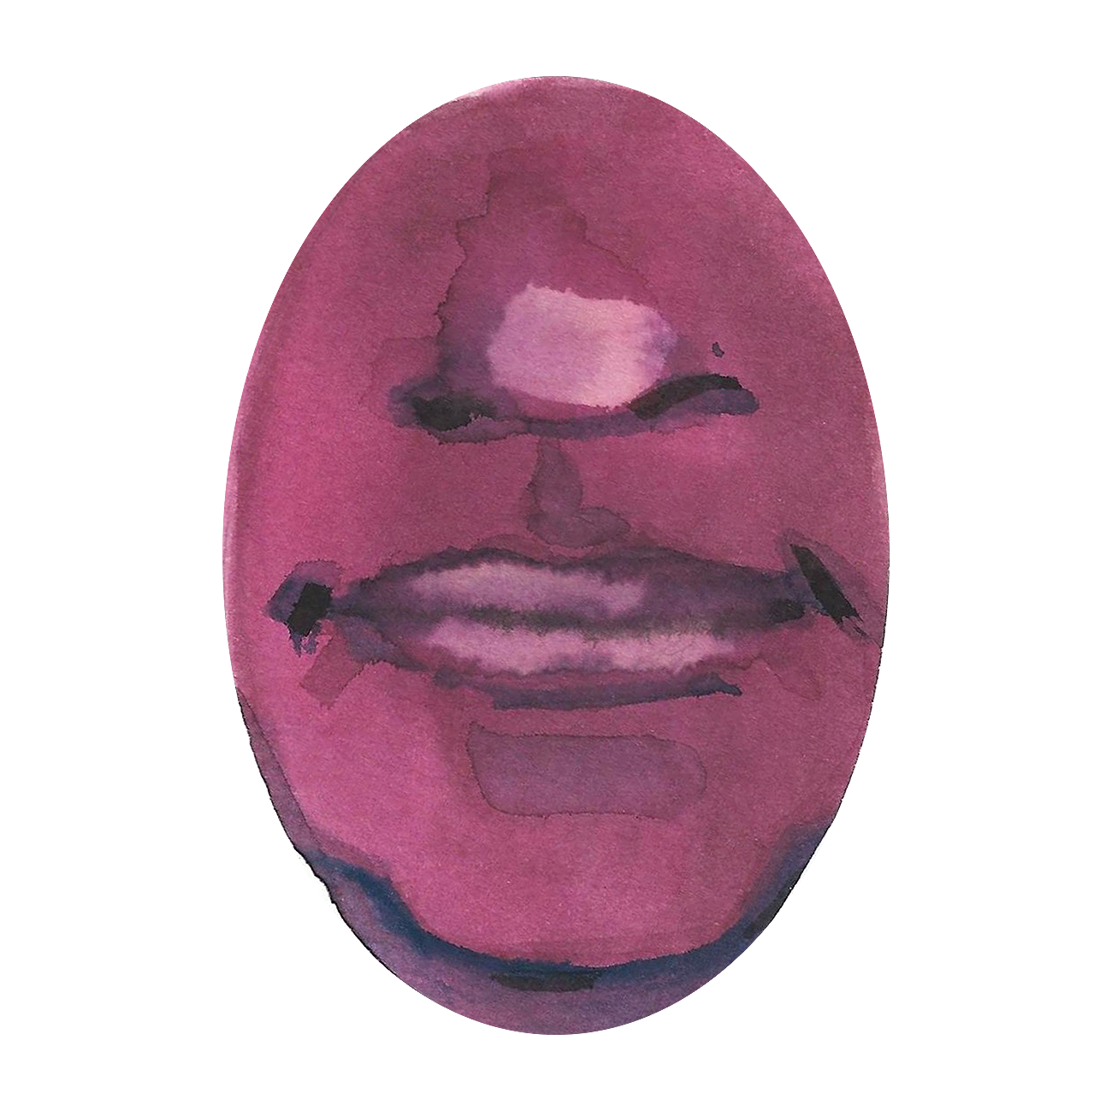
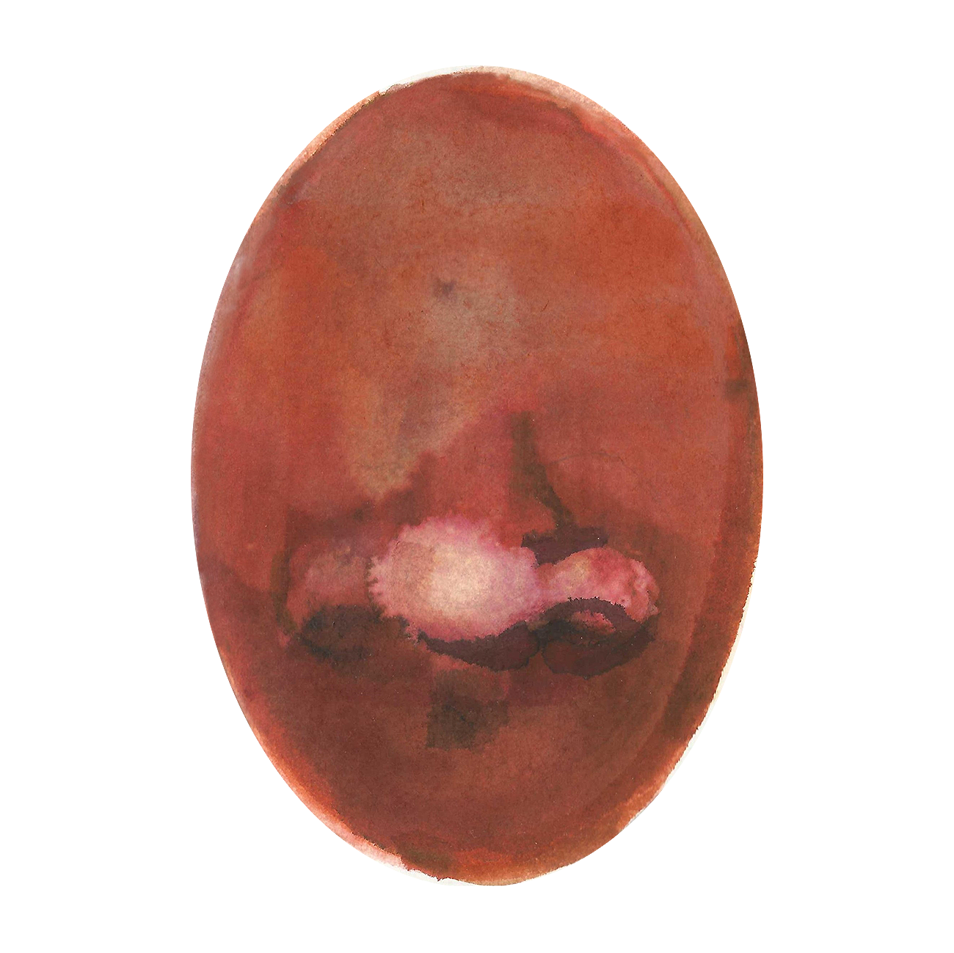
Can anyone tell me what the five senses are?
And which part of our body do we use?

Slide 4
The two golden rules of
No one has to try
No one has to like

Slide 5
Today we are exploring touch and how beans and chickpeas feel different when they are cooked and when they are dry.

Slide 6
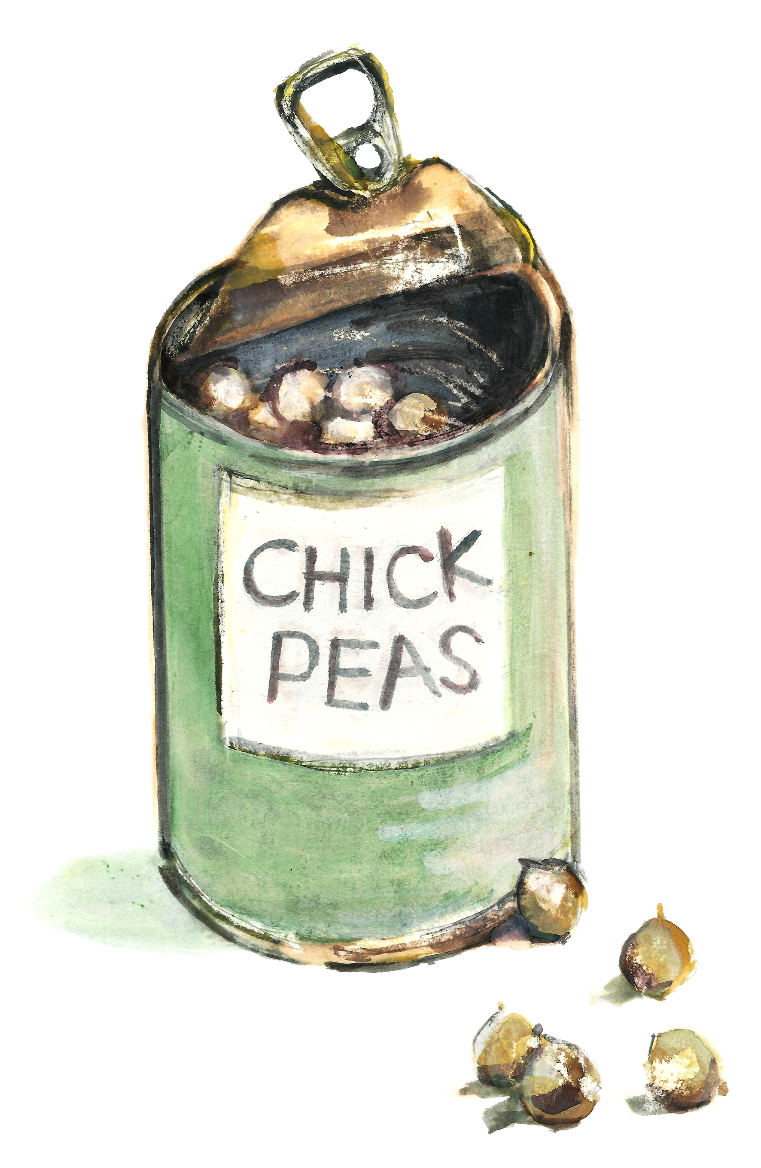
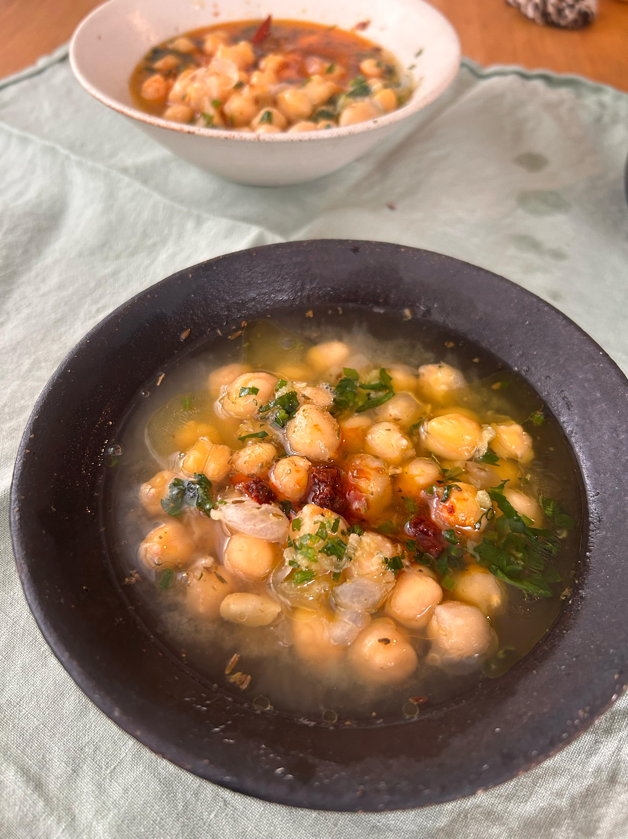
Has anyone ever tried a chickpea?
How did it taste?

Slide 7
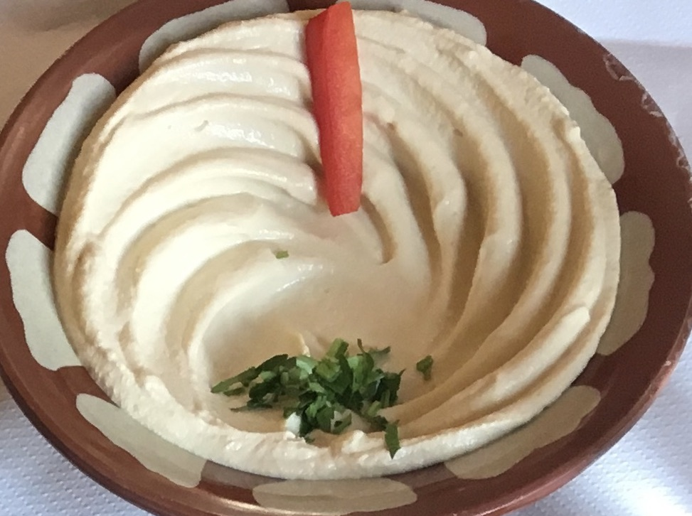
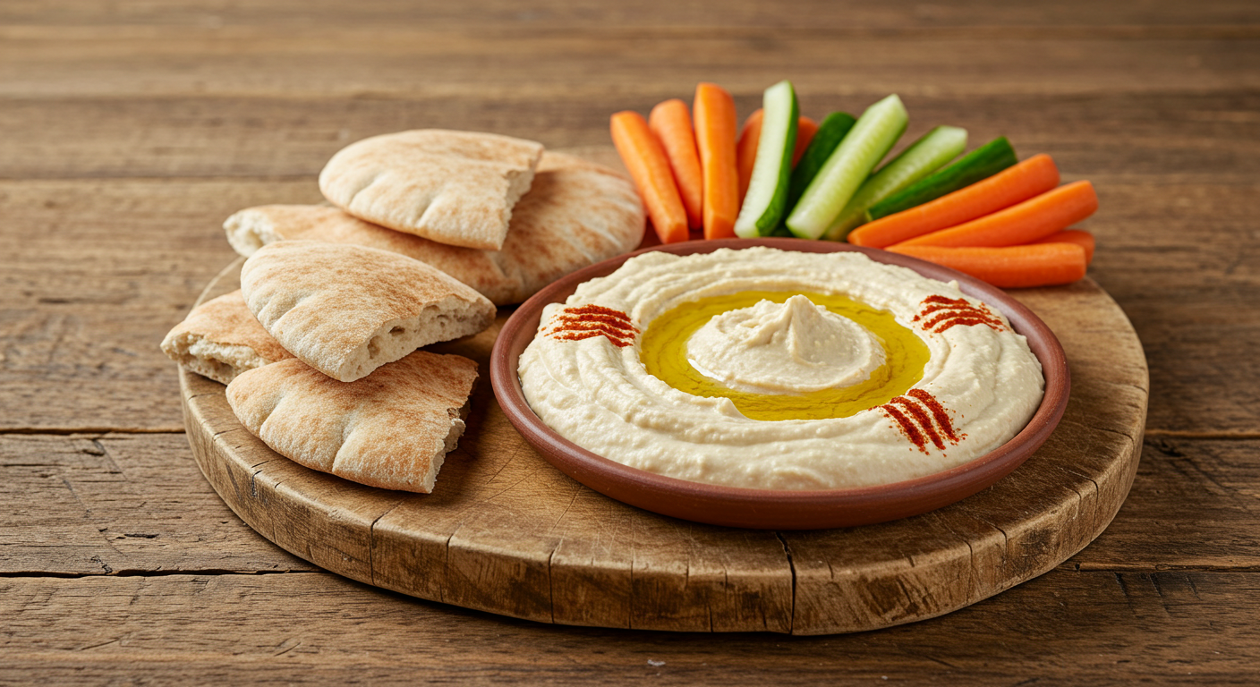
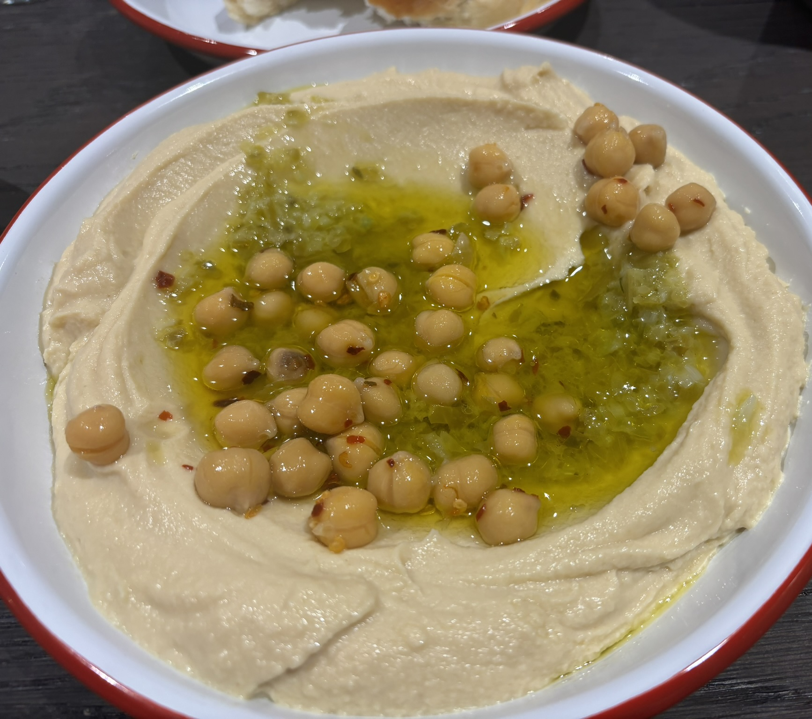
Who likes hummus?
حمص
In Arabic, the word hummus means chickpeas, because hummus is made from chickpeas and tahini (a sesame paste).

Slide 8
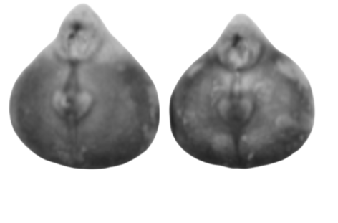
Chickpeas are one of the very oldest crops grown for food by humans.
They have been farmed for at least 10 000 years, starting in Egypt. They were an important protein food.
These are the carbonized remains of some actual chickpeas from Pompeii in AD 79.
Ancient Romans ate chickpeas in soup or in a wine sauce.

Slide 9
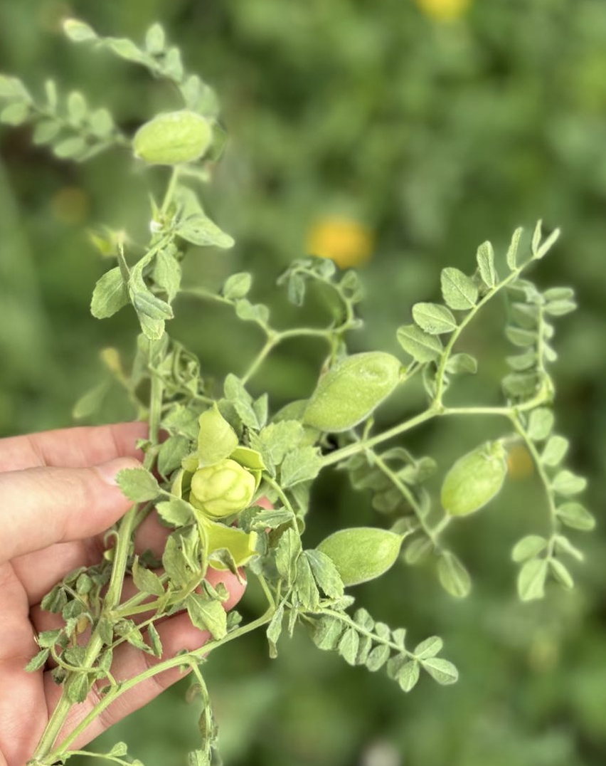
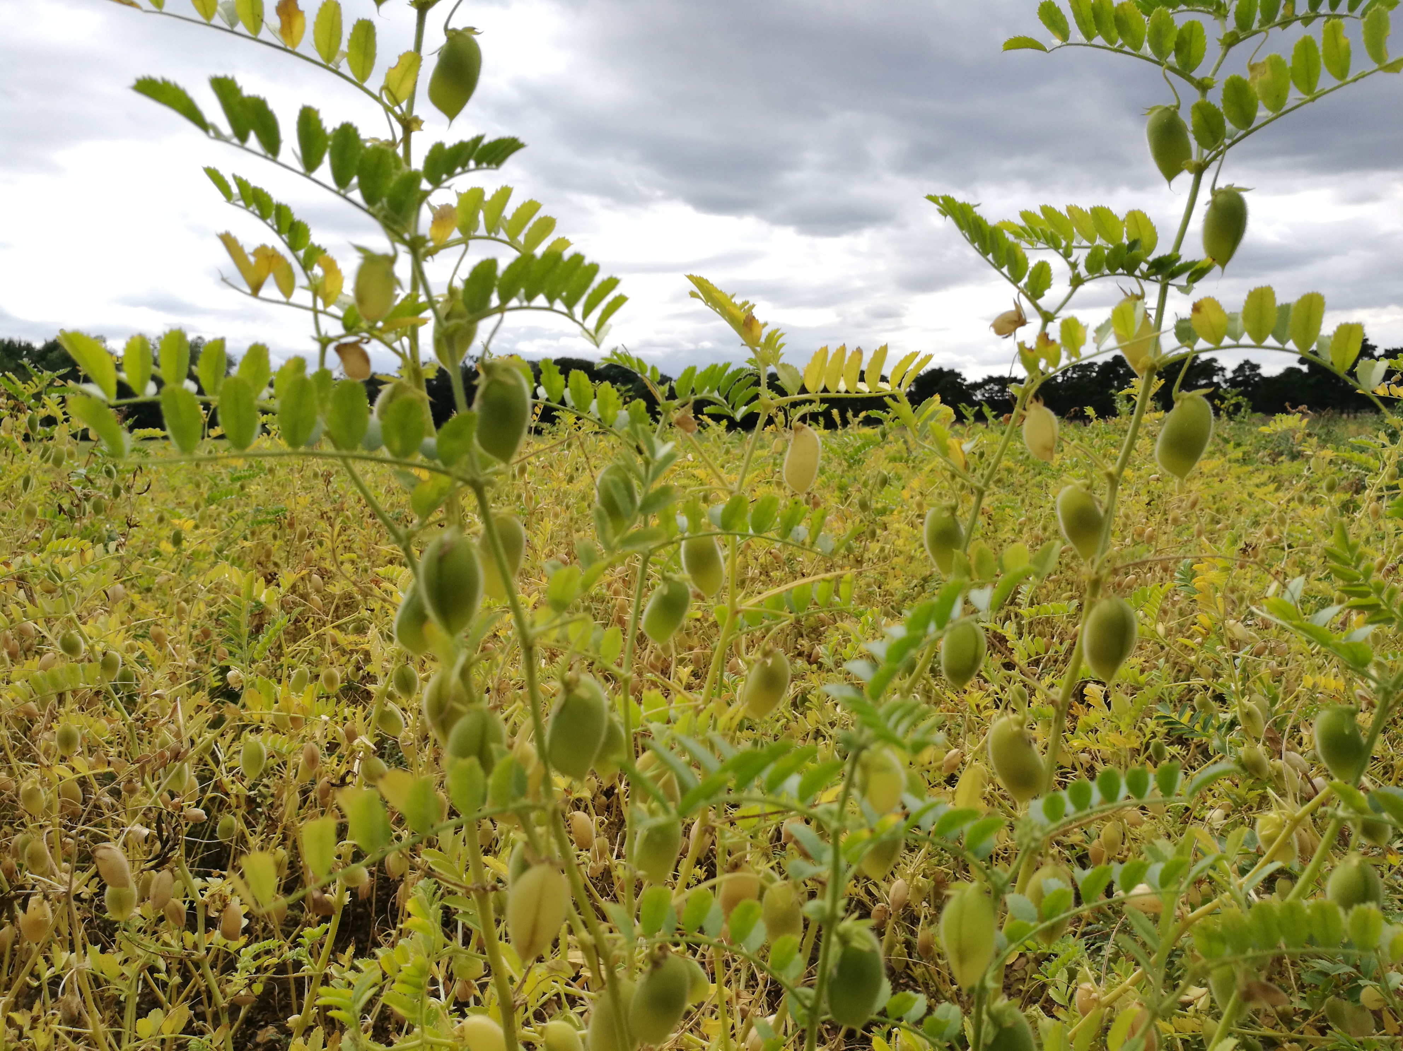
When a chickpea is growing, it looks like this.
What do you notice about the chickpeas growing on the plant?

Slide 10
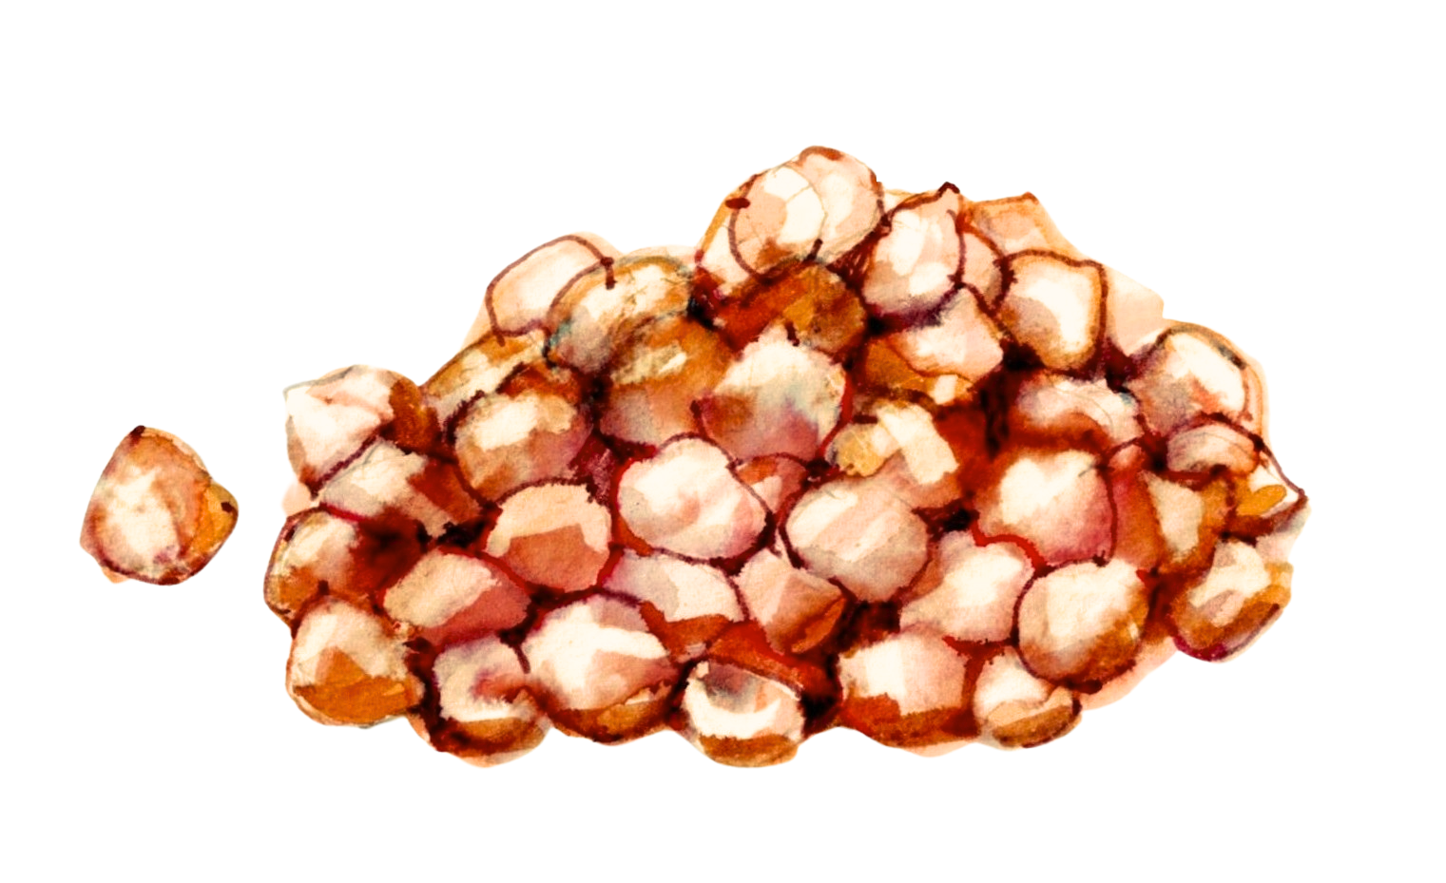
Chickpeas are a very sustainable crop!
Most crops take nutrients out of the soil. But chickpeas (and other beans actually give nutrients to the soil).
Chickpeas fix nitrogen in the soil, acting as a natural fertilizer.

Slide 11
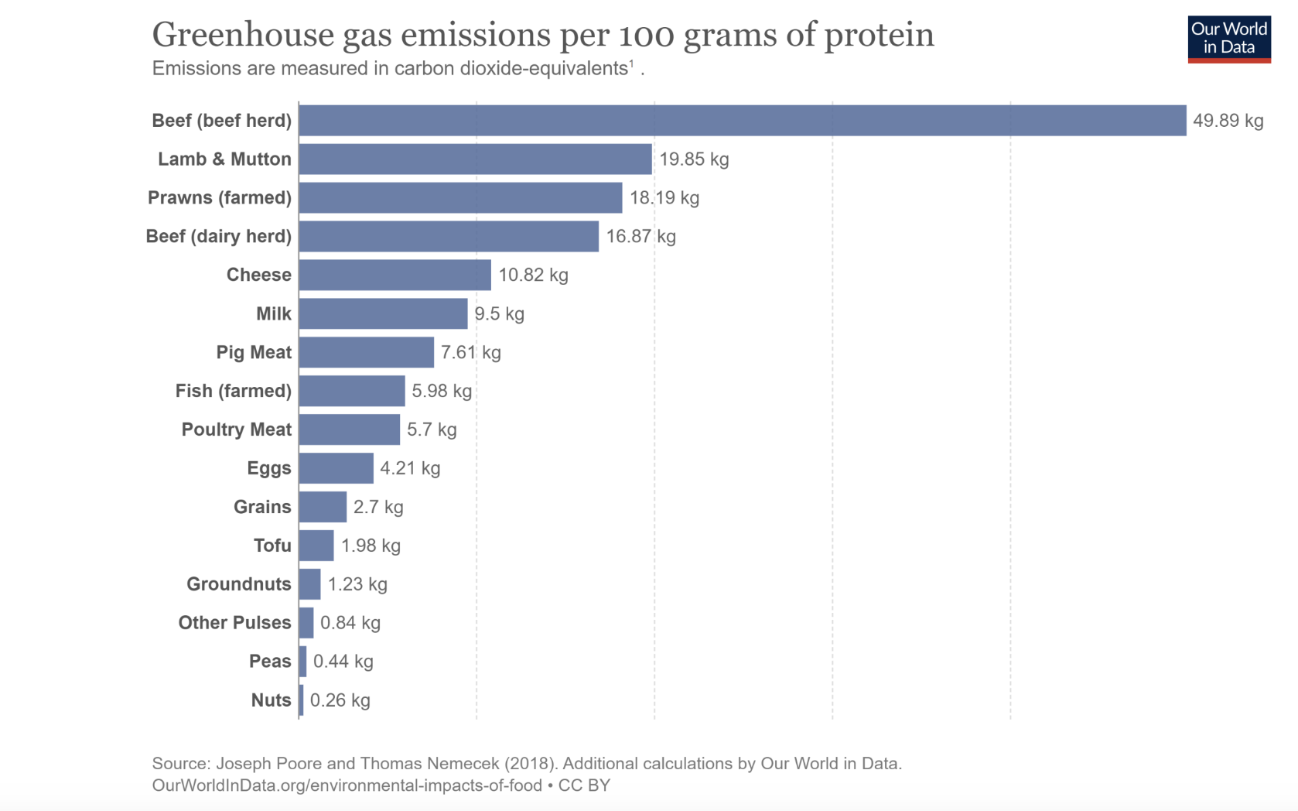
Compared to other high protein foods, chickpeas and other pulses or beans create very low greenhouse gas emissions to produce 100g of protein.

Slide 12
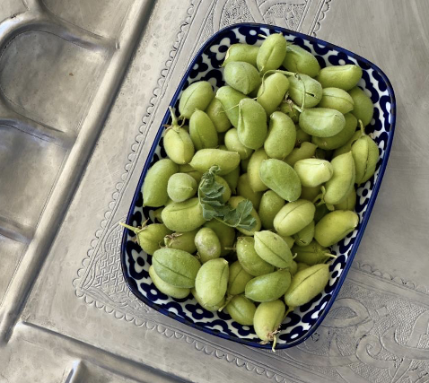
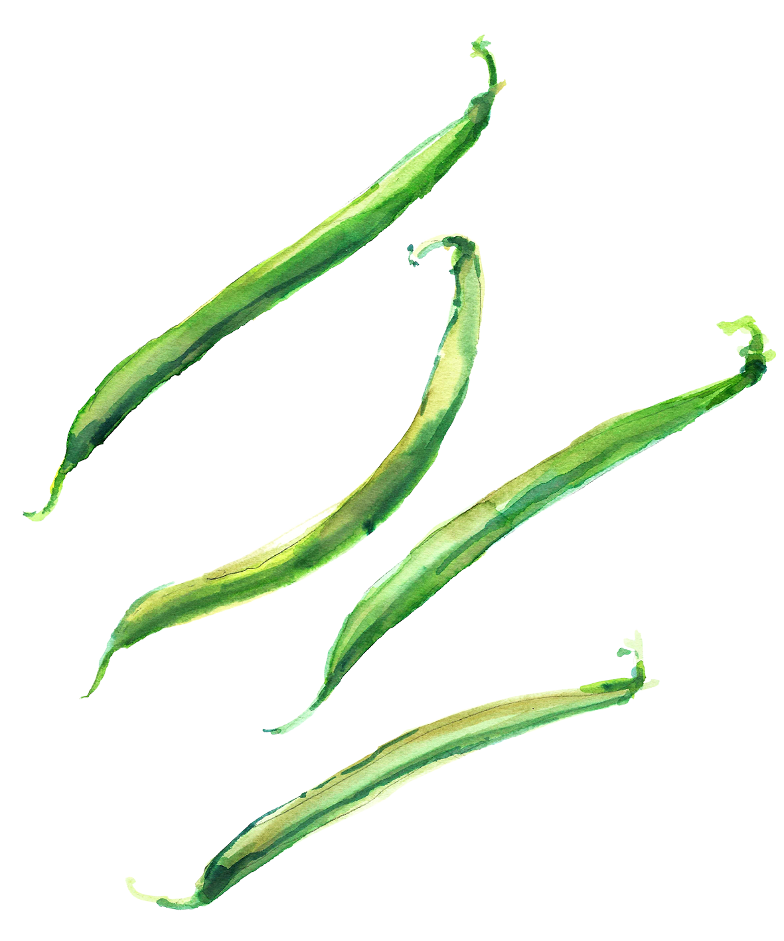
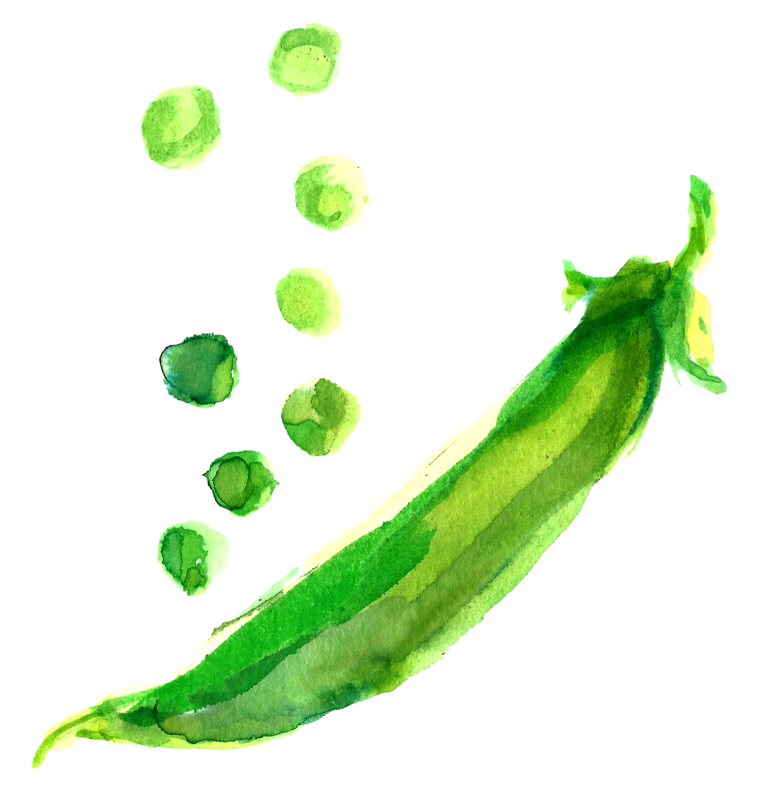
Fresh chickpeas are green and juicy inside the pod!
Sometimes they are sold frozen in bags like peas in Indian food shops. They are called ‘green chana’
Can we think of any other fresh green beans or peas?

Slide 13
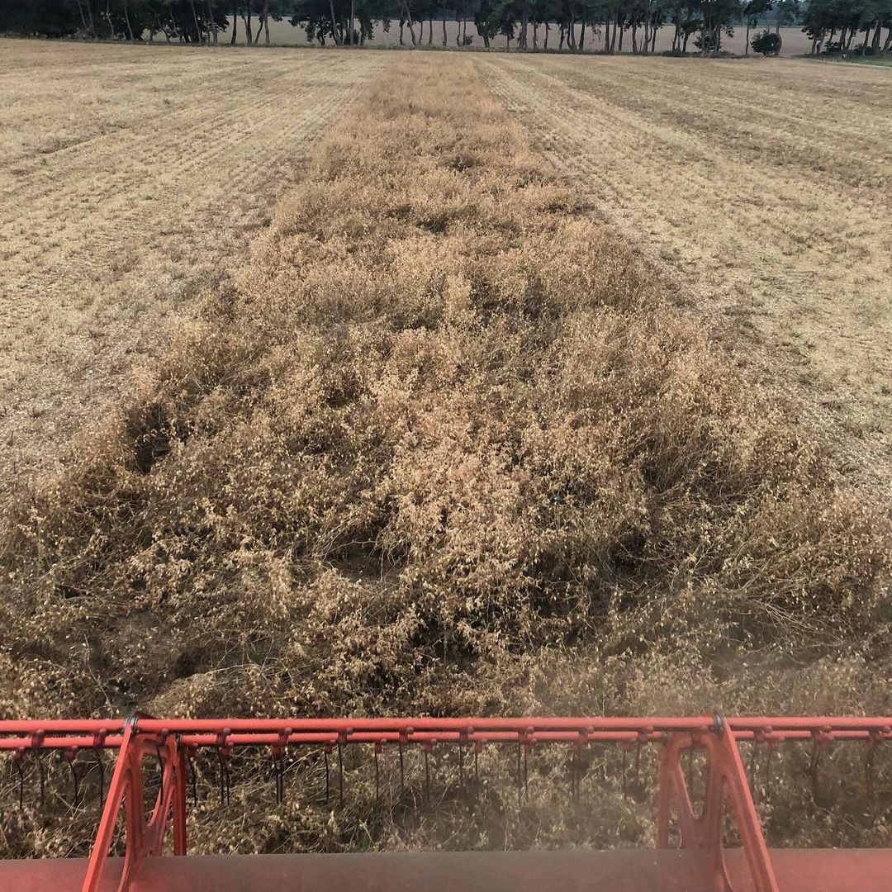
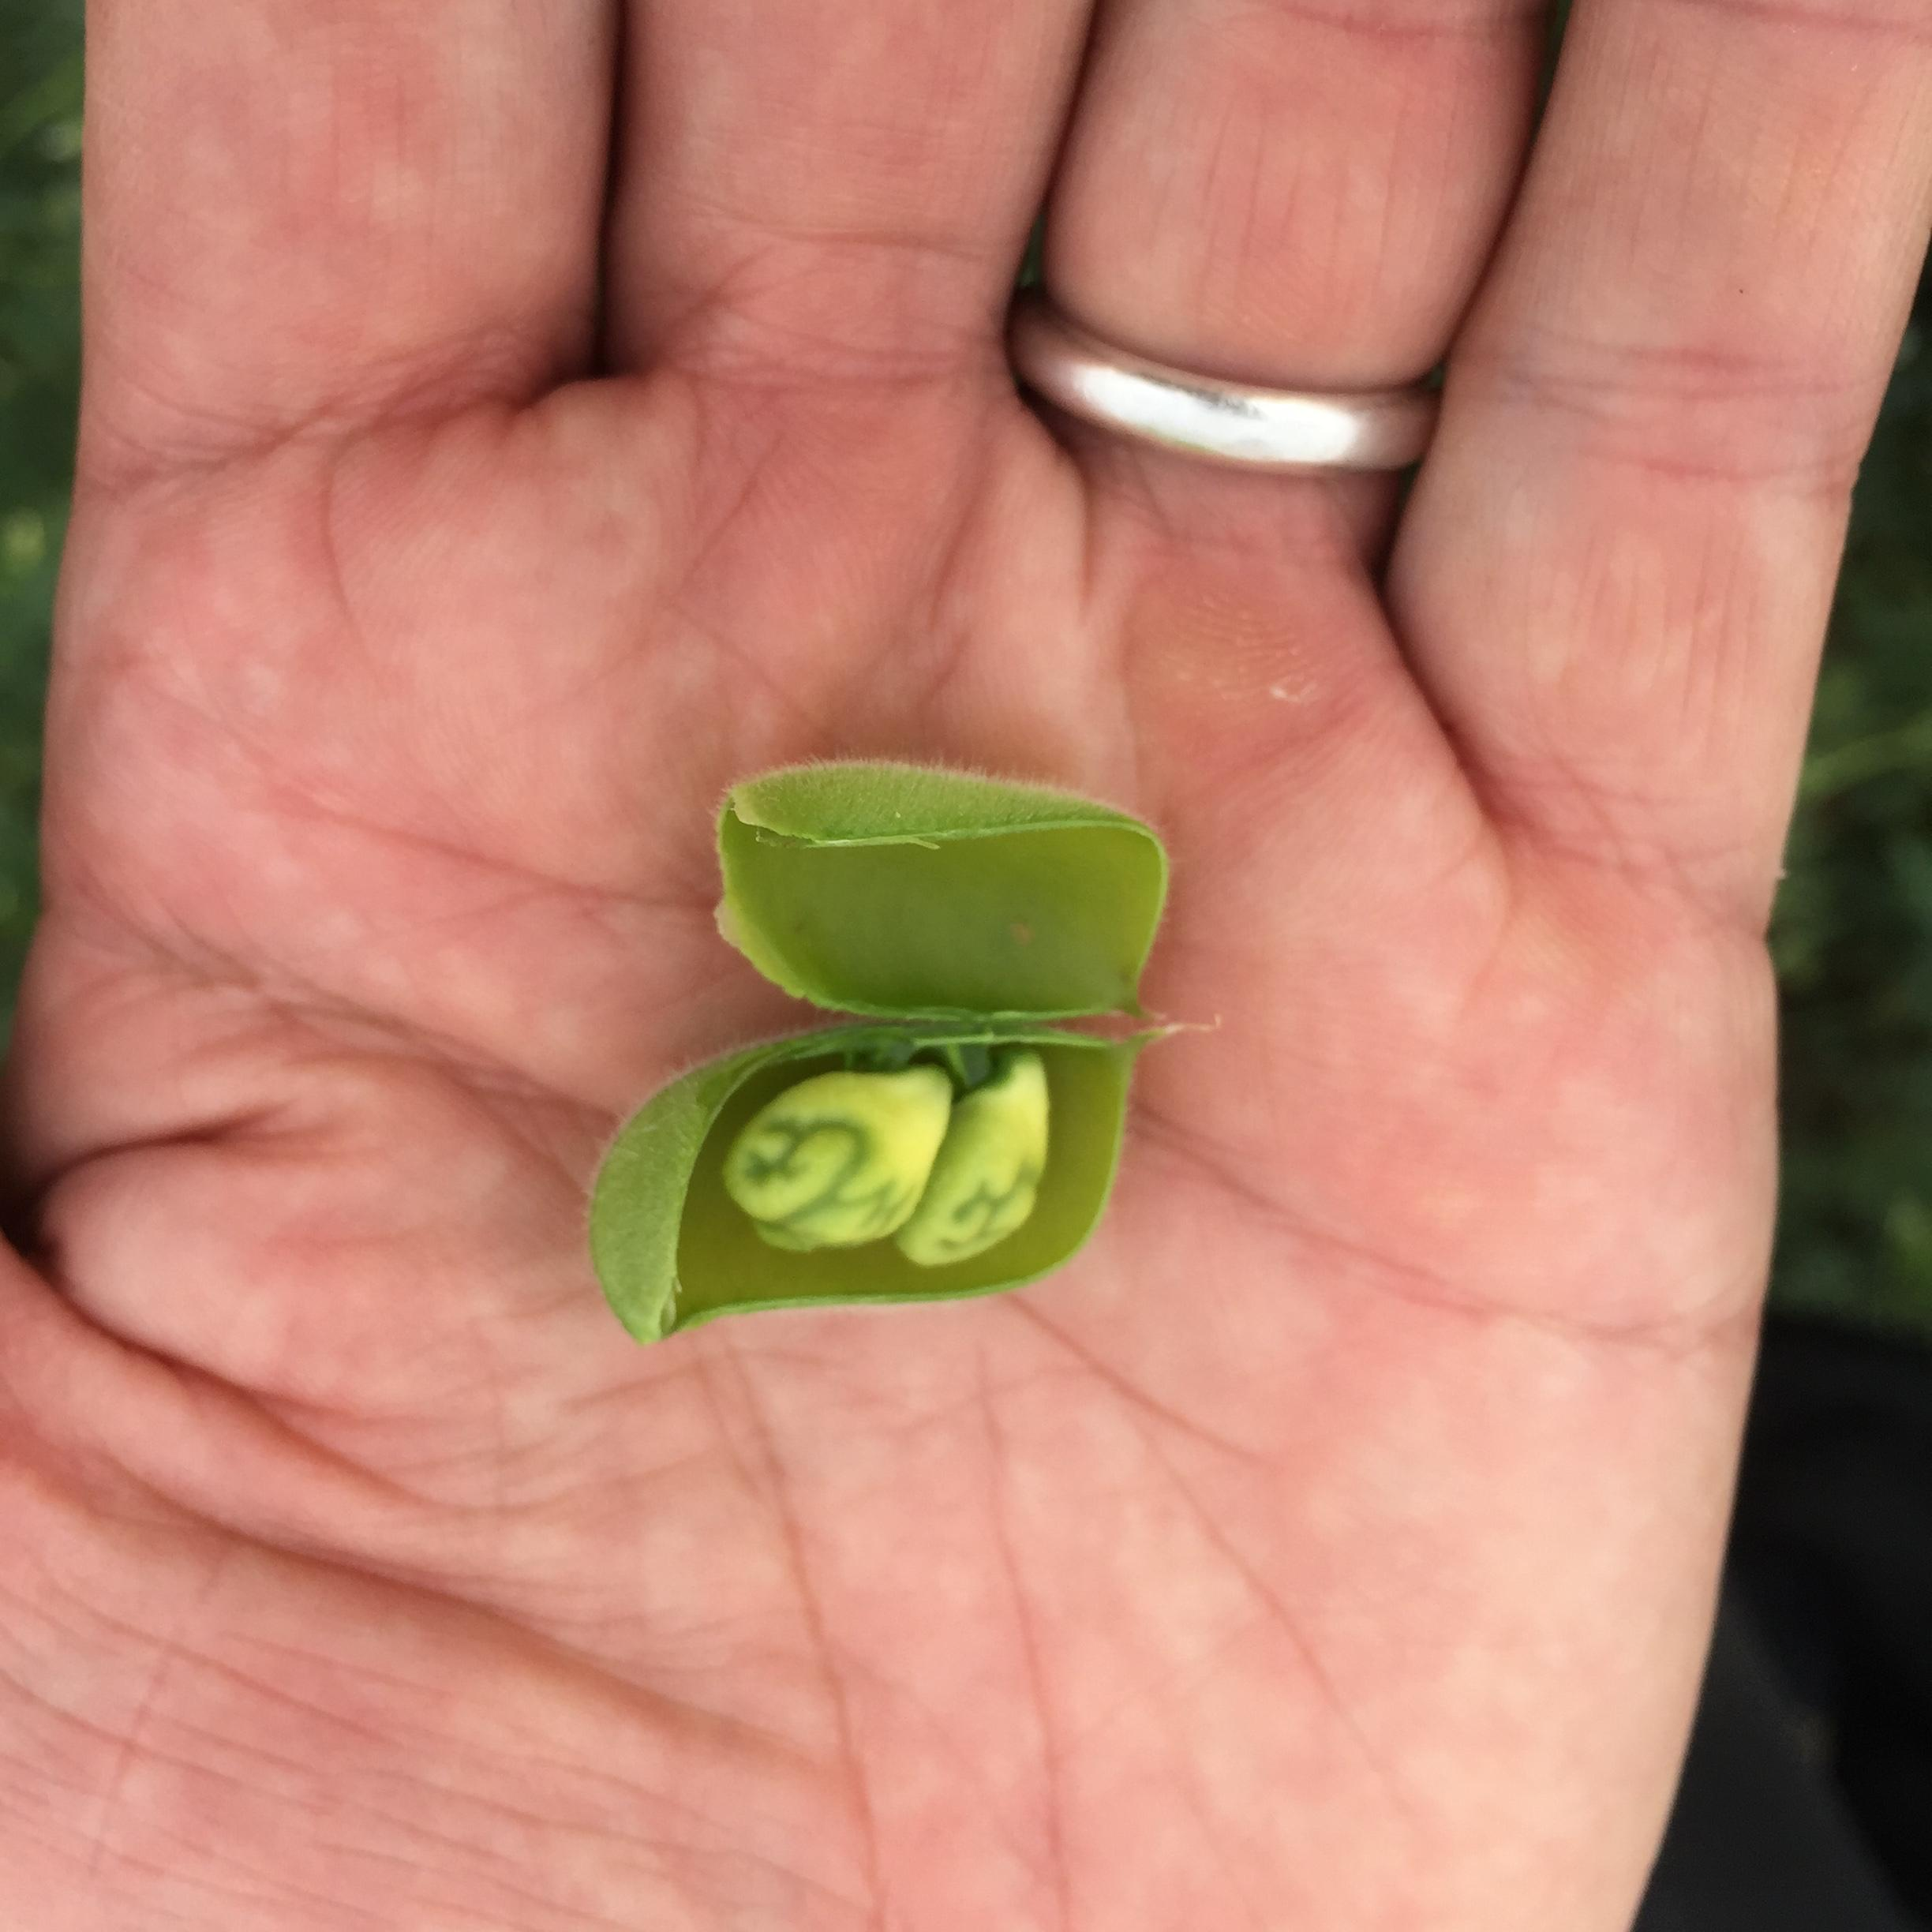
A chickpea is actually a seed. It grows in a pod like a pea. Farmers mostly wait until these green pods turn golden and dry to harvest them, although in Lebanon and other countries, people also enjoy them fresh.
Chickpeas being harvested

Slide 14
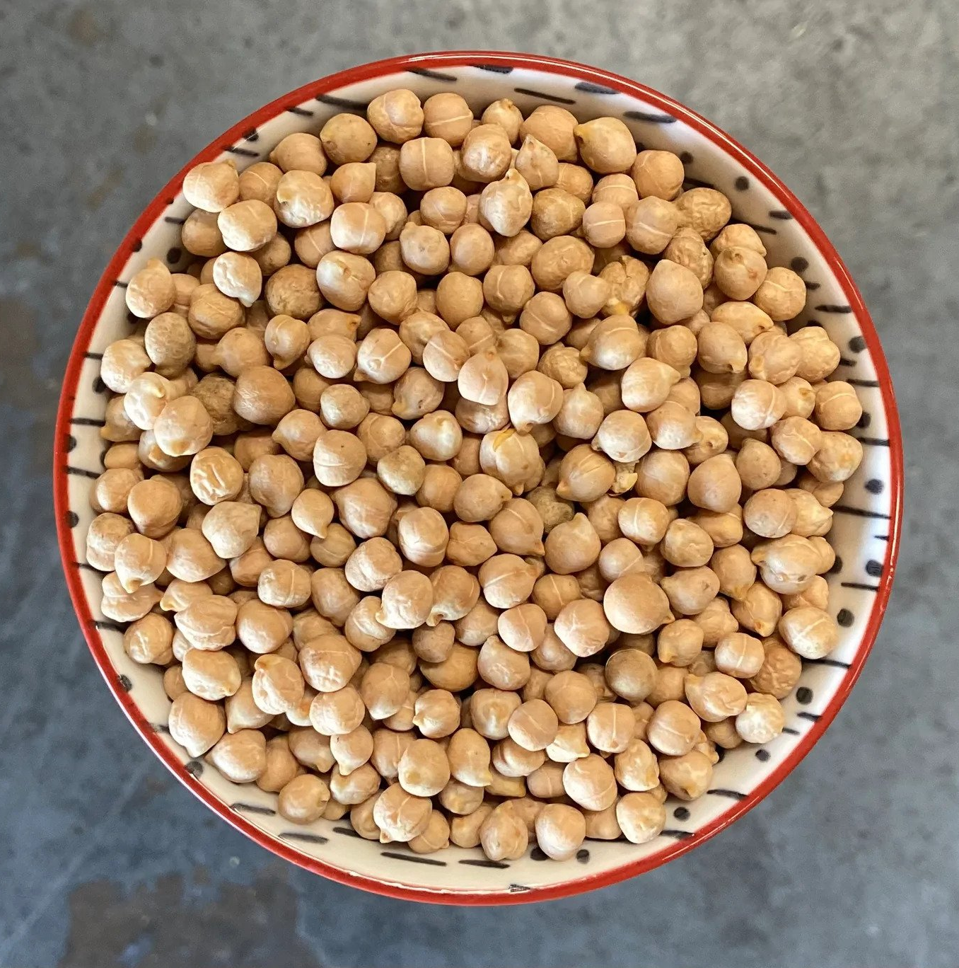
The chickpeas we usually see in our shops are dried.
The colour turns from green to golden brown.
How do these dry chickpeas feel in your hand?

Slide 15
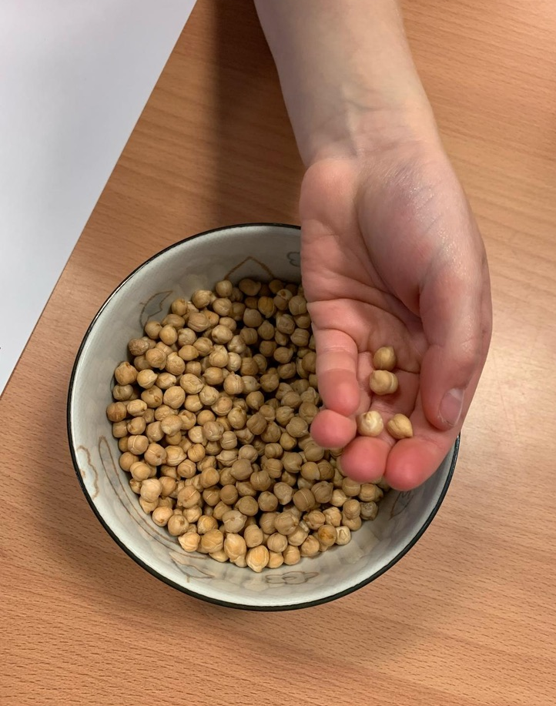
As well as the reasons we talked about before, why else do you think dried chickpeas are a sustainable food?
Do you need to keep them in the fridge?

Slide 16
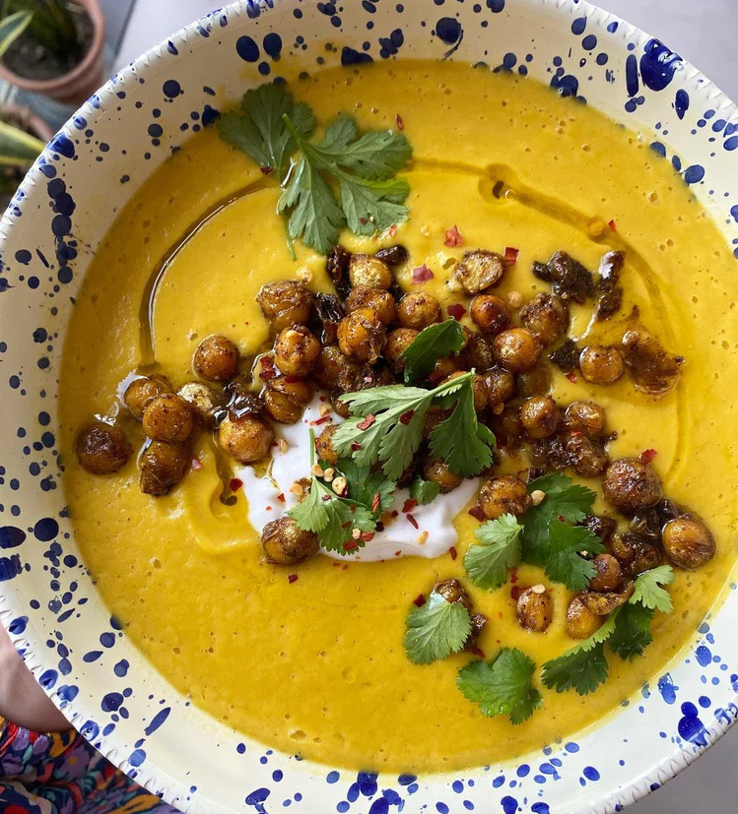
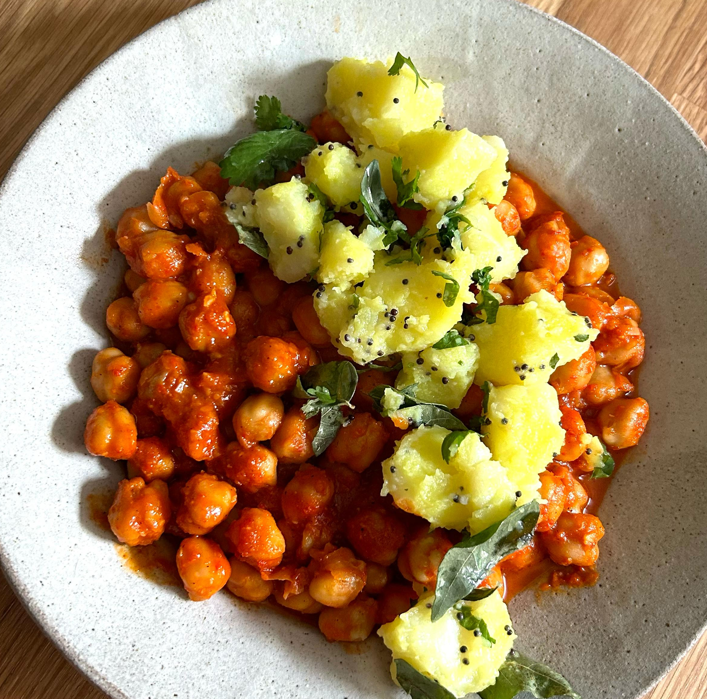
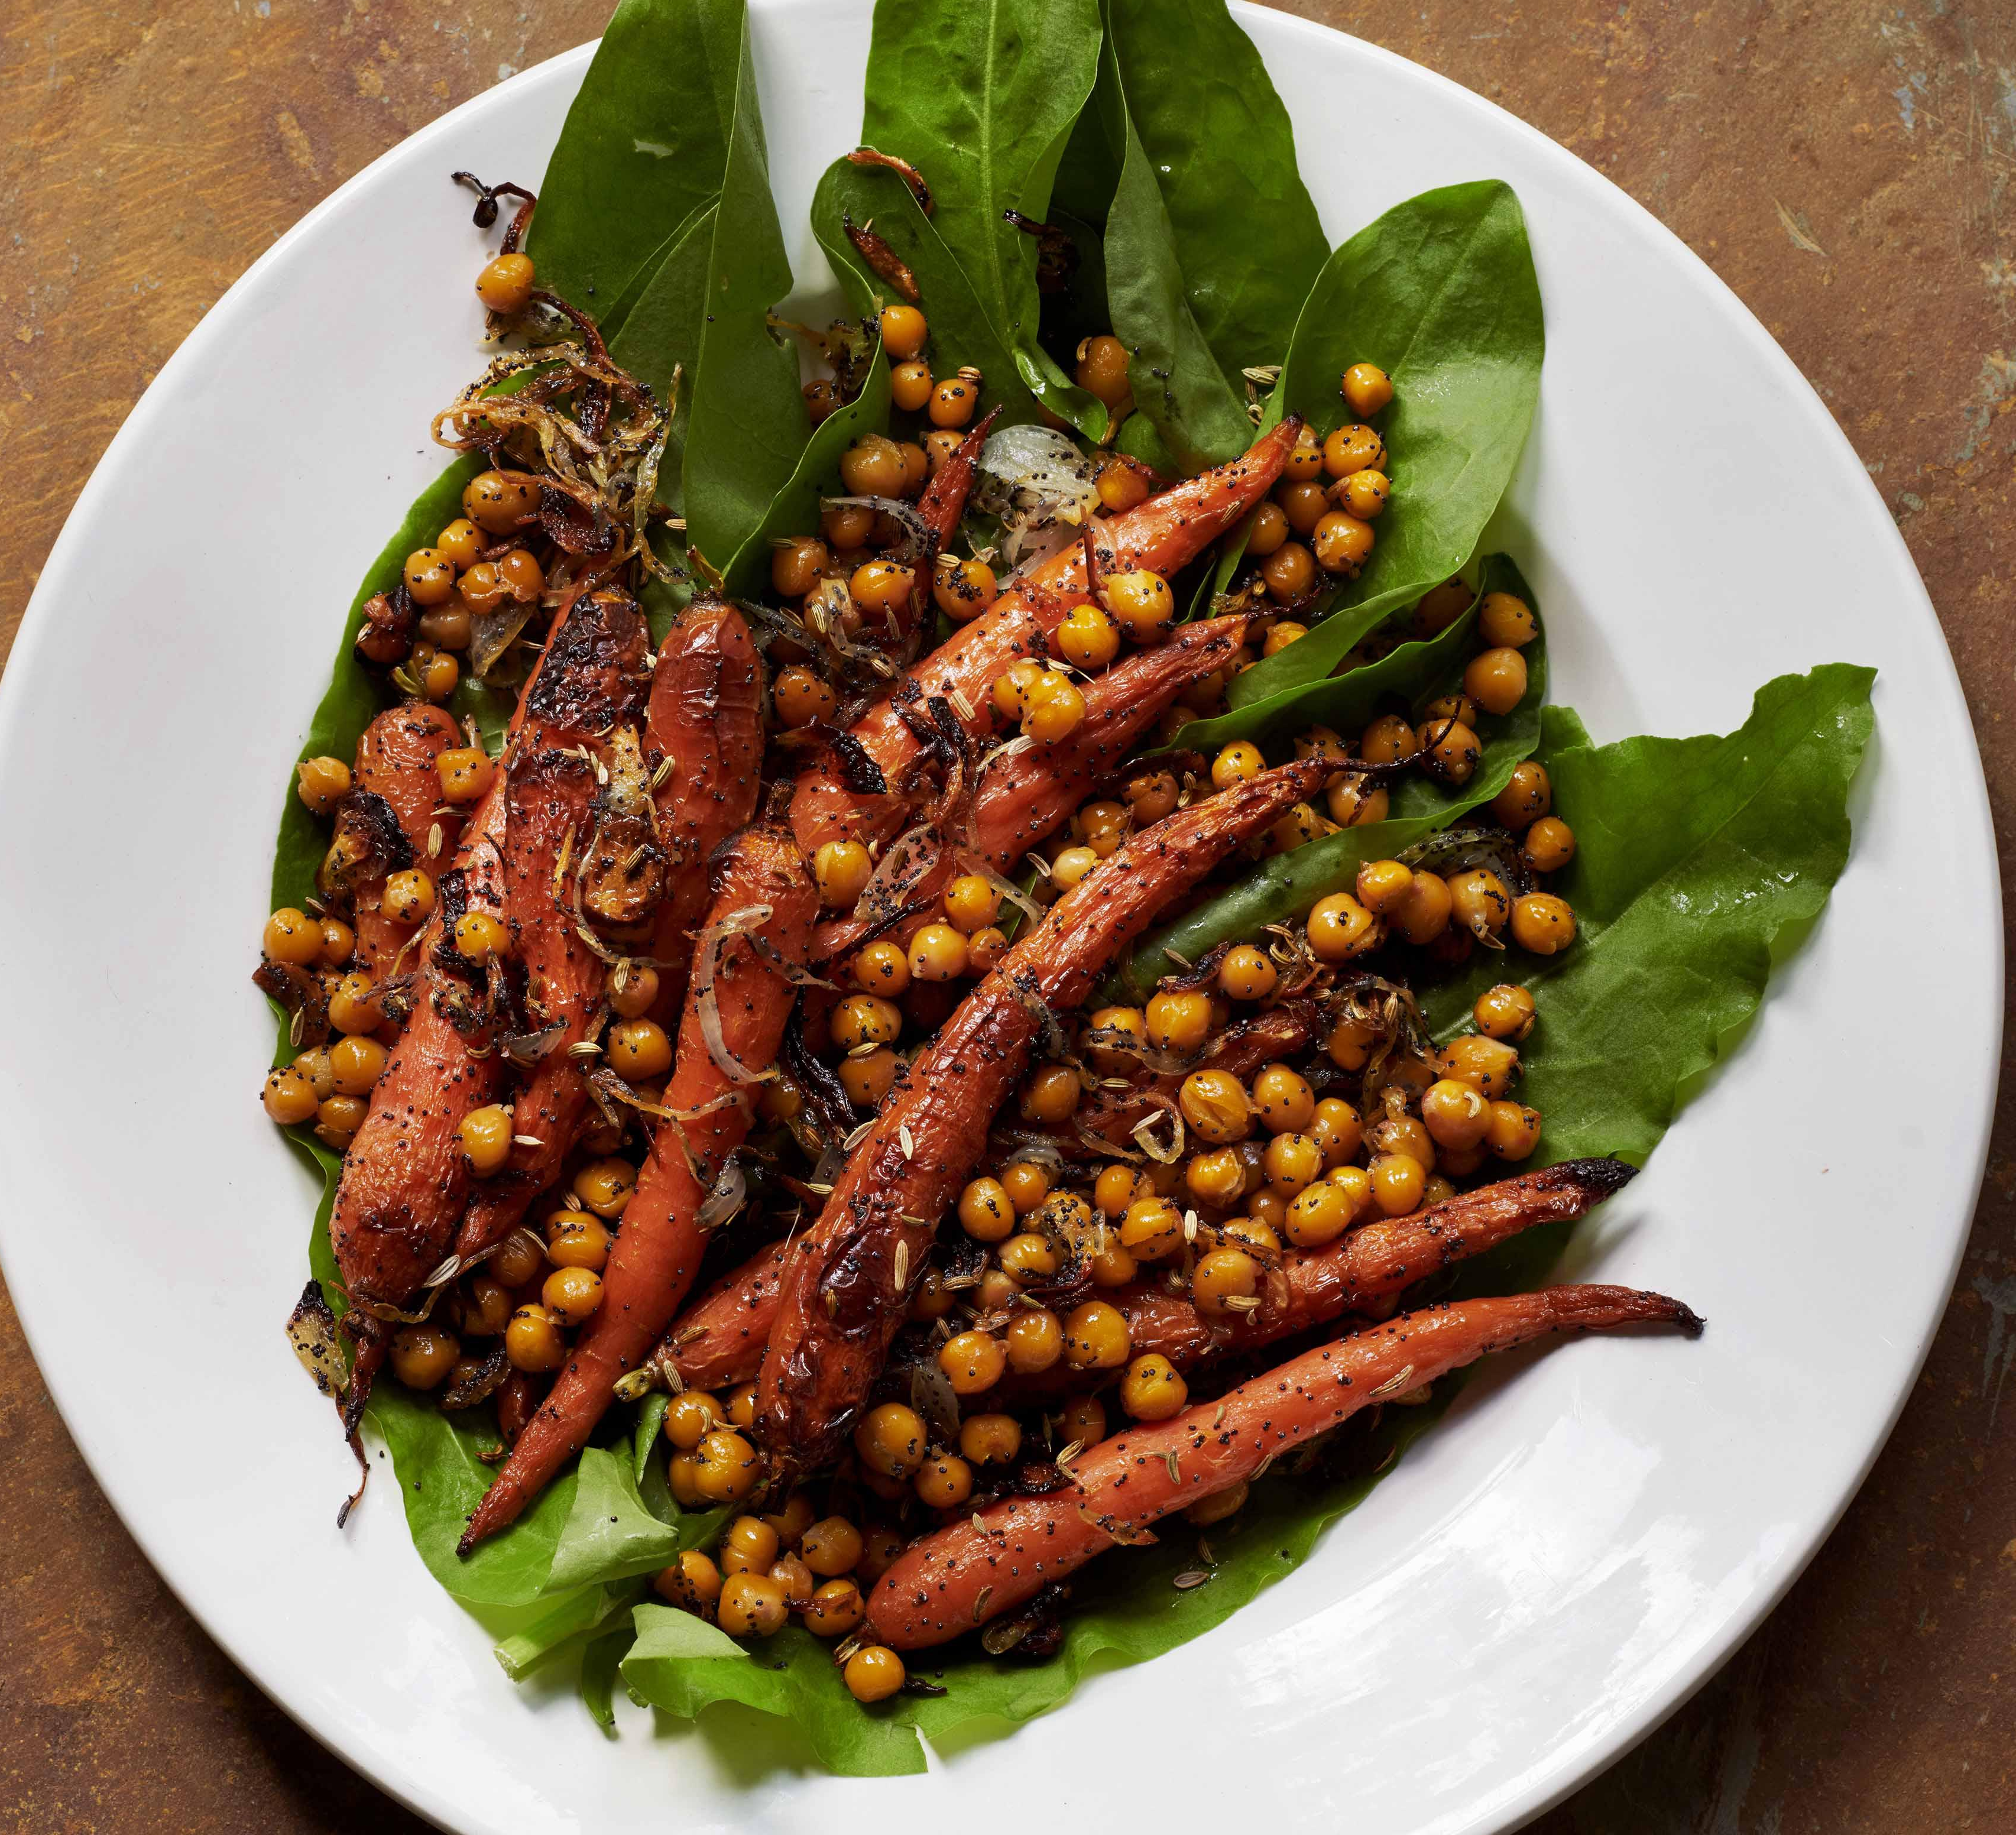
When dried chickpeas are soaked and boiled, they go soft again. Cooked chickpeas are often sold in cans or bottles, ready to cook with.
Does anyone eat chickpeas at home?

Slide 17
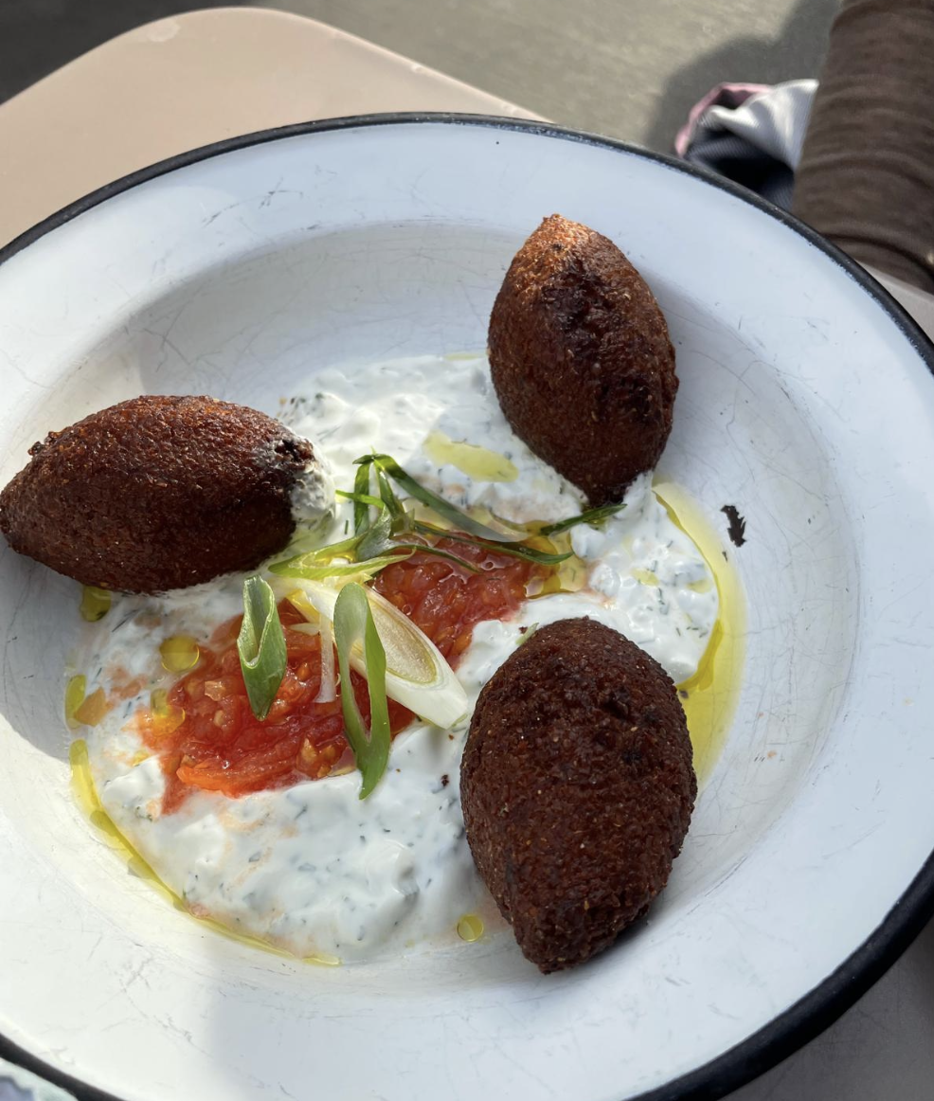
There are many delicious dishes made from chickpeas.
Falafel are tasty snacks made from soaked dried chickpeas, mixed with spices, shaped and fried.

Slide 18
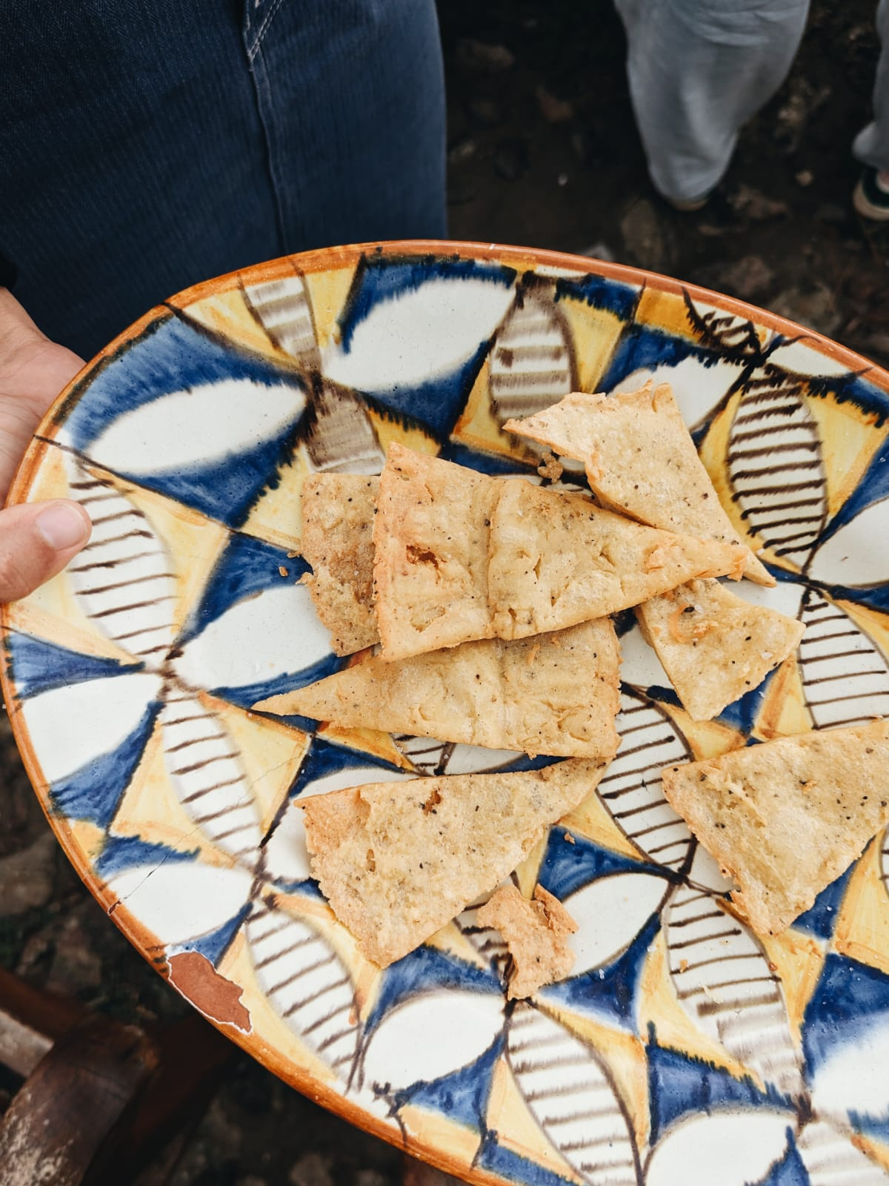
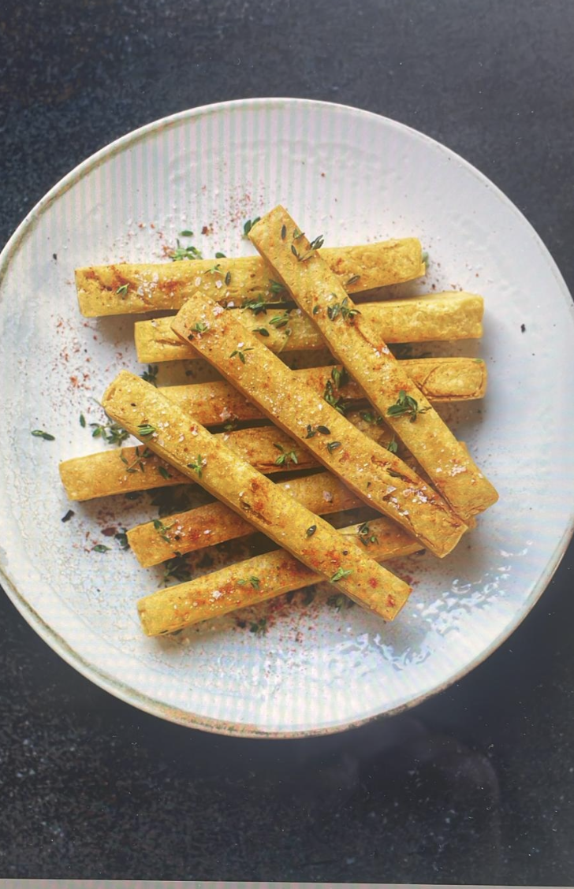
There are also dishes made from chickpea flour.
These look like chips but they are actually something from France called Panisse made from chickpea flour!
In Italy, cooks make these chickpea crackers called panelle.

Slide 19
Dried chickpeas need to be cooked before eating.
You can get chickpeas in jars and tins, ready to eat.

Slide 20
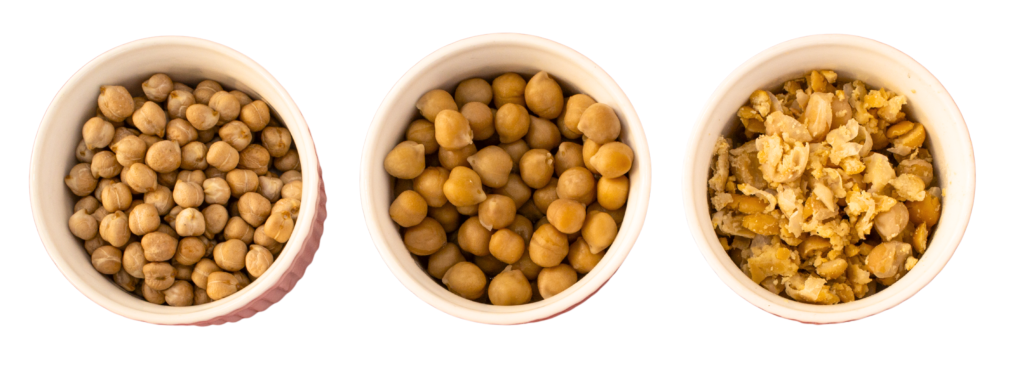
Let’s feel these cooked chickpeas.
How do they feel? How are they different from the dried ones? Can you mash them?

Slide 21
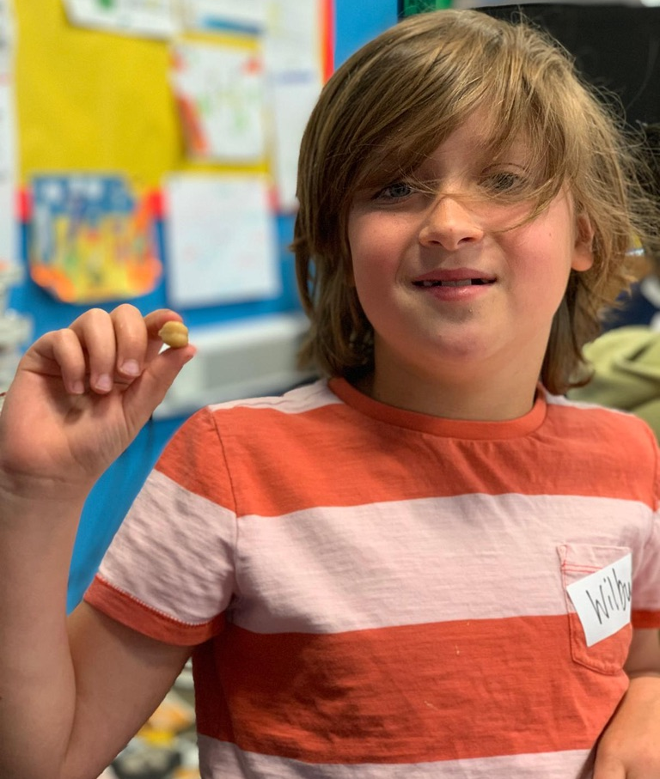
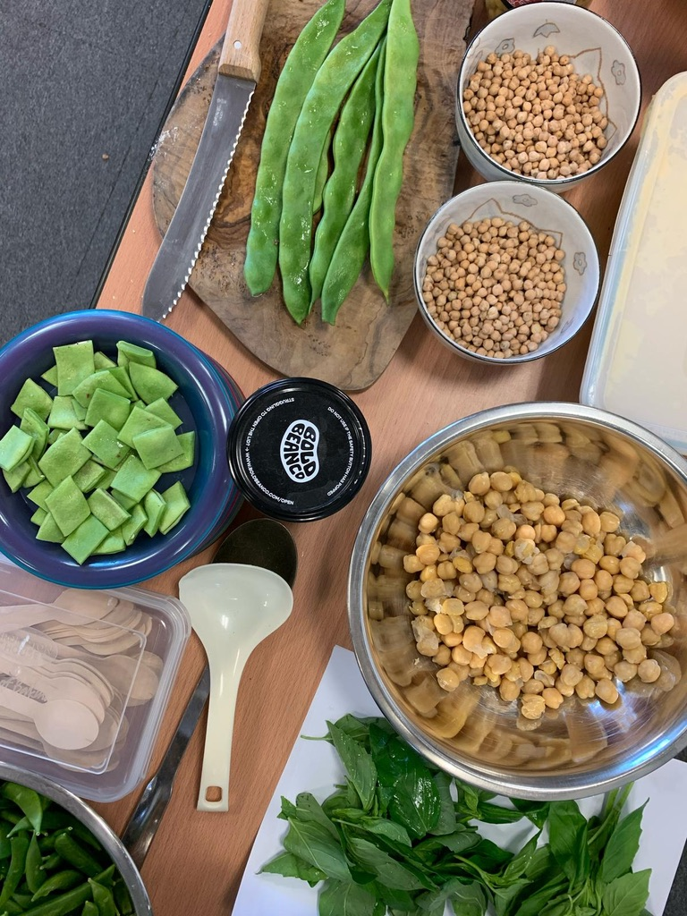
Now shall we taste the chickpeas (and hummus and peas)?

Slide 22
How did the chickpeas feel in your mouth?
Can you describe the texture and write it down?
Were they wet or dry?
Juicy or hard?

Slide 23
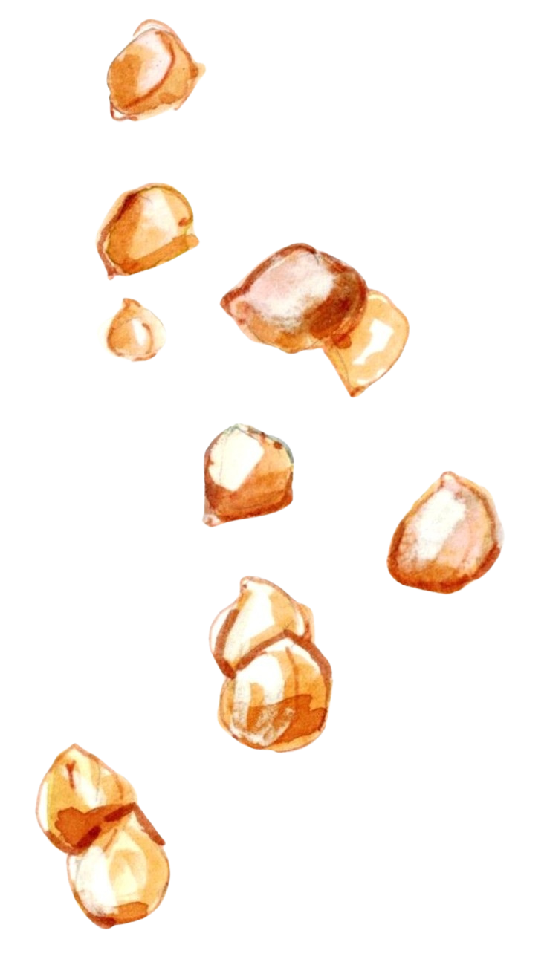
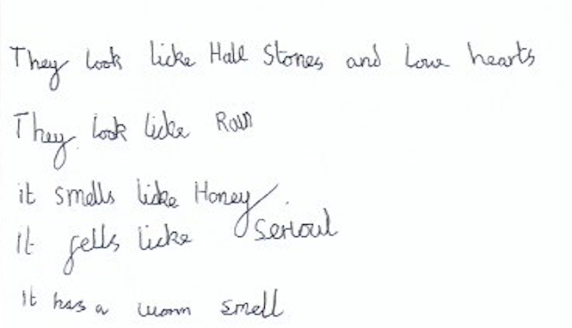
How did the chickpeas and hummus taste to you?

Slide 24
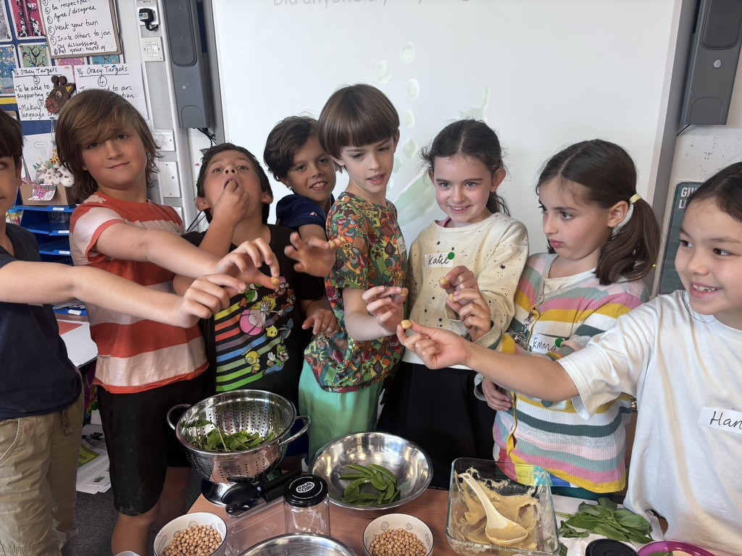
Did anyone try anything new today?

Slide 25
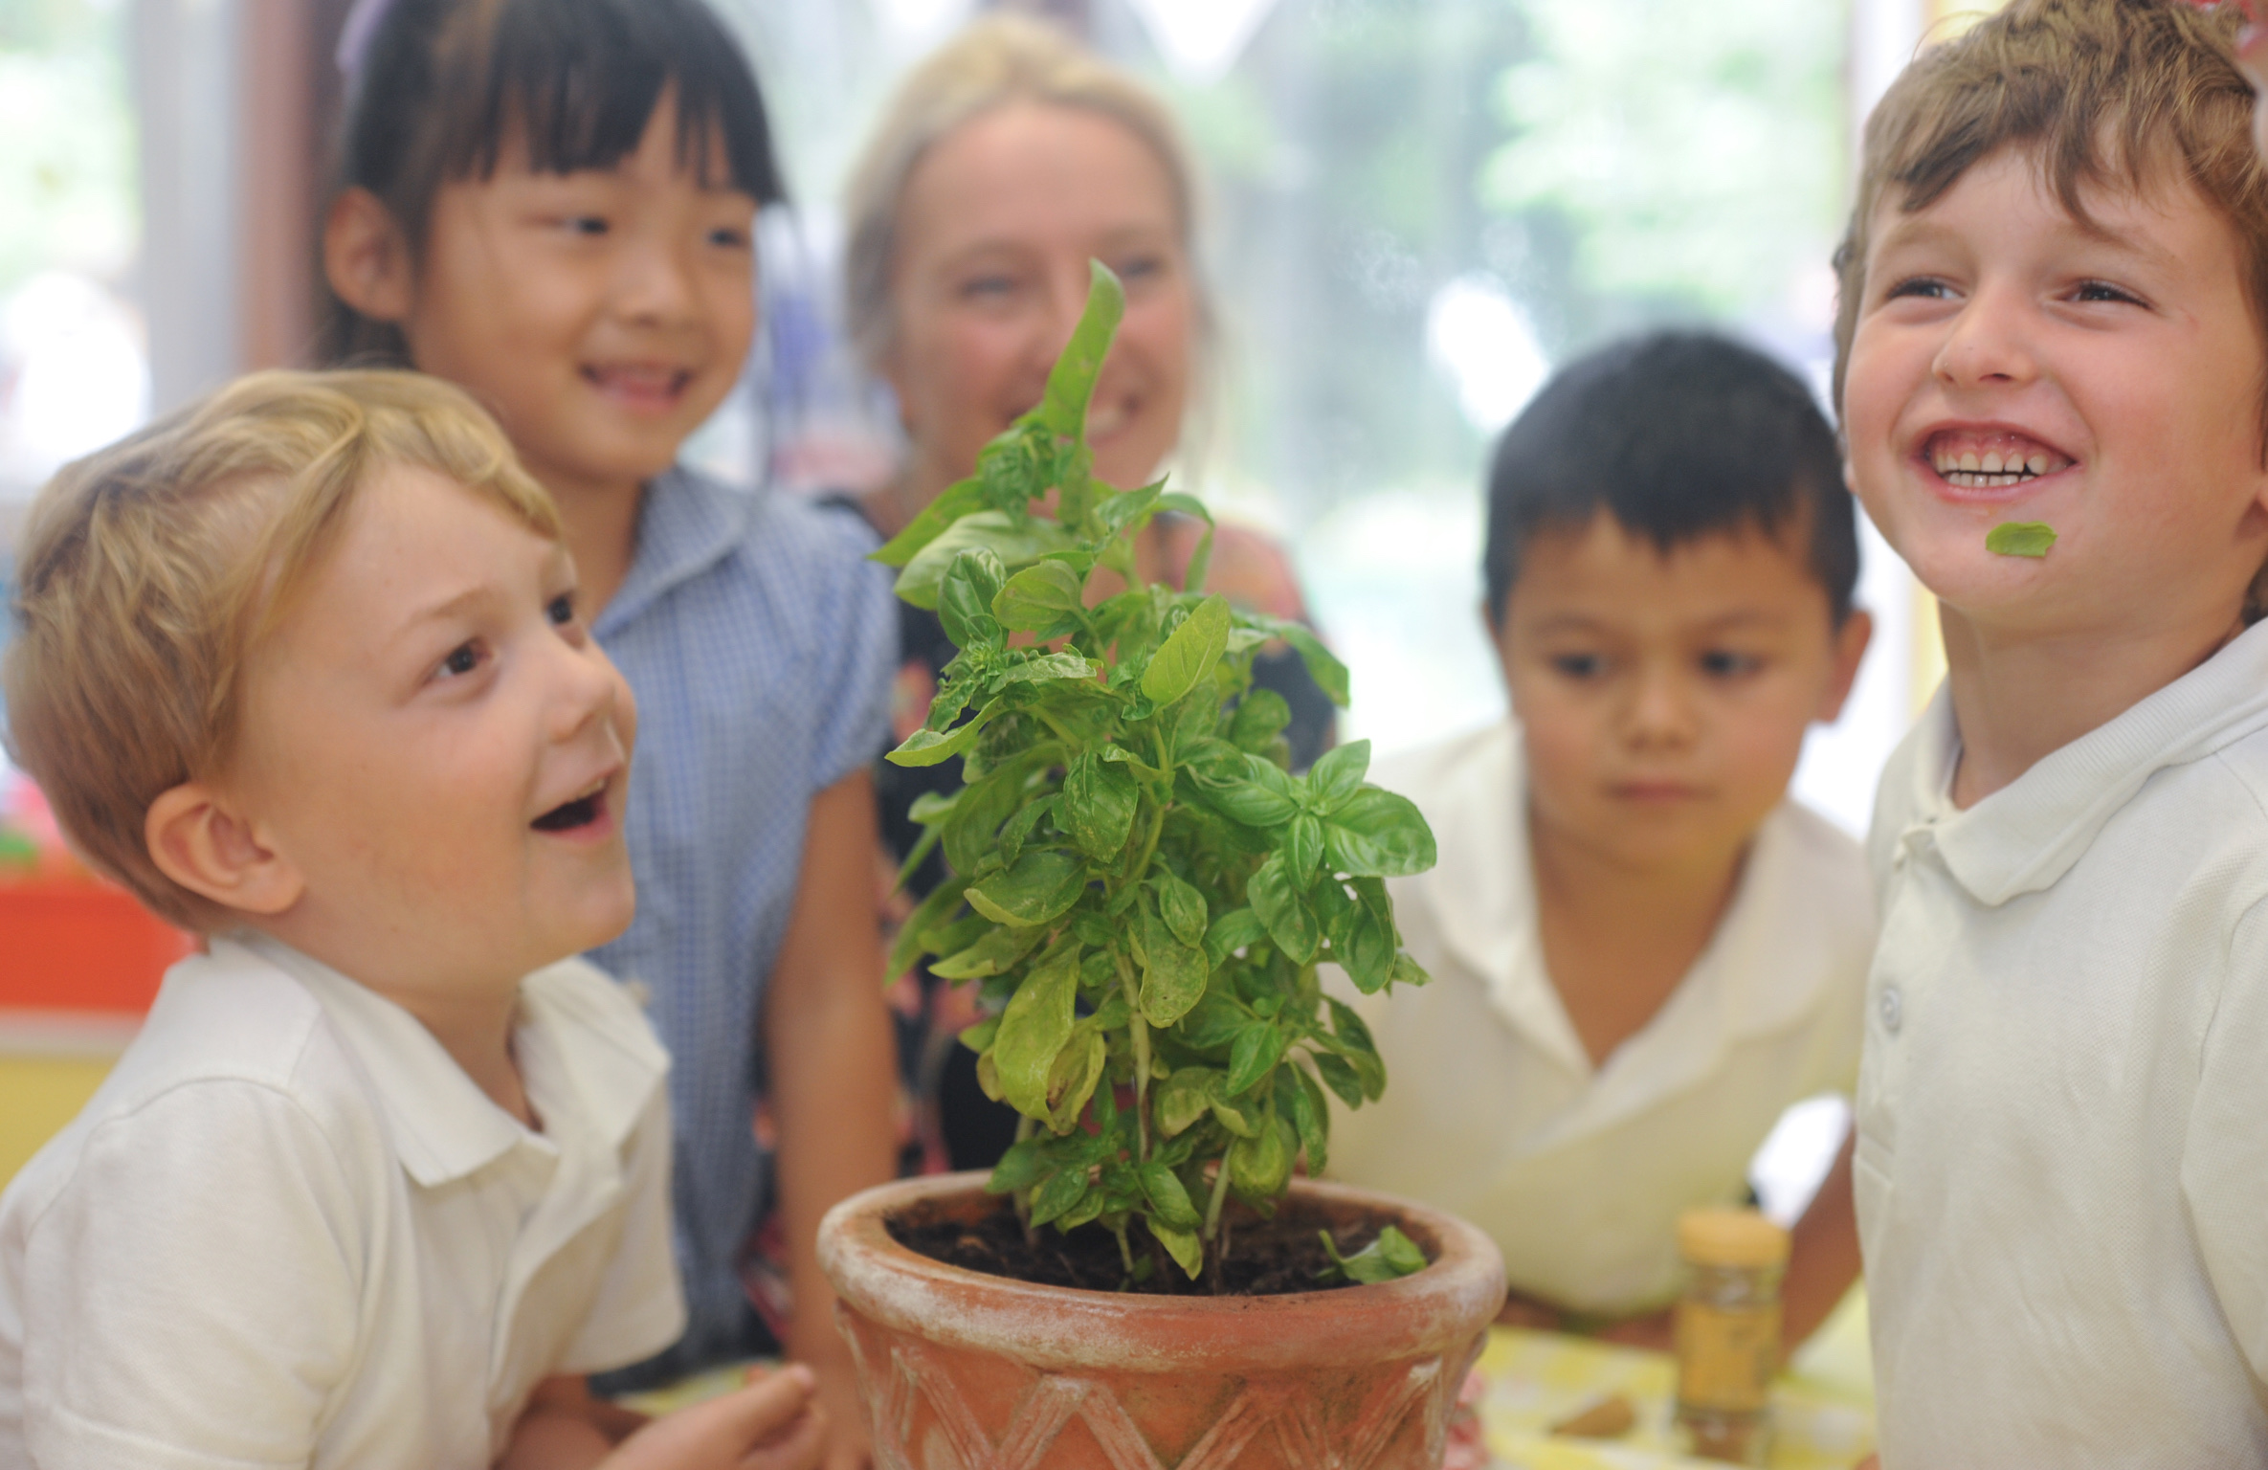
Teachers:
Please click HERE to tell us what new foods the children tried!
Please let us know how many children tried something new today – and what they tried. This information will help us measure the impact of our work. Our main objective is to understand how many children tried a new vegetable or fruit

Slide 26
Next time, we will explore another sense and try some different foods.
© 2025

